Slide 1




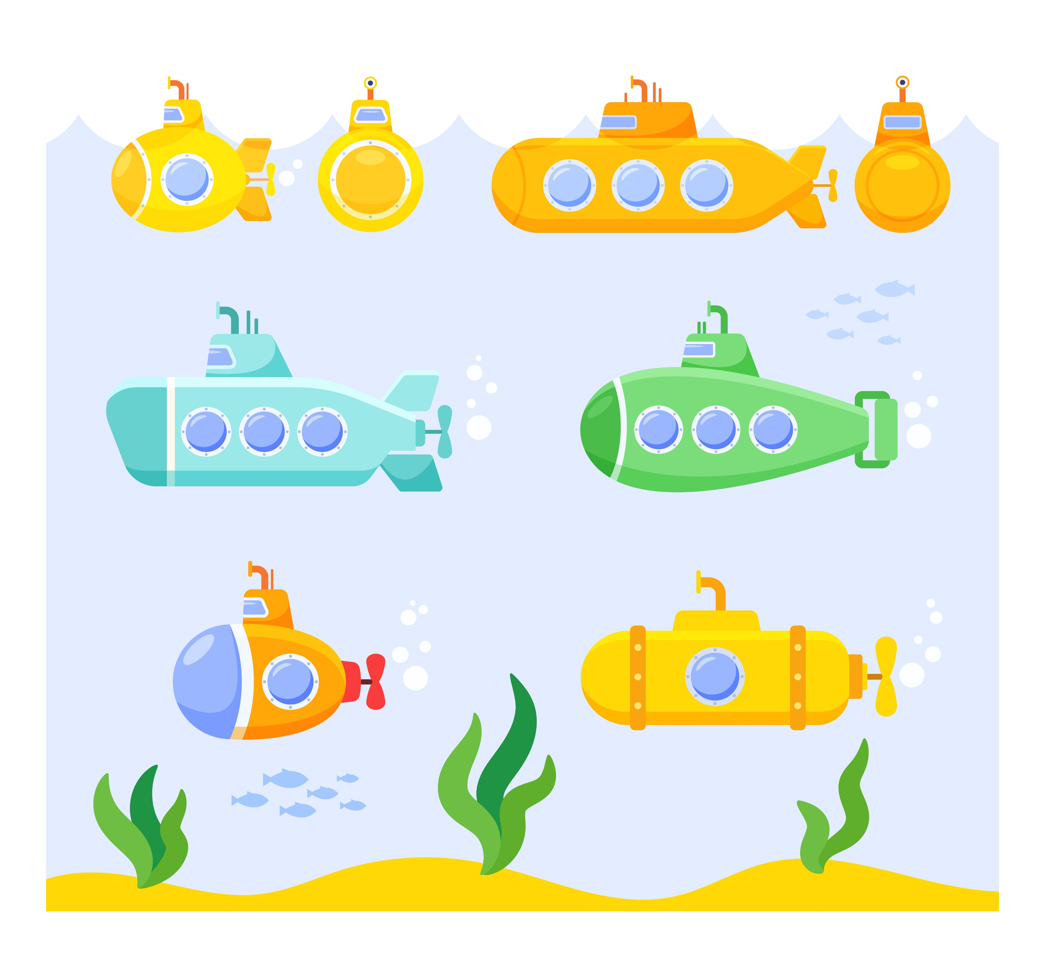
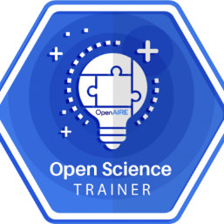

Free dive into science
29th November 2024
Virginia Jiménez Planet Instituto de Salud Carlos III Biblioteca Nacional de Ciencias de la Salud
virginiaj@isciii.es
@goonerua/Freepik
Notes:
Hot topics in OA; a call to action

Slide 2
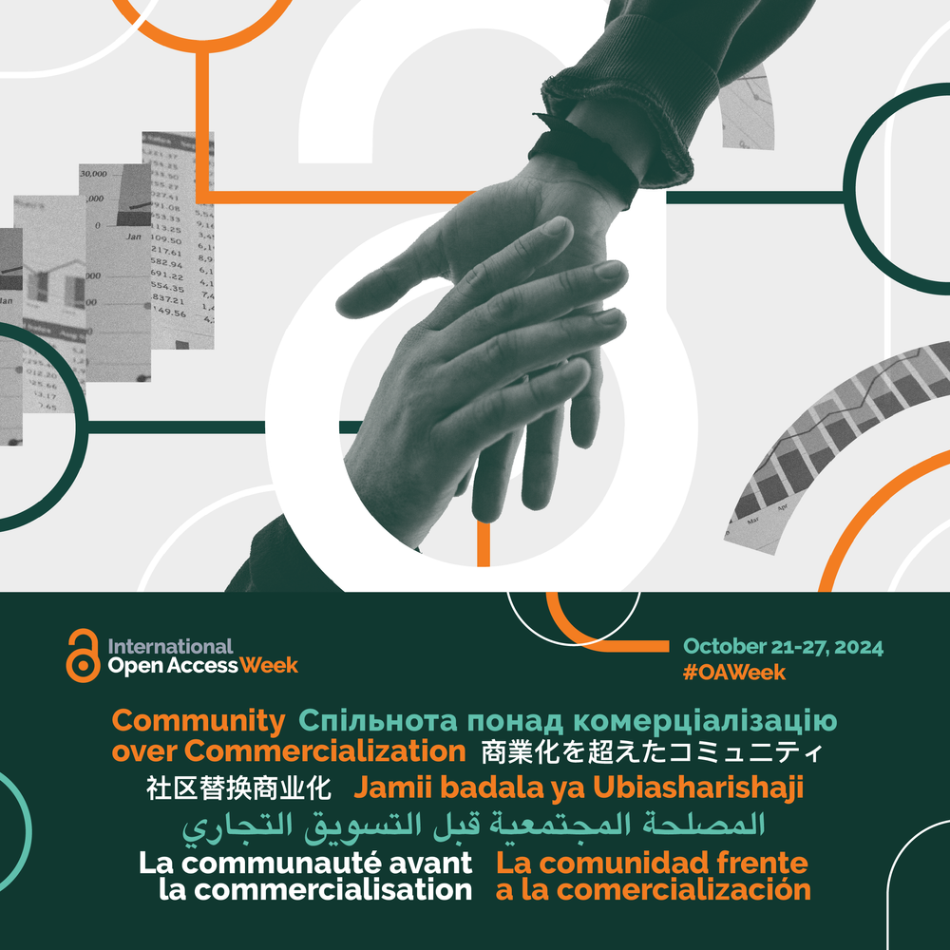
Community over Commercialization
Ongoing critical questions:
What are the consequences when a small number of corporations control knowledge production rather than researchers themselves?
What are the hidden costs of business models that entrench extreme levels of profit while exacerbating inequity?
When does the opaque collection and use of personal data by commercial platforms begin to undermine academic freedom?
When and in what ways can commercialization align with the public interest?
What community-governed infrastructures already exist that better serve the interests of the research community and the public (such as preprint servers, repositories, and open publishing platforms)?
How can we shift the default toward using these community-minded options?
https://www.openaccessweek.org/theme/es
#OAweek
Notes:
Open Access Week is an invaluable chance to connect the global momentum toward the open sharing of knowledge with the advancement of policy changes and the importance of social issues affecting people around the world. The event is celebrated by individuals, institutions, and organizations around the world, and its organization is led by a global advisory committee, which selects each year’s theme. The official hashtag of Open Access Week is #OAweek.
rush to integrate artificial intelligence into commercial academic systems without community consultation. Las preguntas que surgieron sobre el tema el año pasado son aún más apremiantes en 2024 dados a los acontecimientos recientes, como la prisa por integrar la inteligencia artificial en los sistemas académicos comerciales sin consultar a la comunidad. Las preguntas críticas actuales incluyen: ¿Cuáles son las consecuencias cuando un pequeño número de corporaciones controlan la producción del conocimiento en lugar de los propios investigadores? ¿Cuáles son los costos ocultos de los modelos de negocios que afianzan niveles extremos de ganancias y al mismo tiempo exacerban la inequidad? ¿Cuándo comienza la opaca recopilación y uso de datos personales por parte de plataformas comerciales a socavar la libertad académica? ¿Cuándo y de qué manera puede la comercialización alinearse con el interés público? ¿Qué infraestructuras gobernadas por la comunidad existen que sirven mejor a los intereses de la comunidad investigadora y del público (como servidores de preimpresión, repositorios y plataformas de publicación abiertas)? ¿Cómo podemos cambiar la opción predeterminada hacia el uso de estas opciones orientadas a la comunidad?

Slide 3
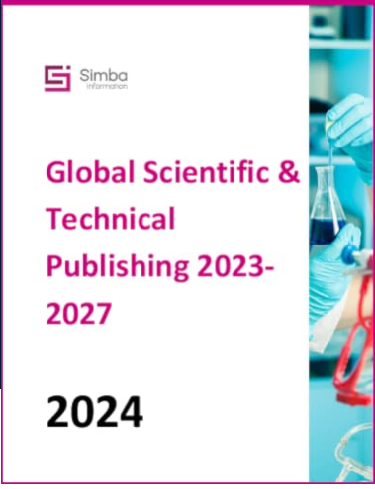
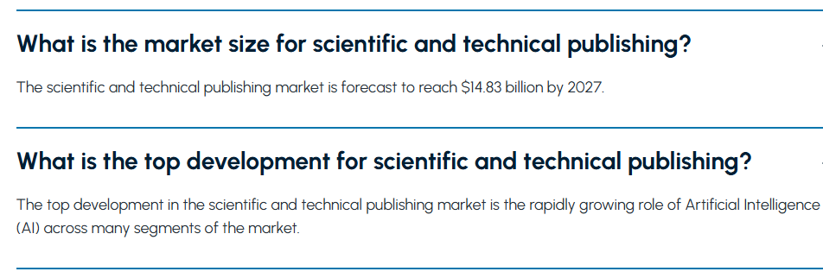
Simba Information’s latest Global Scientific & Technical Publishing 2023-2027 found that the global scientific and technical publishing market measured $12.65 billion in 2022, up 2.7% from 2021. Simba found that product development involving AI was a significant strategy in the market over 2022 and 2023 with the online content segment fueling growth for publishers, representing about 30% of the market, growing almost 7% in 2022. Journals remain the dominant product form, with a 42% share of revenue, but with a slow pace of growth, just under 2%.
https://www.freedoniagroup.com/simba-information/global-scientific-technical-publishing?utm_campaign=SKU%20Workflows&utm_medium=email&_hsmi=296292127&_hsenc=p2ANqtz-9TZW5f3KEdE1LwKx_yZ2e0E78SbA3G35kXXl_mh7fkf1yqWLXkM4RCtK3sUVp2WKXdvrsqSU9F3KvkcISdmfUqAYB8NQ&utm_content=296292802&utm_source=hs_automation

Slide 5
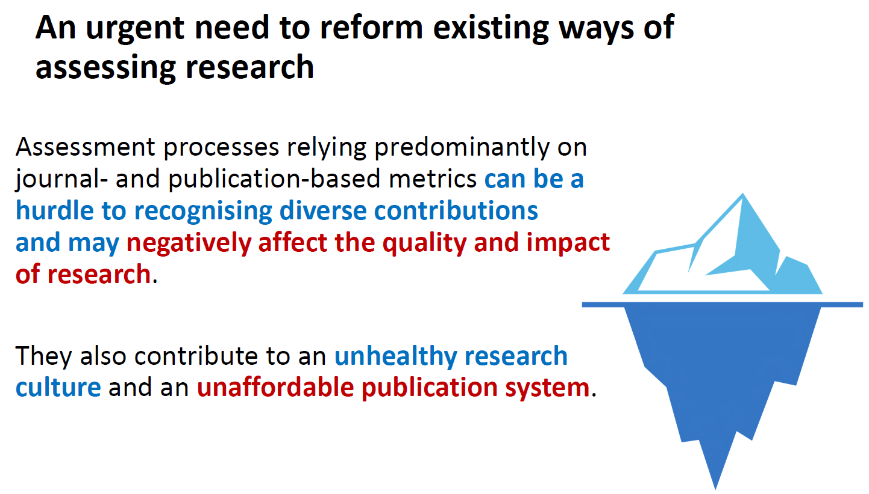
https://hdl.handle.net/20.500.12105/25476

Slide 6
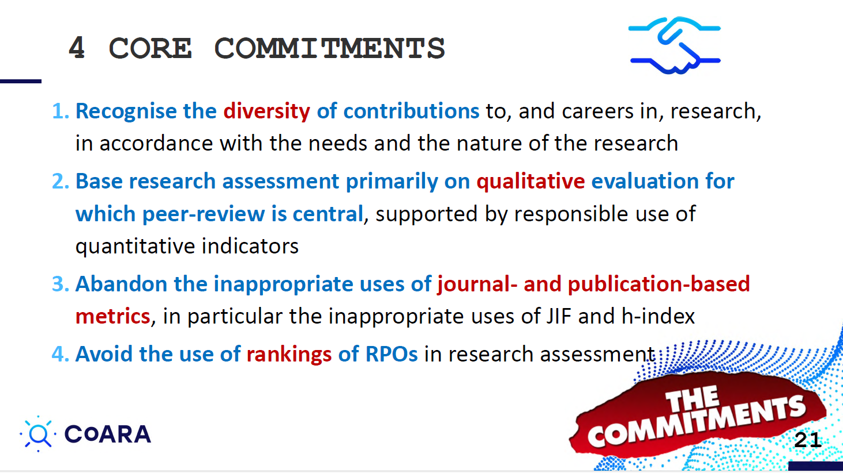
https://hdl.handle.net/20.500.12105/25476

Slide 7
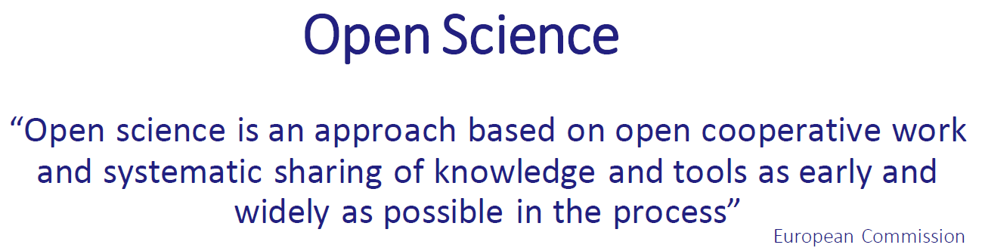
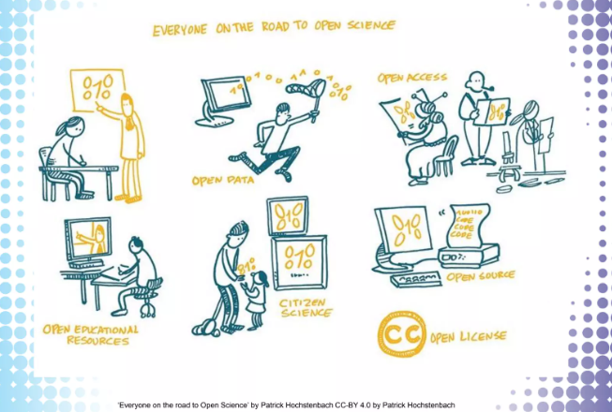
England, J. 2024. 10.5281/zenodo.10810347

Slide 8
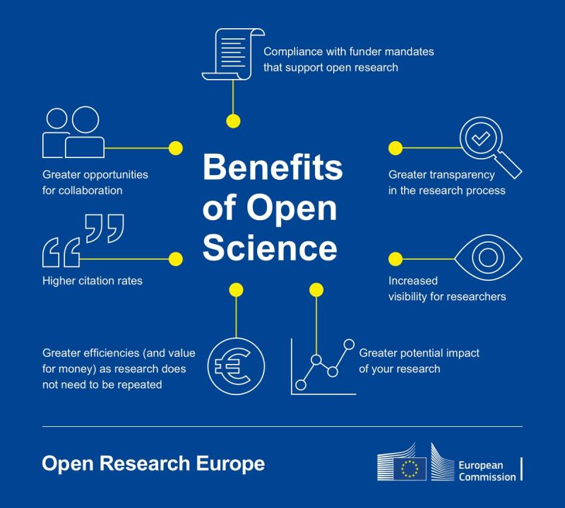

Slide 9
Why is Open Science Excellent?
Better and more efficient research
Early and open sharing of results
Research transparency and reproducibility
Broad research collaboration
Interdisciplinary and collaborative work
Involvement of relevant societal actors in research
http://hdl.handle.net/20.500.12105/19265
Notes:
open science as a new normality in the proposals

Slide 10
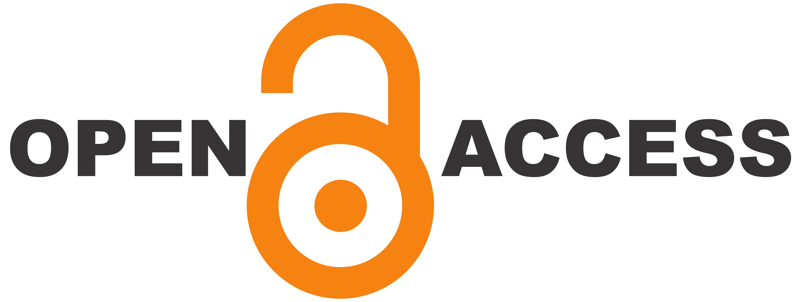

What do you understand by open access?

Slide 11
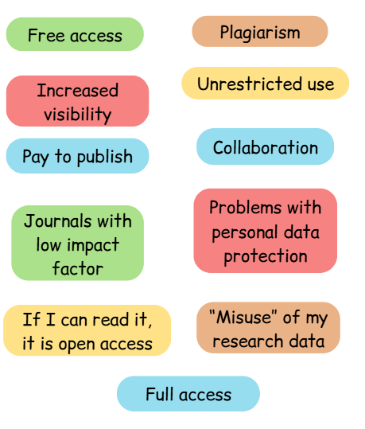
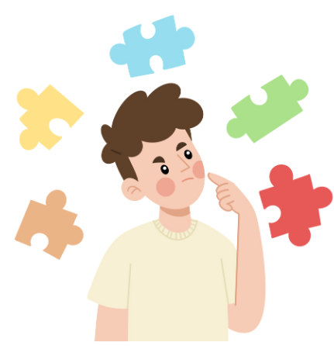
When we talk about Open Access we think of...
http://hdl.handle.net/20.500.12105/19797

Slide 12
Defining Open Access…
OPEN ACCESS
By “open access” to [peer-reviewed research literature], we mean its free availability on the public internet, permitting any users to read, download, copy, distribute, print, search, or link to the full texts of these articles, crawl them for indexing, pass them as data to software, or use them for any other lawful purpose, without financial, legal, or technical barriers other than those inseparable from gaining access to the internet itself. The only constraint on reproduction and distribution, and the only role for copyright in this domain, should be to give authors control over the integrity of their work and the right to be properly acknowledged and cited.
The Budapest Open Access Initiative (2002) - https://www.budapestopenaccessinitiative.org/boai10/
http://hdl.handle.net/20.500.12105/19272

Slide 13
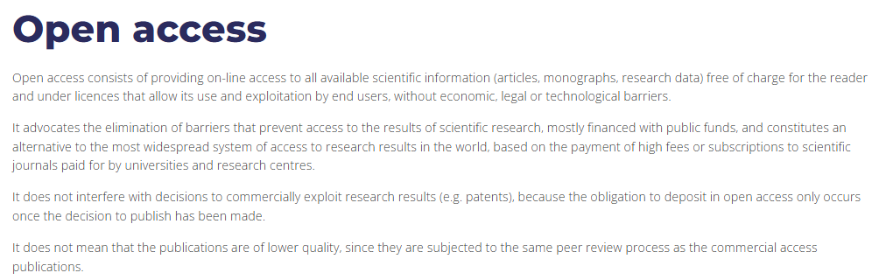
https://recolecta.fecyt.es/en/open-access
Notes:
Diferencias entre publicación gratuita y publicación OA
Una publicación gratuita permite su consulta de modo particular sin necesidad de pagar por ello, pero no permite su reutilización o distribución. El lector solo tiene permisos para la consulta y descarga particular, porque el resto de derechos están retenidos por el autor o editor.
Una publicación OA no solo permite acceso para ser leído, sino que se ceden al lector otros permisos expresados en la licencia que acompaña al contenido. Con esta licencia se pretende facilitar la reutilización y recolección del contenido.
https://www.une.es/faqs-acceso-abierto#cuarta

Slide 14
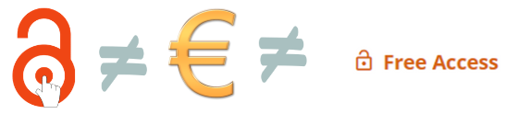
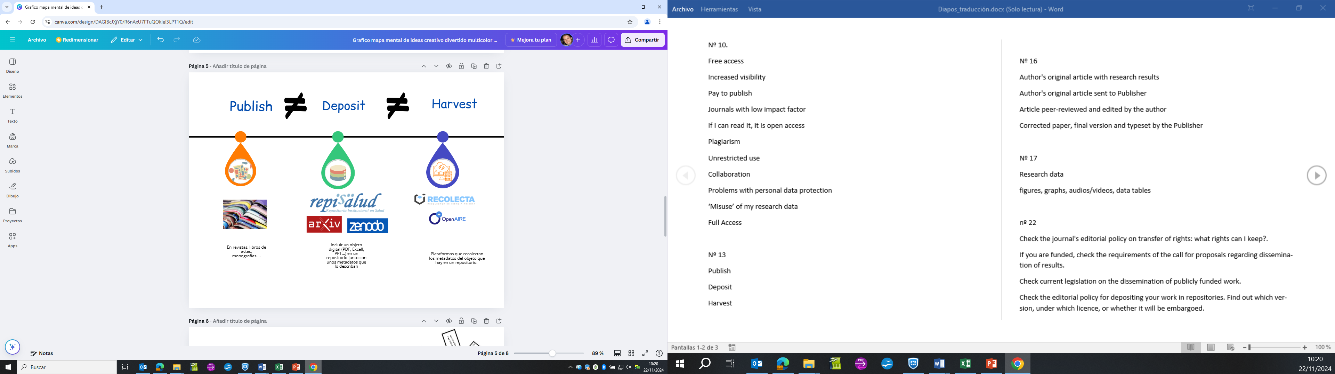
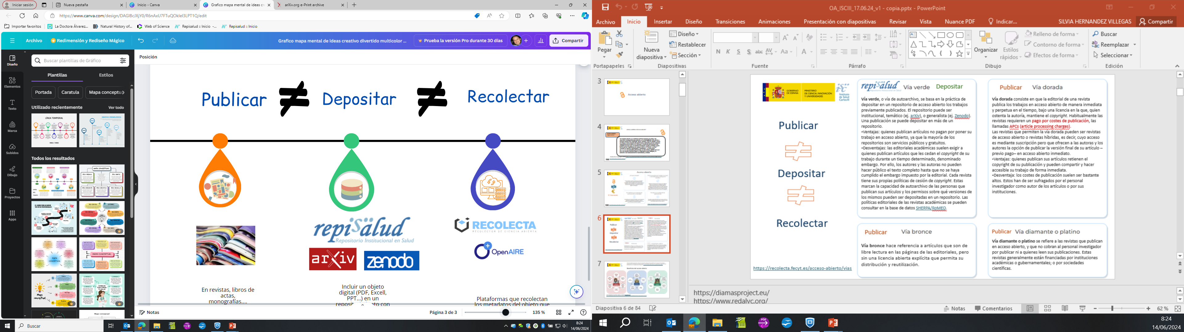
Do not confuse:
Open access does not always mean paying to publish.
Access/reading does not always mean Open Access.
Publishing in journals, books, conferences...
Attach a digital object (PDF, EXCELL, PPT, images...) + metadata describing it.
Platforms that harvest metadata from more than one repository.

Slide 15
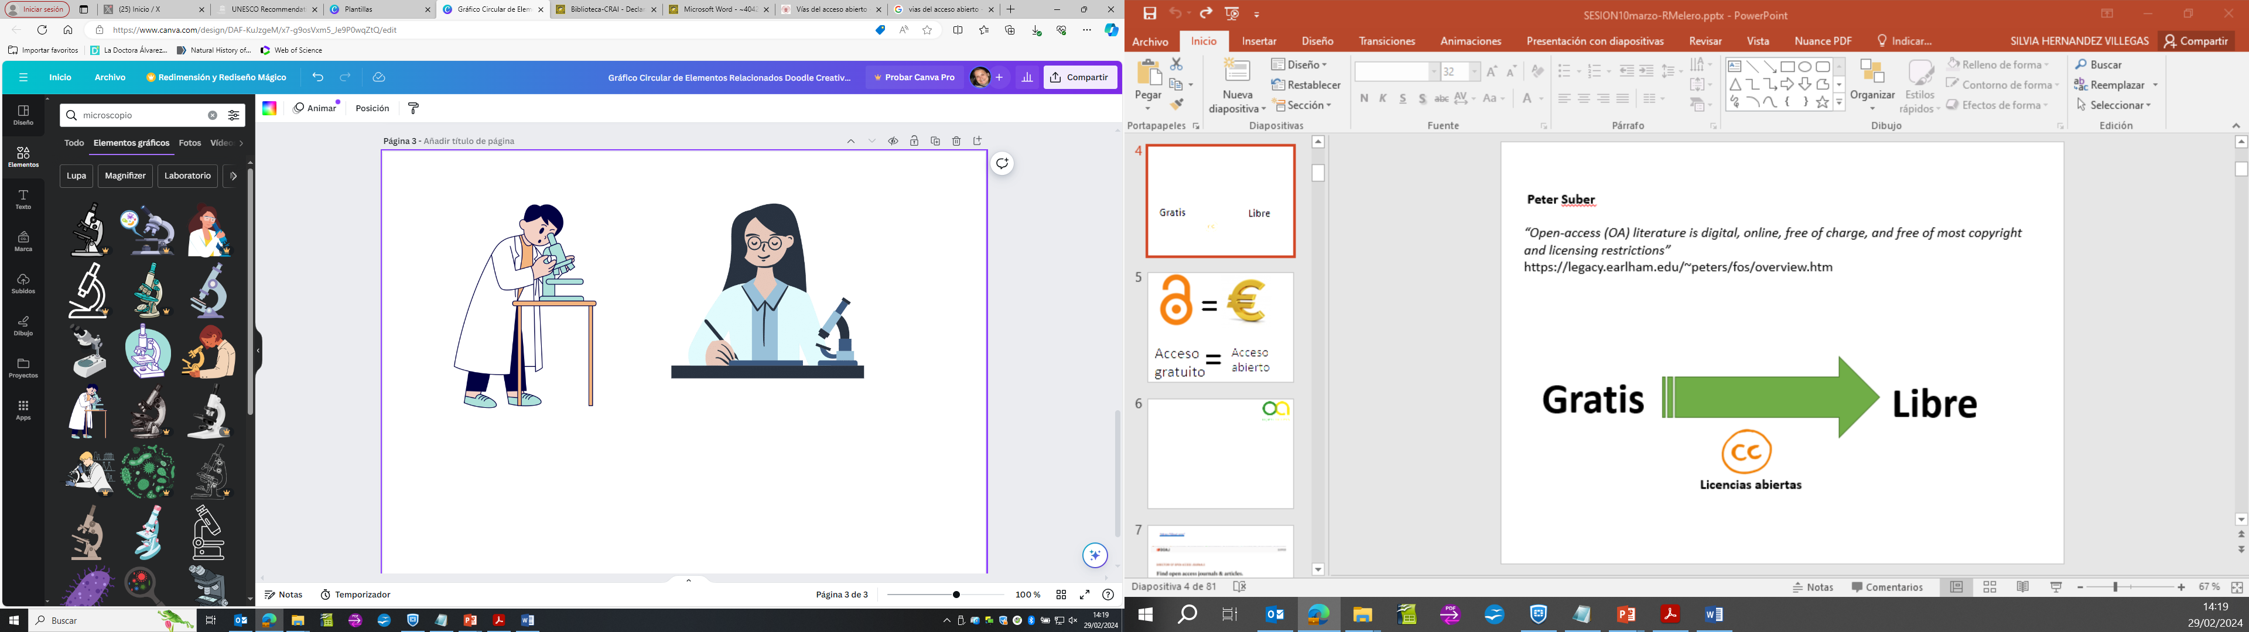
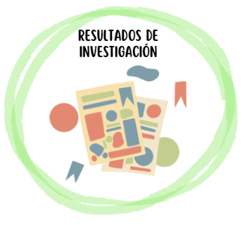
Pathways to implement Open Access
Green
route
The article is deposited in open access repositories sponsored by the scholarly community/public sector.
The editor of a journal publishing the articles in open access immediately and permanently, under a licence where the author maintains the copyright. Journals usually require a payment for publication costs, the so-called APCs (article processing charges).
Gold
route
The journals that allow the Gold route maybe open access journals or hybrid journals, i.e., journals where the access is via subscription but offer authors the option of publishing the final version of their article immediately - upon payment - in open access.
Scientific documentation
Articles that are free to read on the editors pages, but without an explicit open licence that allows their distribution and reuse.
Bronze
Route
Journals that publish in open access, and that do not charge either the authors for publishing or the readers for reading. These journals are generally funded either by academic and government institutions, or by scientific societies.
Diamond or Platinum
route
https://recolecta.fecyt.es/en/open-access/routes
http://hdl.handle.net/20.500.12105/19797

Slide 16
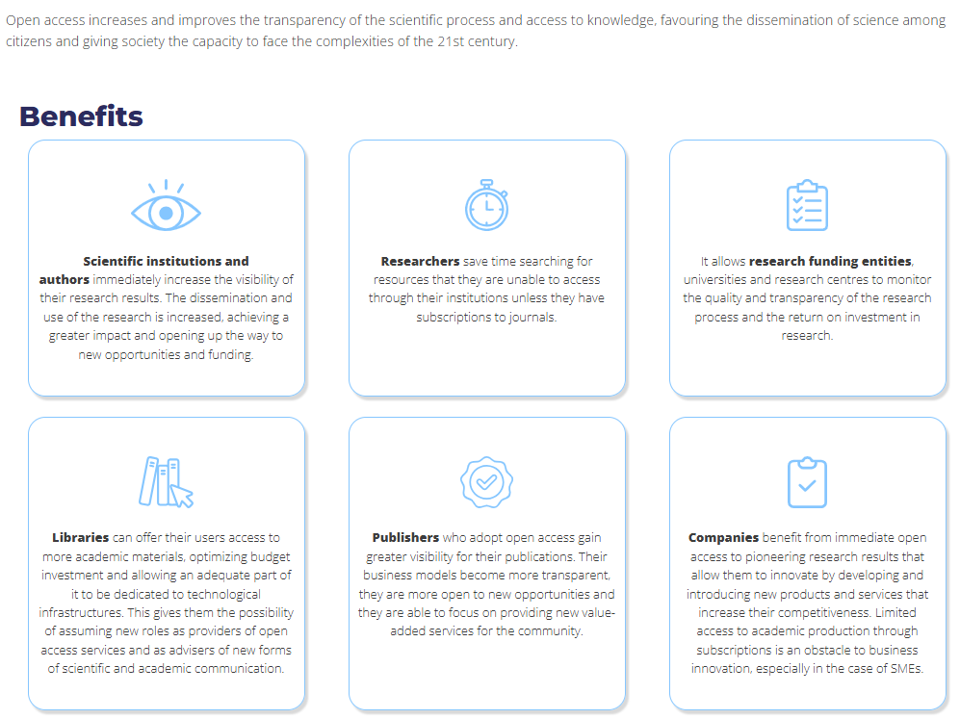
https://recolecta.fecyt.es/en/open-access/benefits

Slide 17
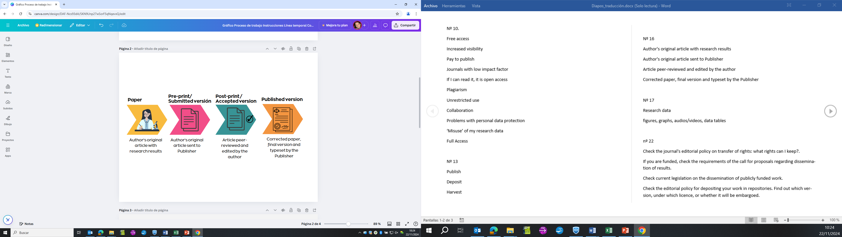

Versions of a scientific article:
http://hdl.handle.net/20.500.12105/19797

Slide 18
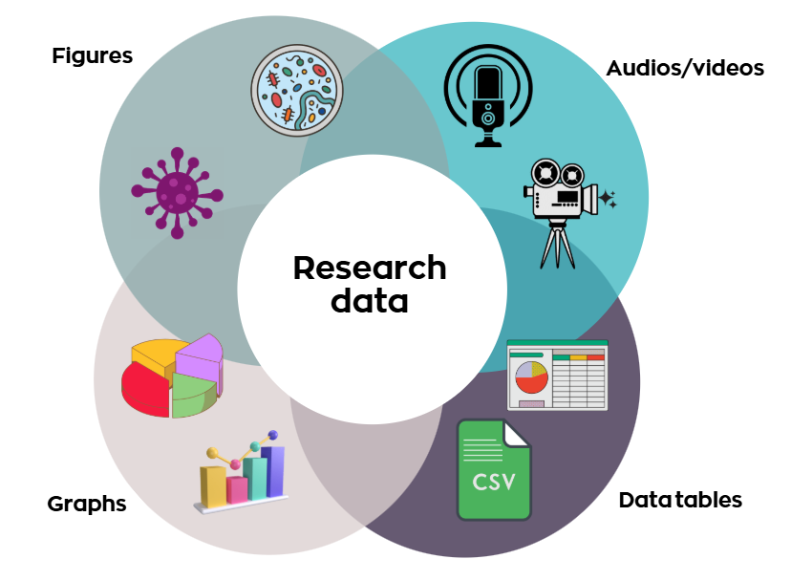
Research data and supplementary material in articles
All information collected during the course of a project is a candidate for research data.
This dataset is sometimes accompanied by a Data Management Plan - to be reused by third parties.
This dataset together with the Data Management Plan is a publication in itself.
http://hdl.handle.net/20.500.12105/19797

Slide 19


Copyright, explotation and deposit rights
Moral rights (not transferable):
Authorship
Integrity of the work
Decision on its dissemination
Copyright
To publish and transfer all rights
Patrimonial rights:
Reproduction
Dissemination
Public Communication
Transformation
The right that the law grants to the author of an intellectual or artistic work to authorise its reproduction and to share in the benefits derived from it. (https://dle.rae.es/)
Publish and transfer certain rights
Melero, Remedios. El significado del acceso abierto a la producción científica y cómo contribuir a su práctica. Master de Salud Pública 2022/2023. Escuela Nacional de Sanidad. Instituto de Salud Carlos III, 2023. (http://hdl.handle.net/20.500.12105/18866)
Ley de propiedad intelectual: https://www.boe.es/buscar/act.php?id=BOE-A-1996-8930
http://hdl.handle.net/20.500.12105/19797

Slide 20
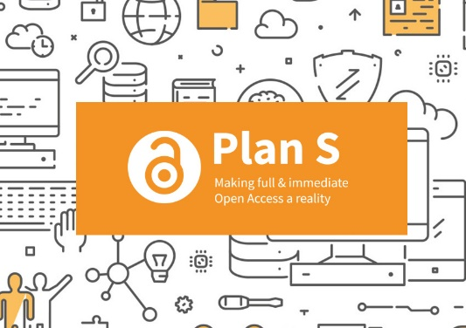
Plan S (S for shock) is a Science Europe initiative launched in September 2018 through the cOAlition S, a consortium created by the European Research Council (ERC) and made up of research funding agencies from 12 European countries (Austria, Finland, France, Ireland, Italy, Luxembourg, the Netherlands, Norway, Poland, Slovenia, Sweden and the United Kingdom), as well as the European Commission itself, the Gates Foundation, and agencies in Jordan and Zambia.
Plan S requires that scientific publications from 2021 that are a result of research financed with public funds should be published in open access journals or platforms and that they comply with its ten principles:
1. Authors or their institutions must maintain the copyright of their publications, which must be published under an open licence, preferably the Creative Commons Attribution Licence (CC BY).
6. Funding agencies will support governments, universities, research organizations, libraries, academies and academic societies so that their strategies, policies and practices are aligned.
2. The funding agencies will develop criteria and requirements that open access journals and open access platforms and repositories must fulfill.
7. The above principles will apply to all types of academic publications, but it is understood that monographs and book chapters will need more time to adapt to the changes required.
3. When quality open access journals or platforms do not exist, funding agencies will provide incentives to establish and support them. Funding agencies are also committed to providing support to open access infrastructures when necessary.
8. Funding agencies will not support the "hybrid" publishing model, although they will accept it temporarily for a limited time and only as part of a transformative agreement.
4. Open access publication fees will be covered by funding agencies or research institutions, not by individual researchers.
9. Funding agencies will supervise the fulfillment of their mandates and will sanction the beneficiaries who do not fulfill them.
5. Funding agencies support the diversity of business models for open access journals and platforms. The application of open access publication rates should be transparent and moderated.
10. Funding agencies must evaluate research results on the merit of the work itself, regardless of other journal metrics such as the impact factor.
https://www.coalition-s.org/resources/rights-retention-strategy/

Slide 21
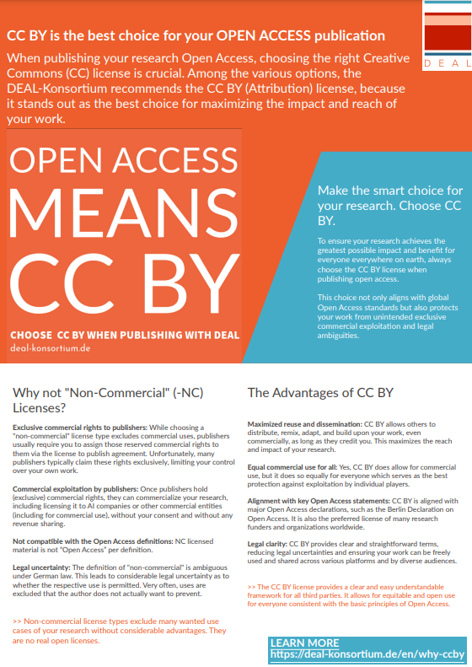
“Open access publishing models foster scientific progress”
The DEAL consortium is one of the largest library consortia in the world and has negotiated national agreements with the three largest academic publishers. Around 500 academic institutions in Germany benefit from these agreements, which enable their researchers to publish with the publishers according to the Open Access model. The consortium, managed by MPDL Services gGmbH and supported by the German scientific organizations, processes around 30,000 publications per year and has ensured that the majority of German scholarly literature published in scientific journals is freely accessible worldwide.
The aim of the campaign is to reduce the prevalence of non-commercial licences (NC licences), which not only prevent re-use and distribution in line with the principles of Open Access, but also often allow publishers to secure exclusive commercial rights, for example to resell content to AI providers.
https://deal-konsortium.de/en/why-ccby

Slide 22
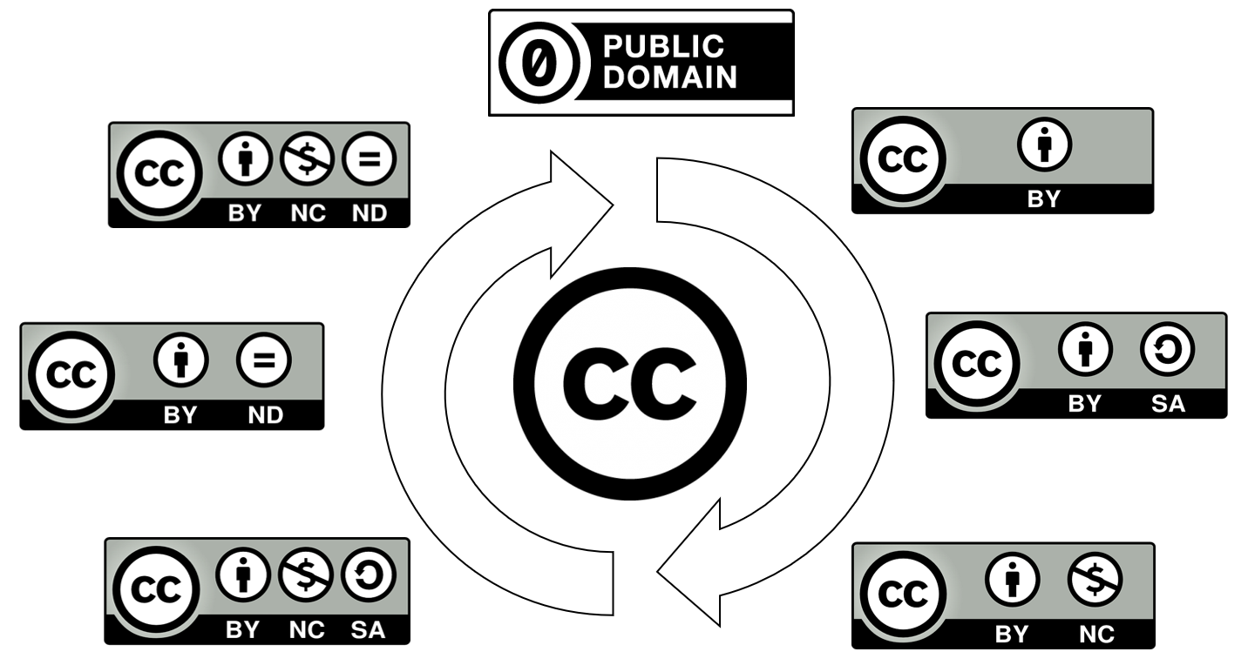
Licences
LICENCES
Document by which the licensor (originally the author) defines the terms of exploitation/use of the work (reproduction, dissemination, public communication, transformation).
The most commonly used licences in open science are Creative Commons Licences:
+ closed
+ open
Jimenez-Planet, Virginia; Hernandez Villegas, Silvia. Gestión de datos de investigación y Planes de Gestión de datos. Seminarios Centro nacional de Epidemiología. 2023. (http://hdl.handle.net/20.500.12105/16206)
https://creativecommons.org/about/cclicenses/

Slide 23
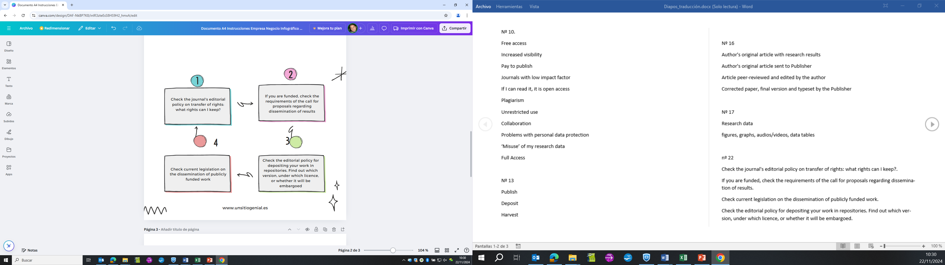
Before submitting your article to a publisher or repository
Licence assignment tools:
https://chooser-beta.creativecommons.org/
https://ufal.github.io/public-license-selector/
http://hdl.handle.net/20.500.12105/19797

Slide 24
Green route - Repositories
Repositories
(Green route)
Repositories are digital platforms that collect, preserve and disseminate the scientific output of an institution or subject area, are freely accessible and allow interoperability with other similar platforms.
Institutional: they collect the scientific production of an academic or scientific institution (examples: Repisalud (ISCIII), DigitalCSIC (CSIC), Docta (UCM), etc.).
Thematic: they collect the production of a specific field of knowledge.(Examples: PubMed Central, RePEc, Arxiv...).
Repositories:
Centralised or generalist: they collect the open scientific production of authors from any institution or discipline (examples: Zenodo, ...).
http://hdl.handle.net/20.500.12105/19797

Slide 25
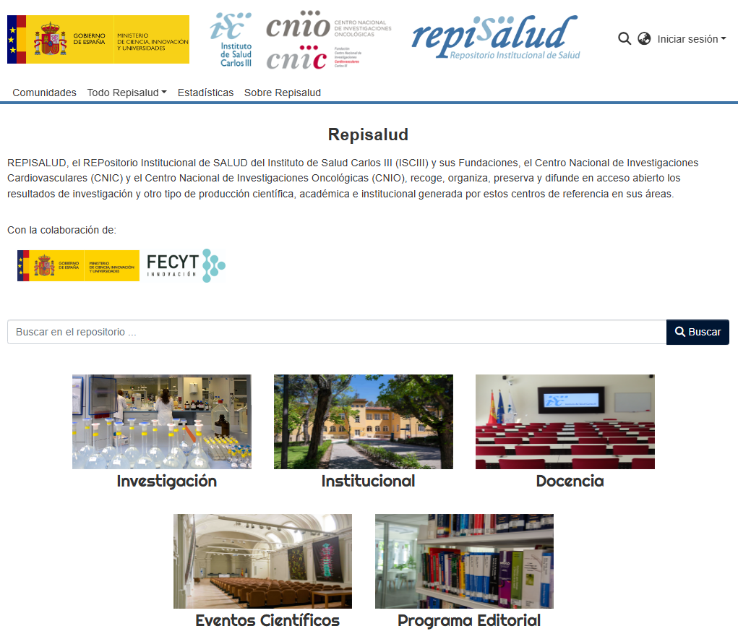
https://repisalud.isciii.es/

Slide 26
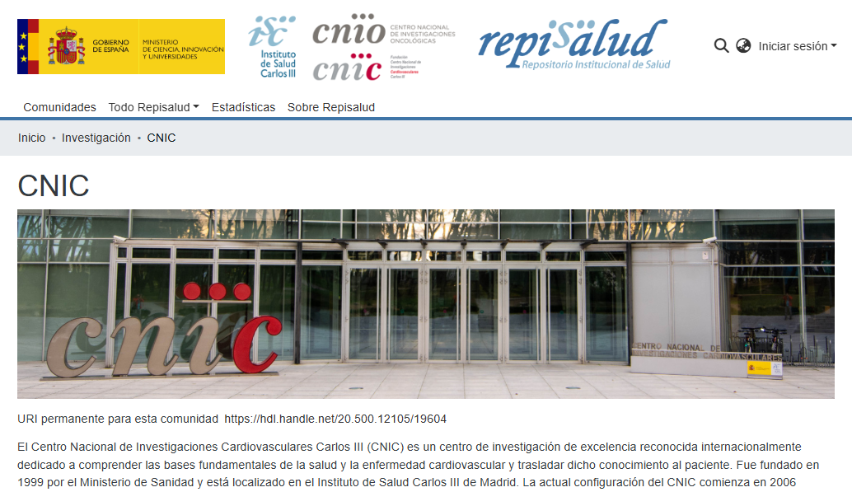
https://hdl.handle.net/20.500.12105/19604

Slide 27
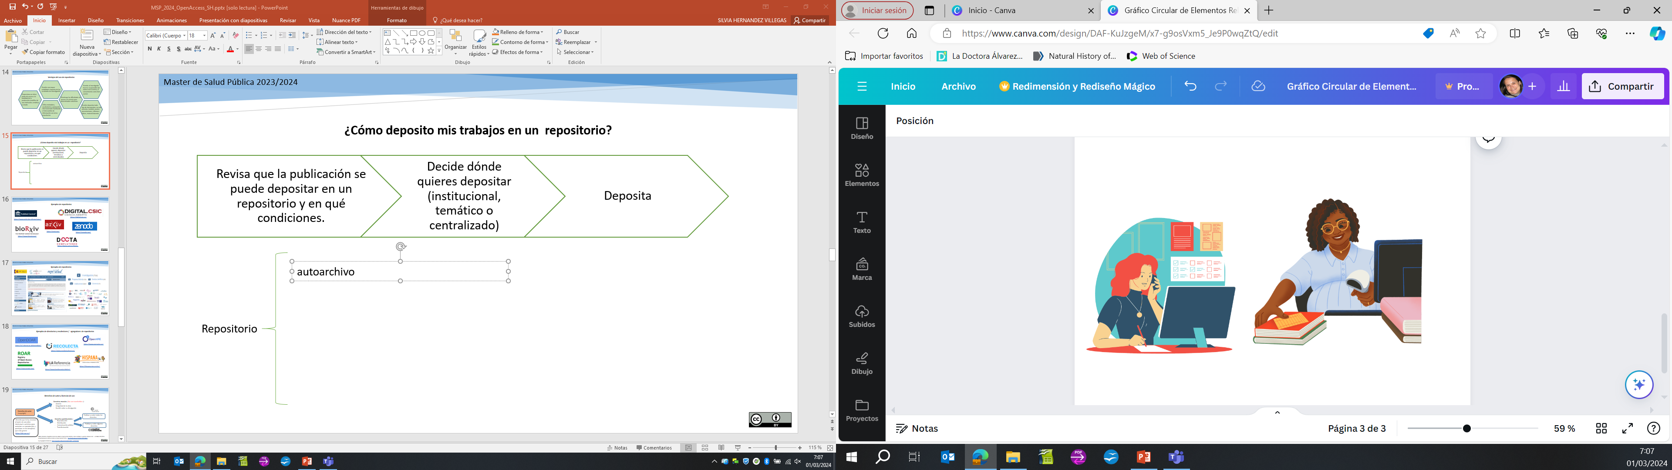
How do I deposit my work in a repository?
Check whether the publication can be deposited in a repository and under what conditions.
Decide where you want to deposit (institutional, thematic or central).
Deposit
Self-archiving: the author takes the initiative and includes his/her work in the repository.
Repository
Delegated archiving: research support staff/librarian on their own initiative or at the request of the author includes the work in the repository.
http://hdl.handle.net/20.500.12105/19797

Slide 28
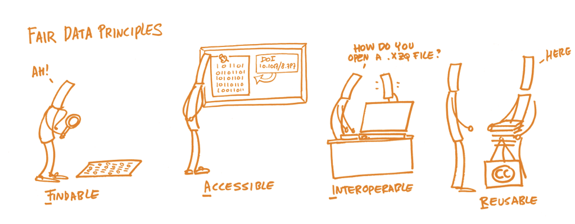
Presence in repositories means:
Increased visibility
Easier location and access
Responsibility as a researcher (knowledge as a common good)
Social impact
Preservation
Digital objects (PDF, PPT, EXCELL...) are important, but so are metadata. Both must comply with the FAIR principles (findable, accessible, interoperable, reusable):
http://hdl.handle.net/20.500.12105/18866

Slide 29
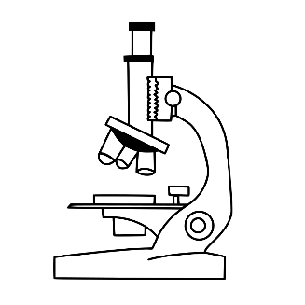
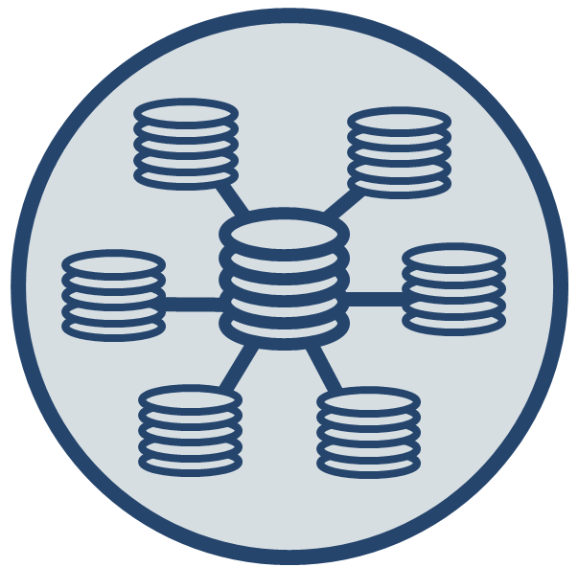
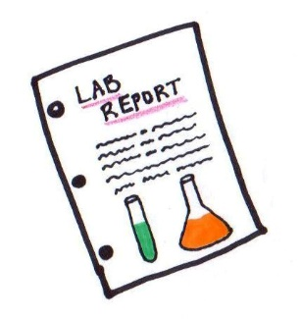
Research Data Management
Data: Quantitative or qualitative information collected by researchers in the course of their work. It provides the information needed to support or validate the findings or conclusions of the research.
Datasets: The set of tabulated data in any structured data storage system.
Data Management Plan (DMP): A document/report/guideline used to plan, organise and document how data are or have been collected as part of a research project. It is a living document that will be modified or updated as the research progresses. It is advisable to produce a data management plan at the beginning of the project and to produce new versions according to any changes that may occur during the course of the project.
http://hdl.handle.net/20.500.12105/16206

Slide 30
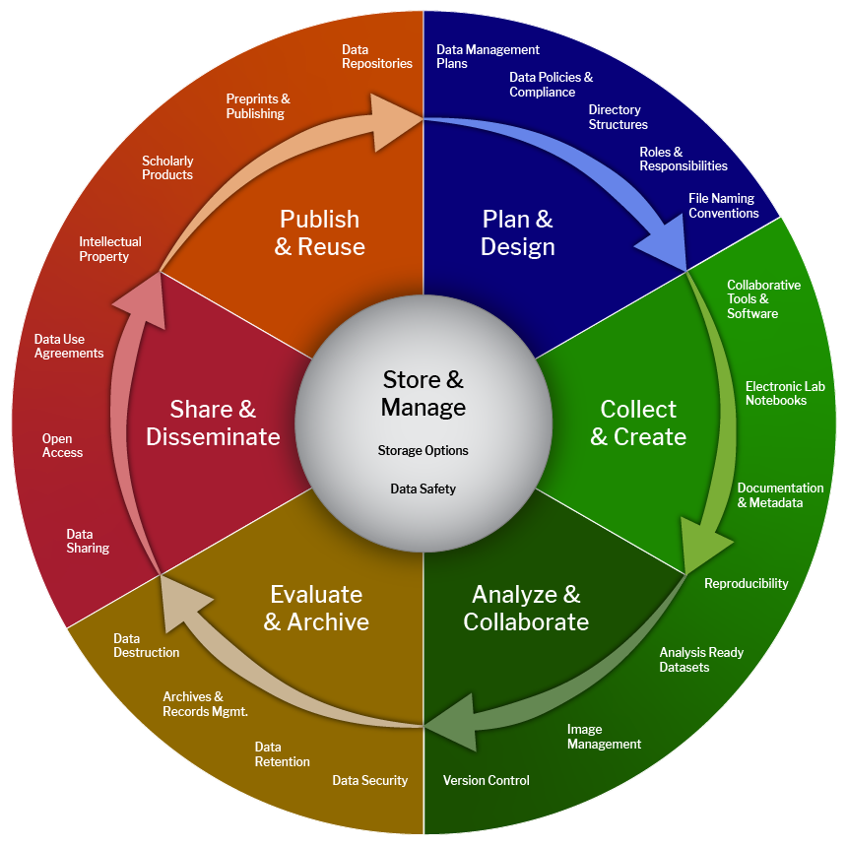
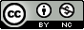
Biomedical Data Lifecycle
https://datamanagement.hms.harvard.edu/plan-design/biomedical-data-lifecycle

Slide 31
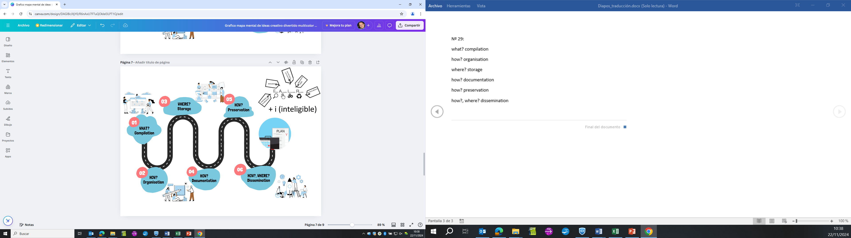
Research Data Management needs to answer the following questions:
http://hdl.handle.net/20.500.12105/19761
https://datos.gob.es/es/noticia/principios-fair-buenas-practicas-para-la-gestion-y-administracion-de-datos-cientificos

Slide 32
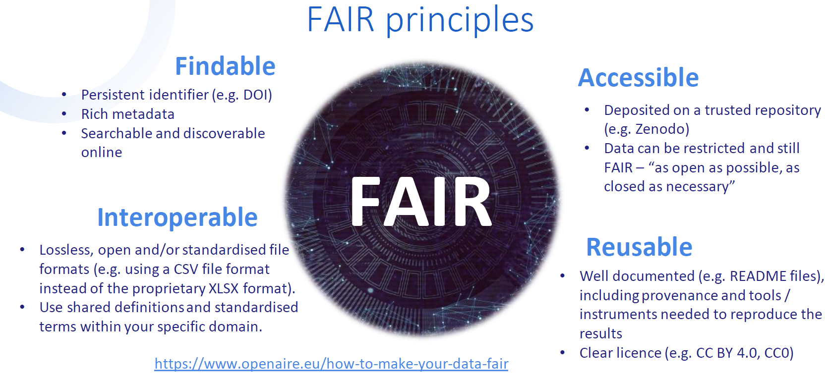
England, J. 2024. 10.5281/zenodo.10810347

Slide 33
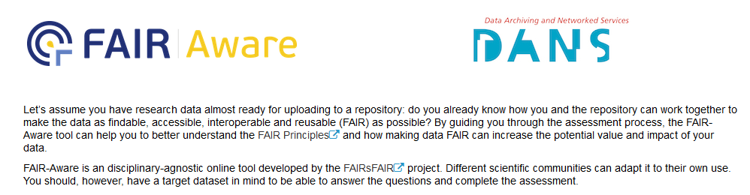
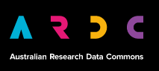
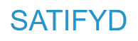
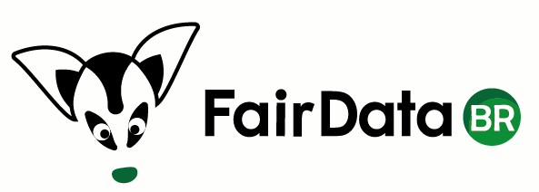
Tools to check if my data is FAIR:
https://fairaware.dans.knaw.nl/
https://ardc.edu.au/resources/working-with-data/fair-data/fair-self-assessment-tool/
https://satifyd.dans.knaw.nl/
https://wrco.ufpb.br/fair/
http://hdl.handle.net/20.500.12105/19761

Slide 34
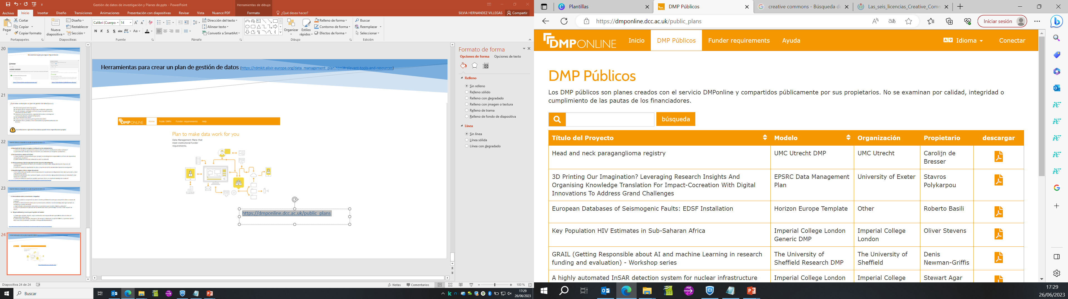
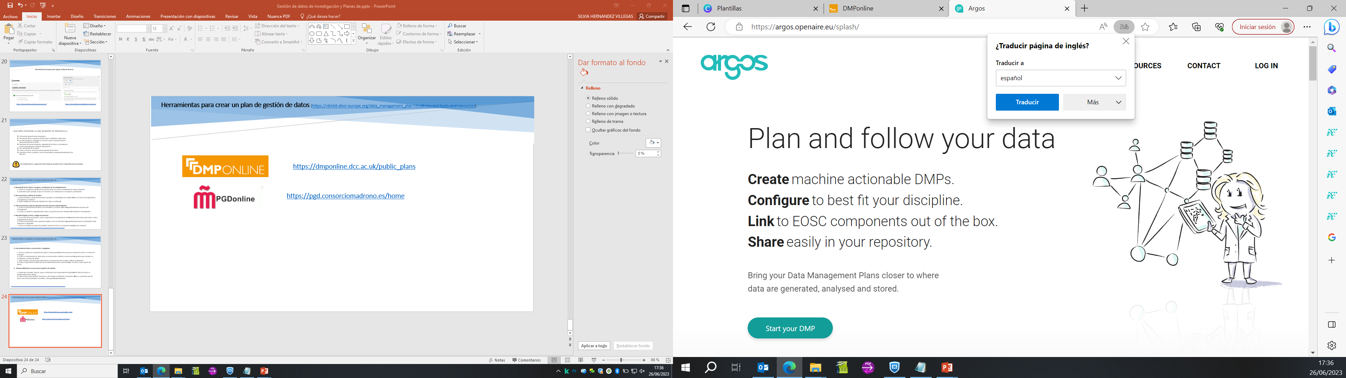
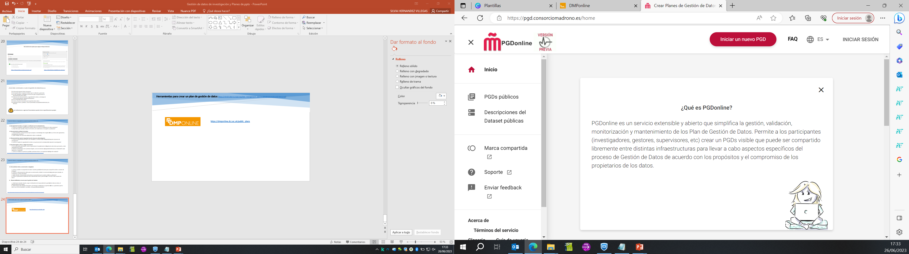
Tools for creating a Data Management Plan
https://dmponline.dcc.ac.uk/public_plans
https://argos.openaire.eu/splash/
https://pgd.consorciomadrono.es/home

Slide 35
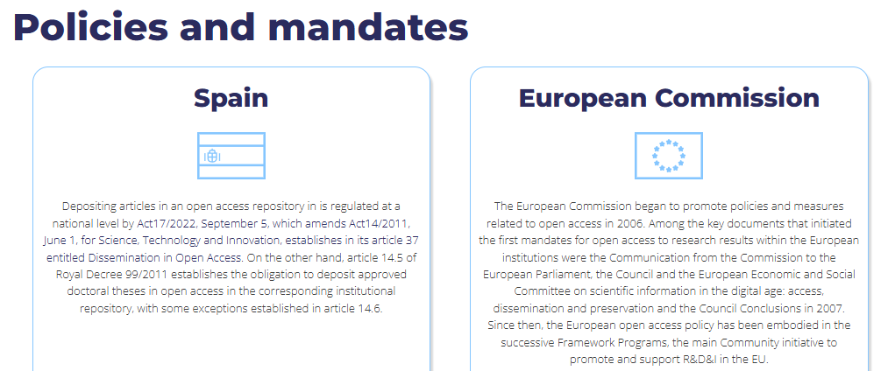
https://recolecta.fecyt.es/en/open-access/policies
http://hdl.handle.net/20.500.12105/19265

Slide 36
Policies and mandates - Spain
Act17/2022, September 5, which amends Act14/2011, June 1, for Science, Technology and Innovation https://www.boe.es/eli/es/l/2022/09/05/17/con
«article 37. Open science.
…
2. Researchers working in the public sector or whose research activities are mainly funded by the public sector and who choose to disseminate their research results through scientific publications must deposit a copy of the final version accepted for publication, together with the associated data, in institutional or thematic open access repositories at the same time as publication.
3. Beneficiaries of public grants shall ensure that they retain the intellectual property rights necessary to comply with open access requirements.
Deposit
¿What? Final version accepted for publication + data associated
¿When? At the latest at the time of publication
¿Where? Institutional or thematic open access repositories
http://hdl.handle.net/20.500.12105/19761

Slide 37
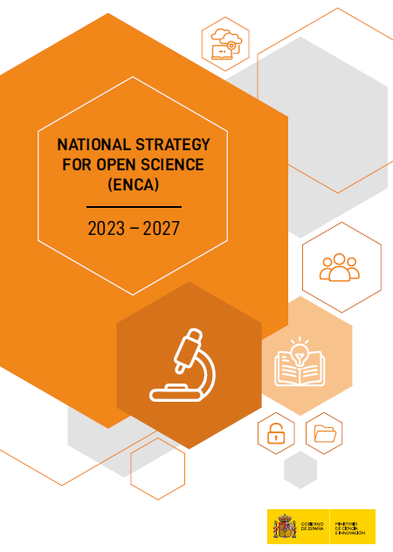
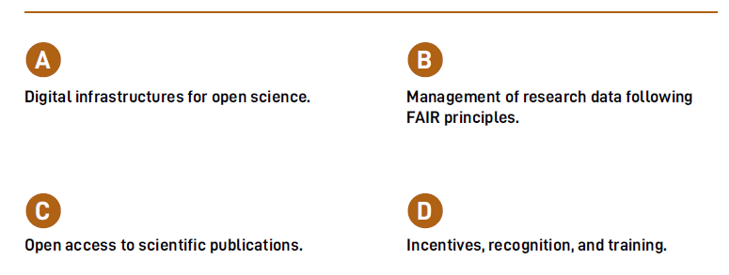
STRATEGIC AXES
https://www.ciencia.gob.es/en/Estrategias-y-Planes/Estrategias/ENCA.html

Slide 38

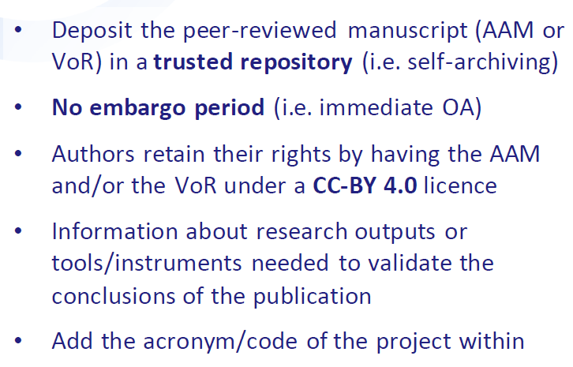
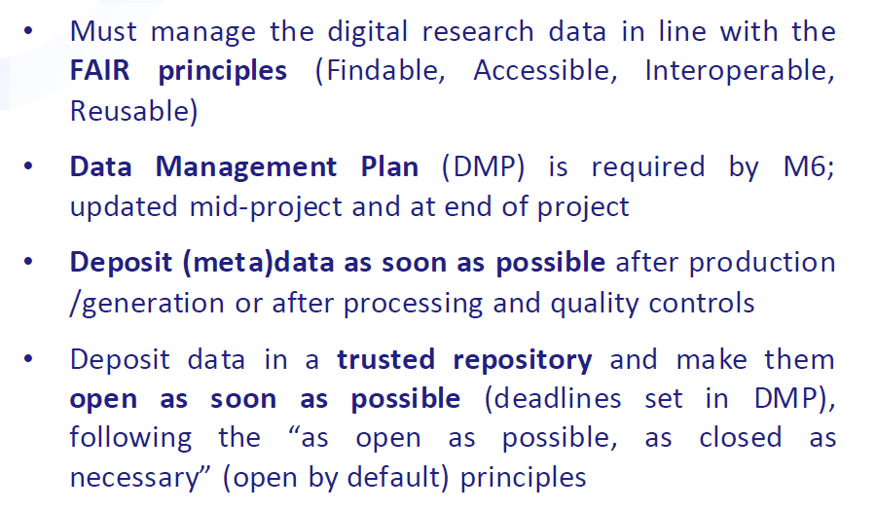
Policies and mandates – European Commission
Peer-reviewed scientific publications:
Research Data Management (RDM):
https://recolecta.fecyt.es/en/acceso-abierto/politicas-y-mandatos/comision-europea
England, J. 2024. 10.5281/zenodo.10810347
Notes:
Only publications fees (if any) in full open access venues for peer-reviewed scientific publications are eligible for reimbursement.

Slide 39
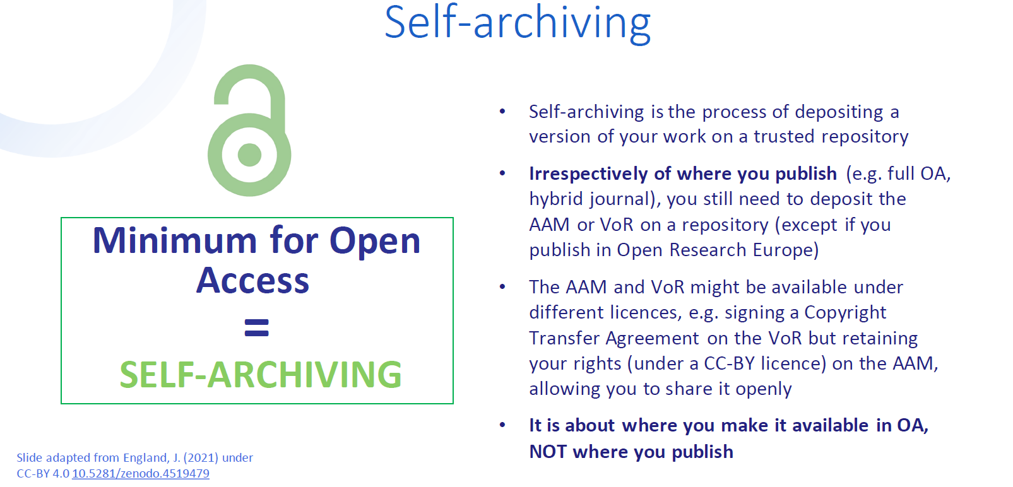
Peer-reviewed scientific publications:
England, J. 2024. 10.5281/zenodo.10810347

Slide 40


Alea Lopez de San Roman, Dagmar Meyer, Emilie Hermans, & Ellen Leenarts. (2021, septiembre 22). Horizon Europe train-the-trainer workshop. Open Science Fair 2021 (OSFair2021). Zenodo. https://doi.org/10.5281/zenodo.5549524

Slide 41


https://open-science-cloud.ec.europa.eu/
https://open-science-cloud.ec.europa.eu/resources/all

Slide 42


BARCELONA DECLARATION ON OPEN RESEARCH INFORMATION (16/04/2024)
https://barcelona-declaration.org/downloads/barcelonadeclaration_espan%c3%b5l.pdf
Notes:
Información sobre la investigación
Por información de investigación entendemos la información (a veces denominada metadatos) relativa a la realización y comunicación de la investigación. Esto incluye, entre otros, (1) metadatos bibliográficos como títulos, resúmenes, referencias, datos del autor, datos de afiliación y datos sobre sitios de publicación, (2) metadatos sobre software de investigación, datos de investigación, muestras e instrumentos, (3) información sobre financiación y subvenciones, e (4) información sobre organizaciones y colaboradores de la investigación. La información sobre investigación se encuentra en sistemas como bases de datos bibliográficas, repositorios de software, repositorios de datos y sistemas actuales de
información sobre investigación.
Información abierta sobre investigación Por información de investigación abierta entendemos la información de investigación de libre acceso y sin restricciones de reutilización. La apertura de la información de investigación es un espectro, no un absoluto. Al igual que los datos de investigación deberían adherirse a los principios FAIR de encontrabilidad, accesibilidad, interoperabilidad y reutilización, la información de investigación abierta también debería seguir estos principios. Si se alcanzan los máximos niveles de encontrabilidad, accesibilidad, interoperabilidad y reutilización, la información de la investigación es abierta y FAIR. Esto requiere, por ejemplo: ANEXO B DEFINICIONES 9 • La utilización de protocolos normalizados e identificadores persistentes para facilitar la localización y la interoperabilidad. • El alojamiento de metadatos en repositorios y sistemas de transferencia de uso generalizado para facilitar su localización y accesibilidad. • La aplicación de una licencia CC0 de Creative Commons o la dedicación al dominio público, según proceda, para apoyar la interoperabilidad y la reutilización. • Transparencia en la procedencia y el tratamiento de los datos para favorecer la interoperabilidad y la reutilización. • La utilización de infraestructuras que ofrezcan interfaces estándar y abiertas

Slide 43


Exploitation rights and deposit licences
http://www.accesoabierto.net/dulcinea
https://openpolicyfinder.jisc.ac.uk/
https://dulcinea.opensciencespain.org/

Slide 44

… an invitation to collaborate as actors of this ecosystem
Notes:
You are actors of this ecosystem.

Slide 45

THANKS!!!
virginiaj@isciii.es
repisalud@isciii.es
VSNU, NFU, KNAW, NWO and ZonMw. Position paper Room for everyone’s talent: towards a new balance in the recognition and rewards for academics https://recognitionrewards.nl/about/position-paper/

Slide 46
* The following teaching materials have been used in the preparation of this presentation:
England, J. (2024, marzo 19). Horizon Europe Open Science requirements in practice - OpenAIRE webinar. Zenodo. https://doi.org/10.5281/zenodo.10810347
Hernández Villegas, Silvia. Acceso abierto. Máster de Salud Pública 2023/2024. Escuela Nacional de Sanidad. Instituto de Salud Carlos III, 2024:
http://hdl.handle.net/20.500.12105/19272
Jiménez-Planet, Virginia; Hernández Villegas, Silvia. Gestión de datos de investigación y Planes de Gestión de datos. Seminarios Centro Nacional de Epidemiología. 2023
http://hdl.handle.net/20.500.12105/16206
Jiménez-Planet, Virginia. Acceso abierto/ciencia abierta. Principios de investigación e innovación responsable (RRI). Instituto de Salud Carlos III, 17 y 20 de mayo 2024.
http://hdl.handle.net/20.500.12105/19762
Jimenez-Planet, Virginia; Hernandez Villegas, Silvia. Acceso abierto en el ISCIII: aclarando conceptos. Instituto de Salud Carlos III. Biblioteca Nacional de Ciencias de la Salud, 2024.
http://hdl.handle.net/20.500.12105/19797

Slide 47
Melero, Remedios. Open Science. Gestión de Datos de Investigación. Plan de Formación Interna. Instituto de Salud Carlos III, 2024.
http://hdl.handle.net/20.500.12105/19761
Melero, Remedios. El significado del acceso abierto a la producción científica y cómo contribuir a su práctica. Máster de Salud Pública 2022/2023. Escuela Nacional de Sanidad. Instituto de Salud Carlos III, 2023.
http://hdl.handle.net/20.500.12105/18866
Méndez Rodríguez, Eva. CoARA, Evaluación de la Ciencia. Acto de entrega de los Premios ISCIII de Investigación e Innovación Responsable (RRI) en Salud. Instituto de Salud Carlos III, 7 de noviembre de 2024.
https://hdl.handle.net/20.500.12105/25476
Rico Castro, Pilar. Acceso Abierto y Ciencia Abierta. Principios de investigación e innovación responsable (RRI) - 16-24 de octubre 2023.
http://hdl.handle.net/20.500.12105/19265

