Slide 1
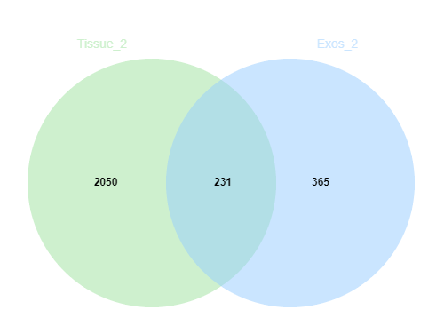









KRAS WT_1
KRAS WT_2
KRAS WT_3
KRAS WT_4
KRAS Mut_1
Tissues
Exosomes
Tissues
Exosomes
Tissues
Exosomes
Tissues
Exosomes
Tissues
Exosomes
KRAS Mut_2
KRAS Mut_3
KRAS Mut_4
KRAS Mut_5
KRAS Mut_6
Tissues
Exosomes
Tissues
Exosomes
Tissues
Exosomes
Tissues
Exosomes
Tissues
Exosomes
Supplementary Figure S2

