Slide 1
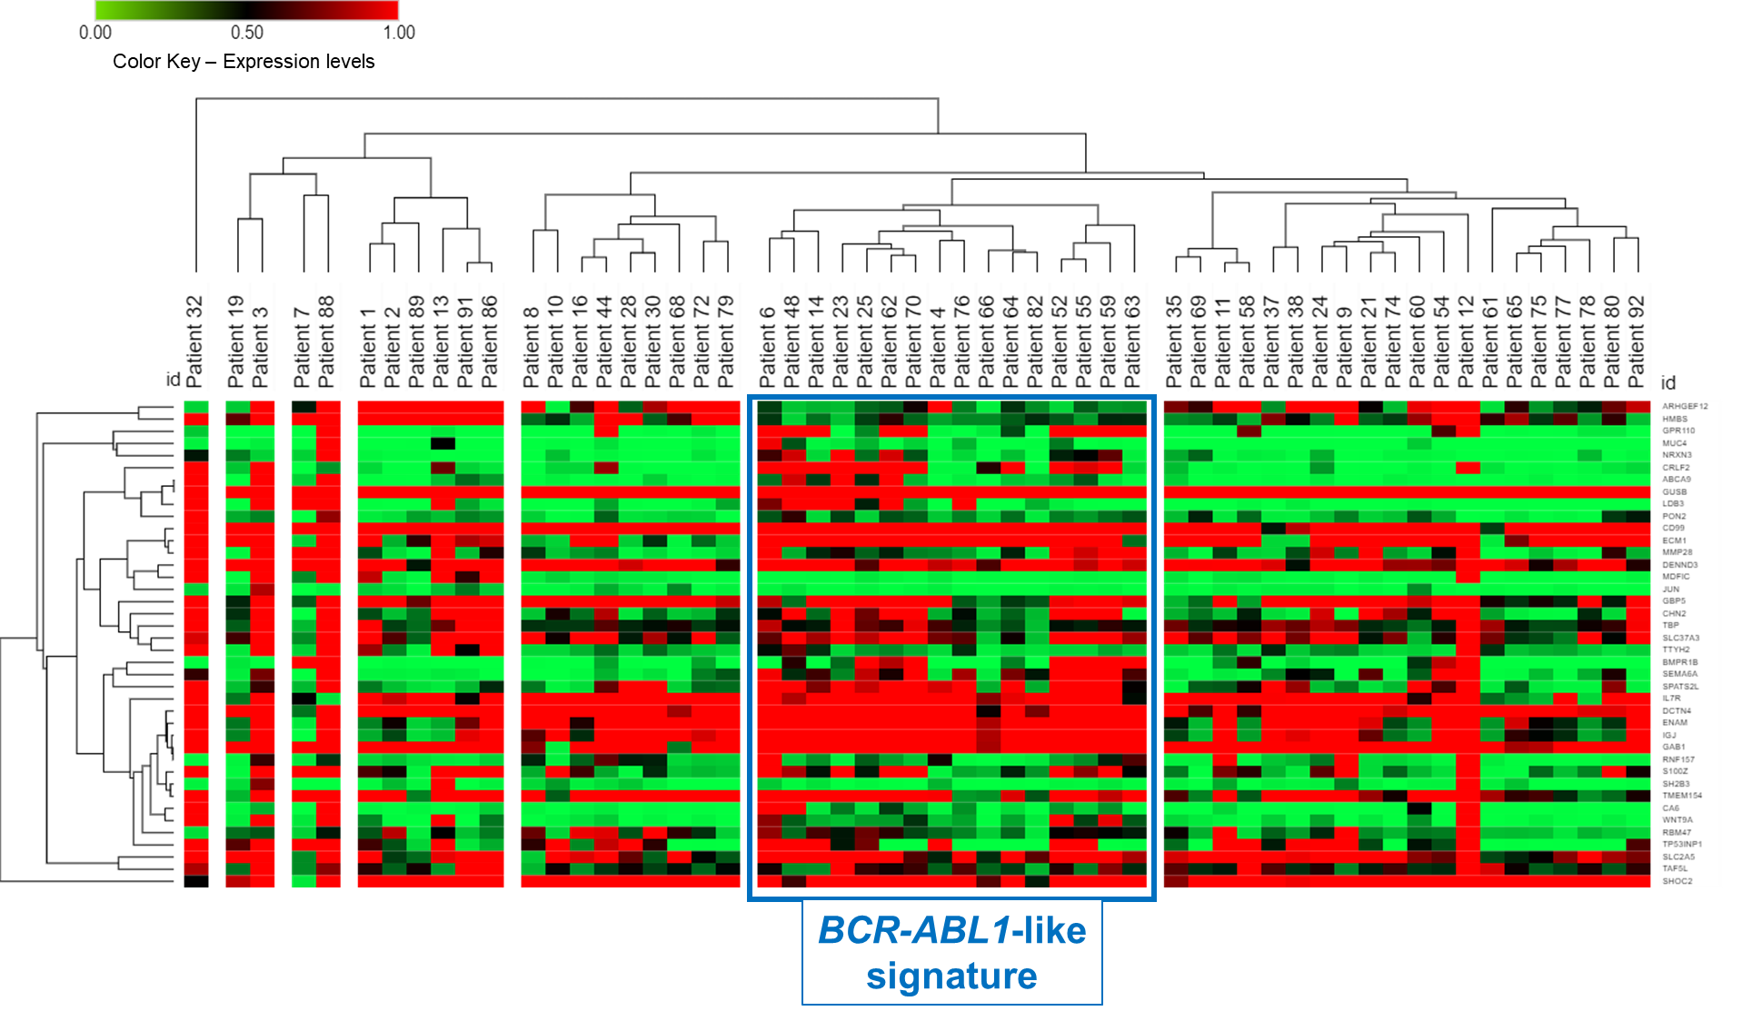
Supplemental Figure S1

Slide 2
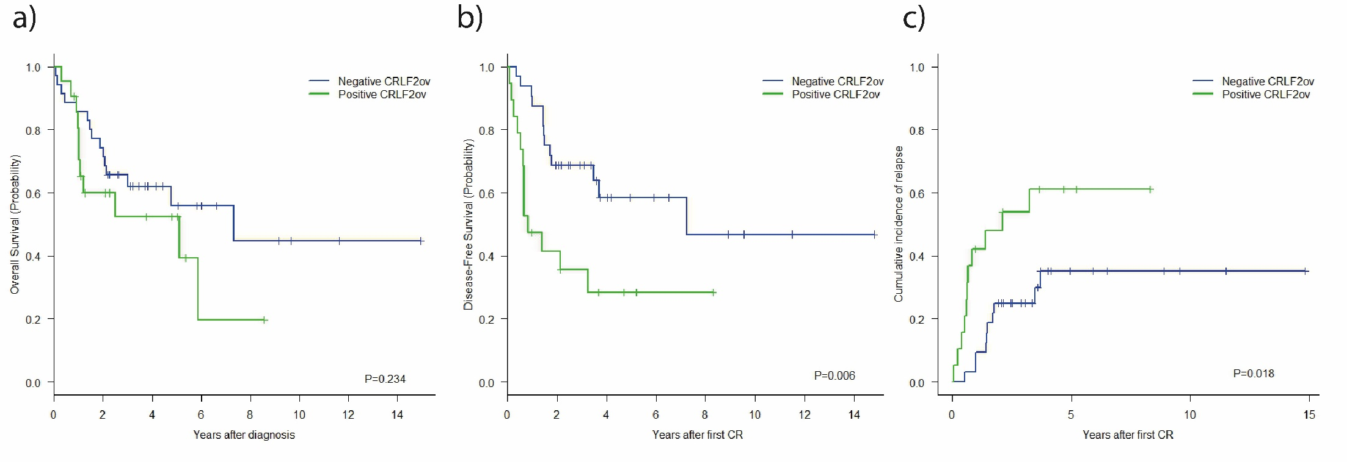
Supplemental Figure S2

