Slide 1
Supplementary Information
The targetable kinase PIM1 drives ALK inhibitor resistance in high-risk neuroblastoma independent of MYCN status
Trigg et al.

Slide 2
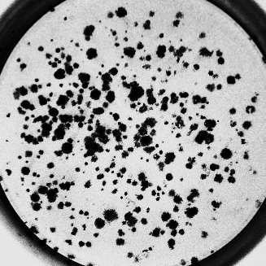
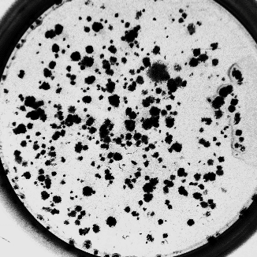
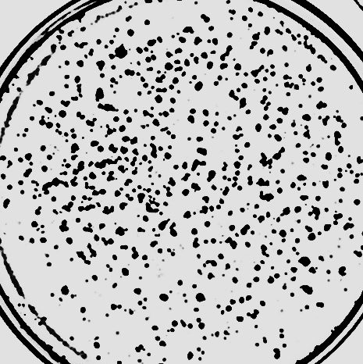
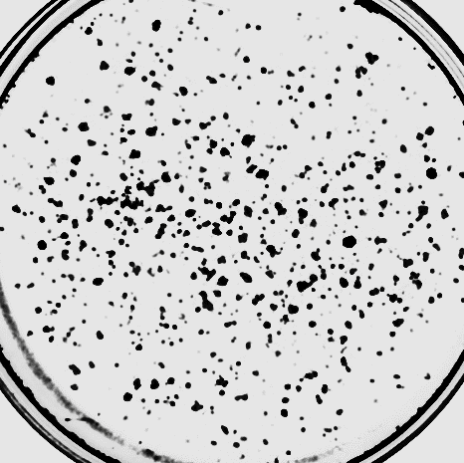
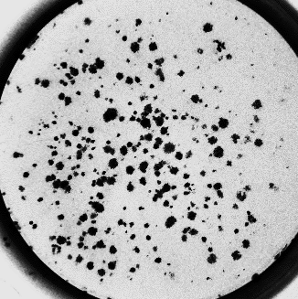
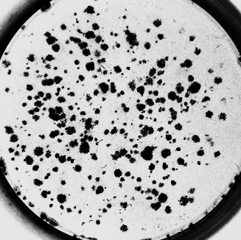
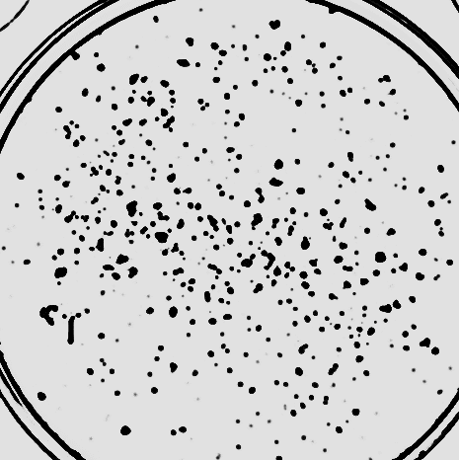
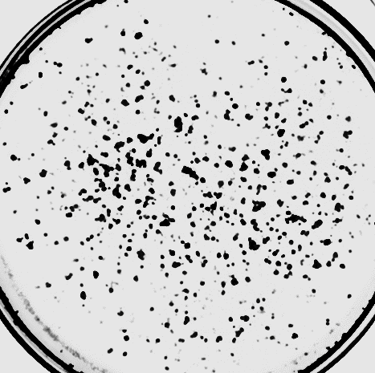
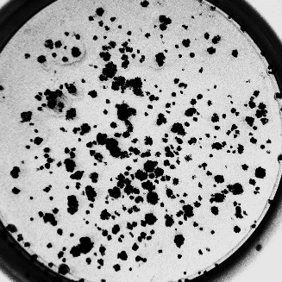
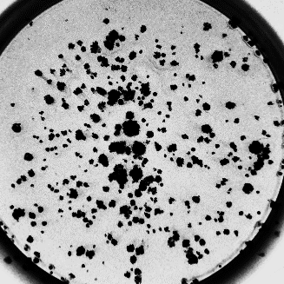
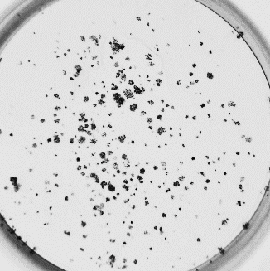
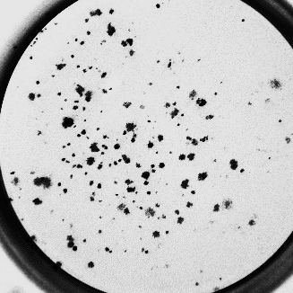
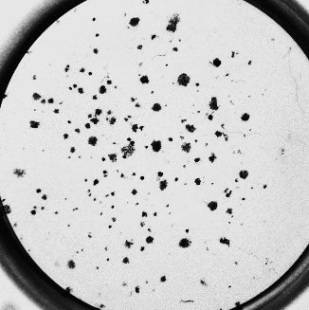
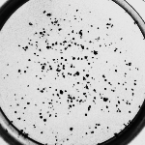
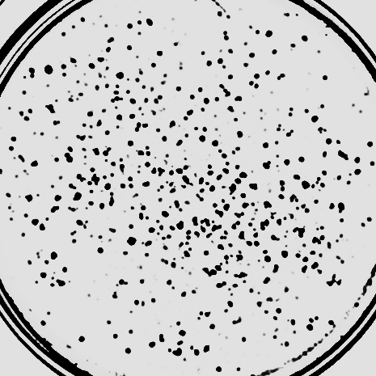
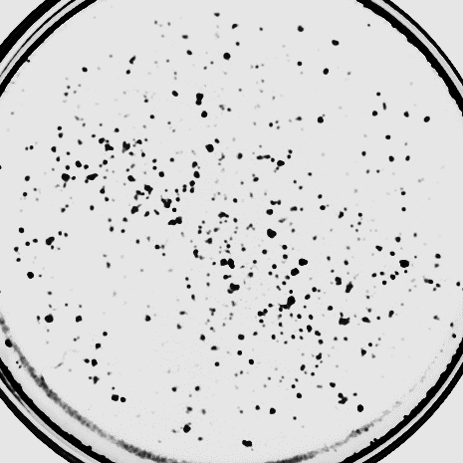
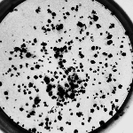
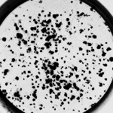
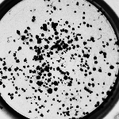
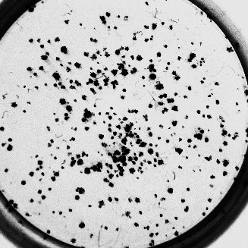
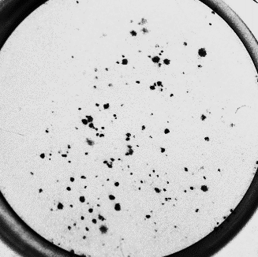
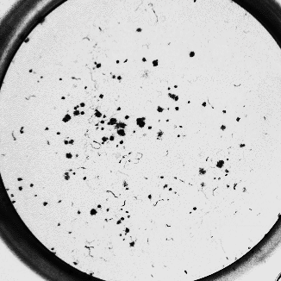
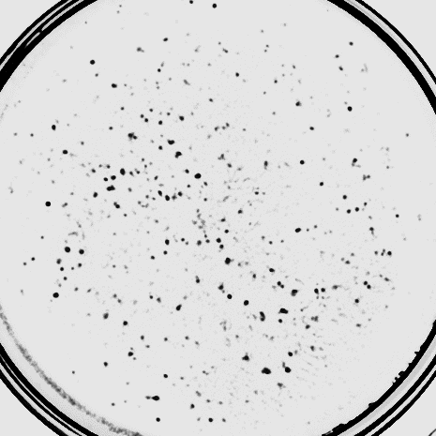
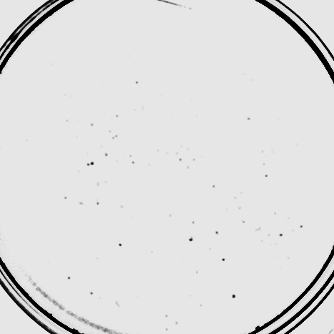
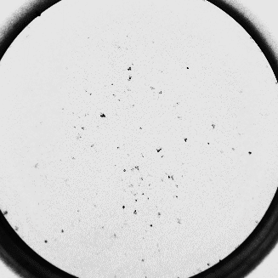
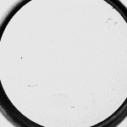
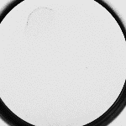
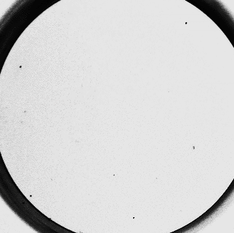
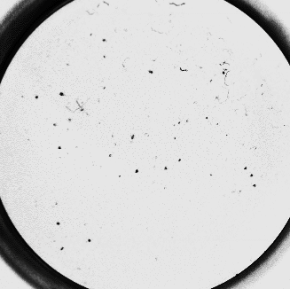
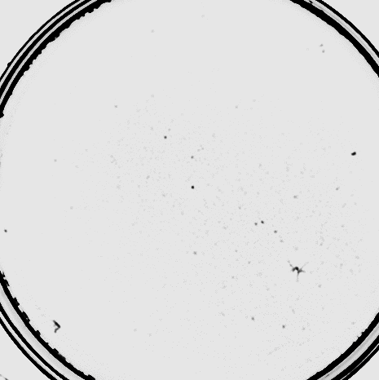
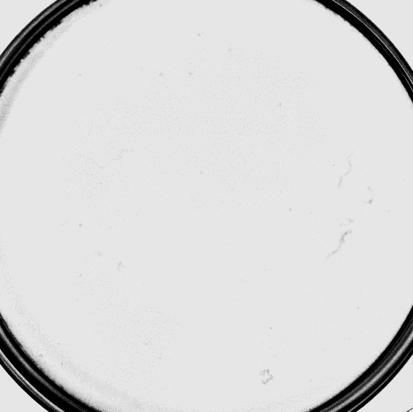
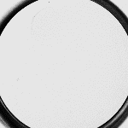
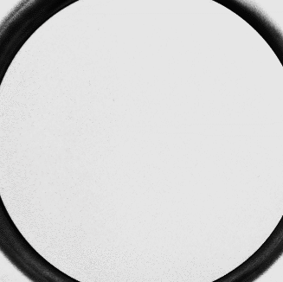
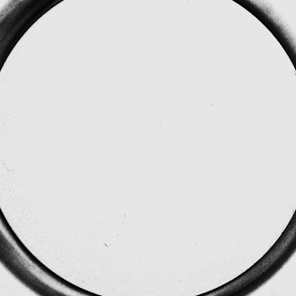
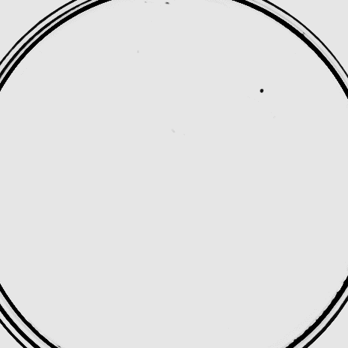
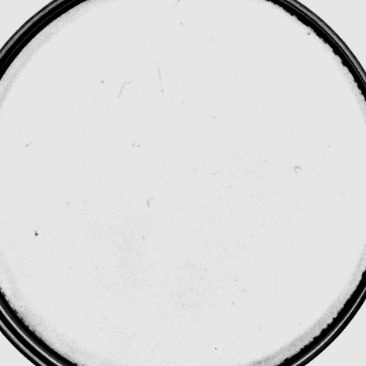
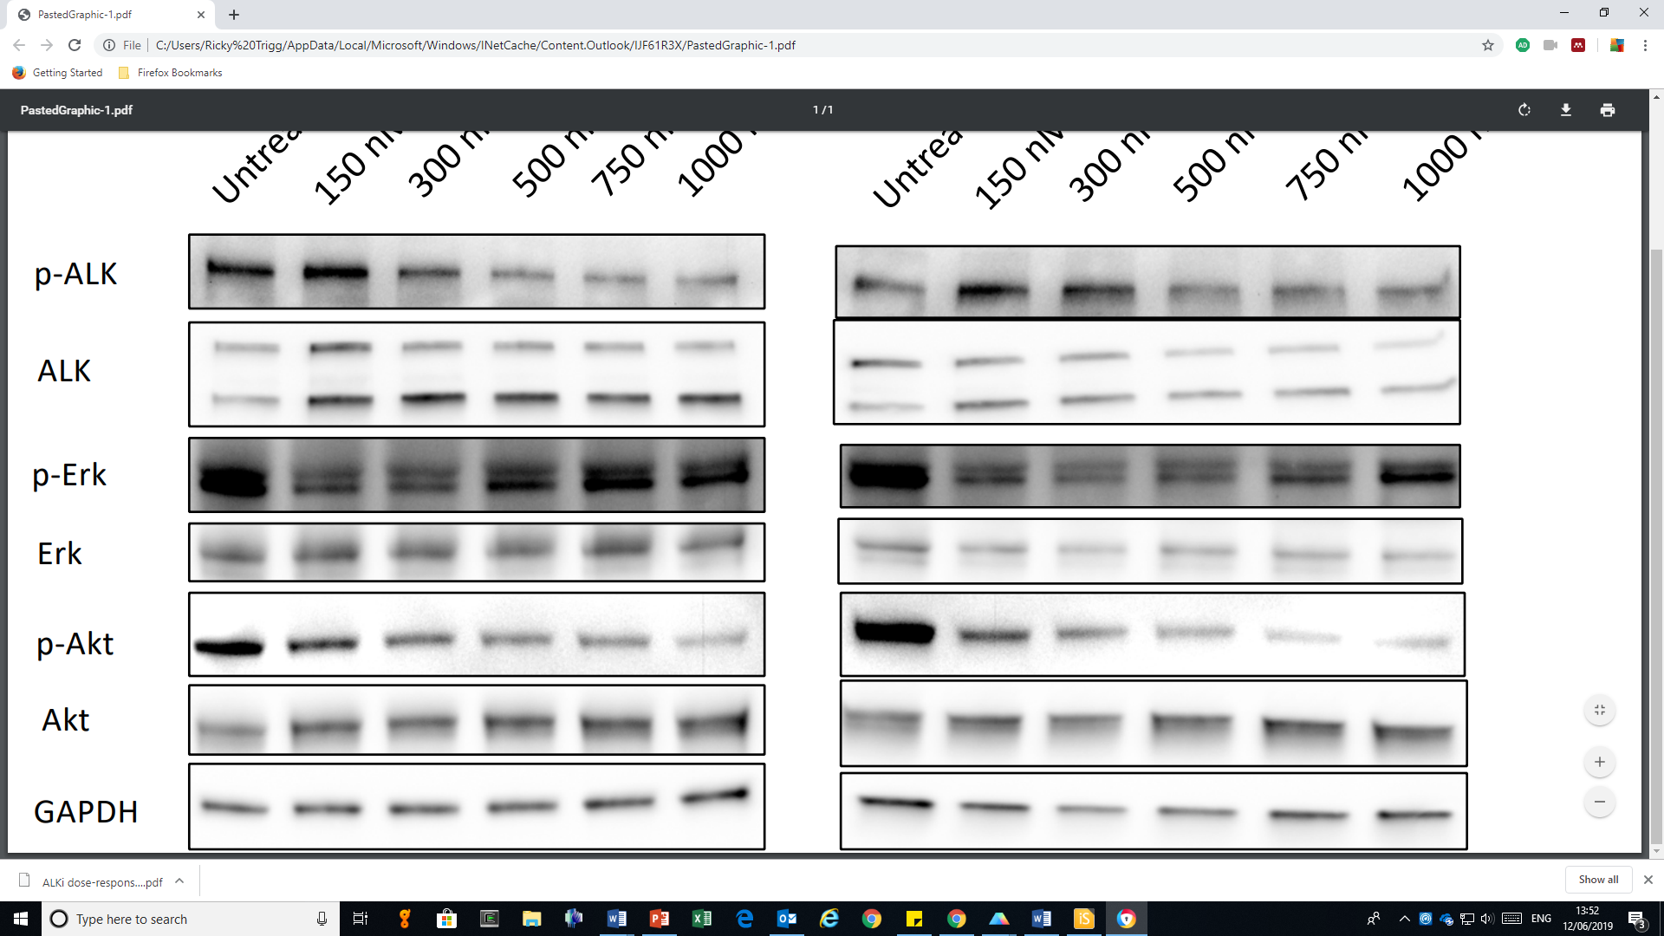
a
Supplementary Fig. 1
b
SH-SY5Y
CHLA-20
COG-N-426
(nM)
brigatinib
ceritinib
brigatinib
ceritinib
brigatinib
ceritinib
MYCN-
0
MYCN+
30
100
300
1000
3000
c
brigatinib (nM)
ceritinib (nM)
SH-SY5Y
1000
500
750
1000
750
500
300
300
150
0
150
0
p-ALK (Y1604)
220 kDa
ALK
220 kDa
140 kDa
p-AKT (S473)
60 kDa
AKT
60 kDa
GAPDH
37 kDa
d
CHLA-20
SH-SY5Y
Gene
Gene
Supplementary Fig. 1 Characterization of NB cell line sensitivity to ALK inhibition and validation of CRISPR activity
a 72-hour dose-response curves of NB cell lines incubated with brigatinib or ceritinib. Data points represent means +/- s.e.m. of technical triplicates (duplicates for CHLA-90 and FELIX). b 14-day (CHLA-20; SH-SY5Y) and 21-day (COG-N-426) colony formation assays following incubation with brigatinib or ceritinib. c Immunoblot analysis of the indicated proteins in SH-SY5Y cells treated with increasing concentrations of brigatinib or ceritinib for 24 hours. d RT-qPCR based gene expression in SH-SY5Y and CHLA-20 cells transduced with gRNAs targeting 15 genes to confirm CRISPR SAM activity. Data were normalized to cells treated with non-targeting gRNA. Data points represent means +/- s.e.m. of technical triplicates. Source data are provided as a Source Data file for Supplementary Figures 1a and 1d.

Slide 3
Supplementary Fig. 2
a
brigatinib ED₅₀
b
brigatinib ED₅₀
ceritinib ED₅₀
ceritinib ED₅₀
Log-normalized gRNA counts, ALK inhibitor-treated
Treated - untreated log-normalized gRNA counts
brigatinib ED₇₅
brigatinib ED₇₅
ceritinib ED₇₅
ceritinib ED₇₅
Log-normalized gRNA counts, untreated
Ranked gRNAs
(by fold-enrichment)
Supplementary Fig. 2 CRISPRa screen in CHLA-20 cells treated with ALK inhibitors
a Log-normalized read counts for each gRNA in untreated (DMSO) vs ALK TKI-treated CHLA-20 cell populations. Dashed black lines represent linear regressions. Data represent the average of two biological replicates, MET and PIM1 are highlighted. b gRNAs ranked by fold-change vs difference in log-normalized read counts between DMSO and ALK TKI-treated CHLA-20 cell populations. MET and PIM1 are highlighted.

Slide 4
a
Supplementary Fig. 3
SH-SY5Y
b
SH-SY5Y
c
SH-SY5Y
Gene
Supplementary Fig. 3 Validation of CRISPRa screen hits in SH-SY5Y cells
a Log₁₀-transformed ED₅₀ values from 96-hour dose-response curves of SH-SY5Y cells treated with brigatinib or ceritinib five days post-transduction with gRNA molecules targeting each indicated candidate gene, ns = not significant; *p < 0.05; **p < 0.001; ***p < 0.0001 (one-way ANOVA). Data points represent means +/- s.d. of technical triplicates. Significance levels for each ED₅₀ shift relative to scrambled gRNA are shown in Table S3. b Representative 96-hour dose-response curves of SH-SY5Y cells transduced with MET or non-targeting (NT) gRNAs. Data were analyzed for significance by one-way ANOVA. c RT-qPCR based gene expression in SH-SY5Y cells transduced with gRNAs targeting candidate resistance-inducing genes. Data were normalized to cells treated with NT gRNA. Data points represent means +/- s.e.m. of technical triplicates. Source data are provided as a Source Data file for this figure

Slide 5
Supplementary Fig. 4
a
CHLA-20
b
CHLA-20
c
Gene
Supplementary Fig. 4 Validation of CRISPRa screen hits in CHLA-20 cells
a Log₁₀-transformed ED₅₀ values from 96-hour dose-response curves of CHLA-20 cells treated with brigatinib or ceritinib five days post-transduction with gRNA molecules targeting each indicated candidate gene, ns = not significant; *p < 0.05; **p < 0.001; ***p < 0.0001 (one-way ANOVA). Data points represent means +/- s.e.m. of technical triplicates. Significance levels for each ED₅₀ shift relative to scrambled gRNA are shown in Table S3. b Representative 96-hour dose-response curves of CHLA-20 cells transduced with MET or non-targeting (NT) gRNAs. Data were analyzed for significance by one-way ANOVA. c RT-qPCR based gene expression in CHLA-20 cells transduced with gRNAs targeting candidate resistance-inducing genes. Data were normalized to cells treated with NT gRNA. Data points represent means +/- s.e.m. of technical triplicates. Source data are provided as a Source Data file for this figure.

Slide 6
a
b
Supplementary Fig. 5
c
d
e
f
Supplementary Fig. 5 High expression of PIM1 in NB is associated with advanced, high-risk disease independent of MYCN amplification
a-d Kaplan-Meier survival analyses of the SEQC cohort (n = 498) for (a) PIM1 expression, (b) MYCN amplification status, (c) PIM1 expression in MYCN- patients and (d) PIM1 expression in MYCN+ patients. The Bonferroni-corrected p-values shown were calculated using the Log-rank test. e Log₂ PIM1 mRNA expression in the SEQC cohort by INSS stage 1 (n = 121), 2 (n = 78), 3 (n = 63), 4 (n = 183) and 4S (n = 53). *p < 0.05; **p < 0.005; ***p < 0.001. The p-values shown were determined by an unpaired Student’s t-test. f Log₂ PIM1 mRNA expression in the SEQC cohort by tumor risk category. The p-value shown was determined by an unpaired Student’s t-test. Source data are provided as a Source Data file for 5a-d and 5f-g.

Slide 7
a
Karpas 299
SU-DHL-1
Supplementary Fig. 6
Gene
Gene
b
c
Karpas 299
Cell line
SU-DHL-1
Supplementary Fig. 6 Overexpression of PIM1 in ALK-positive ALCL cell lines decreases sensitivity to ALK inhibitors
a RT-qPCR based gene expression in Karpas 299 or SU-DHL-1 cells transduced with gRNAs targeting specific genes. Data were normalized to cells transduced with non-targeting (NT) gRNA. Data points represent means +/- s.e.m. of technical triplicates. b Expression of PIM1 in Karpas 299 (K299) and SU-DHL-1 cells 5 days post-transduction with PIM1-targeted gRNA relative to NT gRNA, as determined by RT-qPCR. Data points represent means +/- s.e.m. of triplicate experiments. c 72-hour dose-response assay of brigatinib or ceritinib in Karpas-299 and SU-DHL-1 cells treated with PIM1-targeting and NT gRNA. Data points represent means +/- s.e.m. of duplicate experiments (triplicate for SU-DHL-1 PIM1 gRNA). ED₅₀ values were compared by unpaired Student’s t-test. Source data are provided as a Source Data file for this figure.

Slide 8
Supplementary Fig. 7
a
b
Cell line
c
ALK-
Supplementary Fig. 7 Expression levels of PIM family members in NB cell lines and the response of ALK-negative NB cell lines to PIM inhibition
a RT-qPCR based expression levels of PIM2 and PIM3 in 25 NB cell lines, normalized to expression levels observed in the GIMEN cell line. Data represent means +/- s.e.m. of technical triplicates. b Pearson correlation of mRNA levels of PIM1 and PIM2, PIM1 and PIM3 or PIM2 and PIM3 in all cell lines shown in (a). c 72-hour dose-response assays for ALK- NB cell lines treated with AZD1208 or PIMi. Data represent means +/- s.e.m. of technical triplicates. Source data are provided as a Source Data file for this figure.

Slide 9
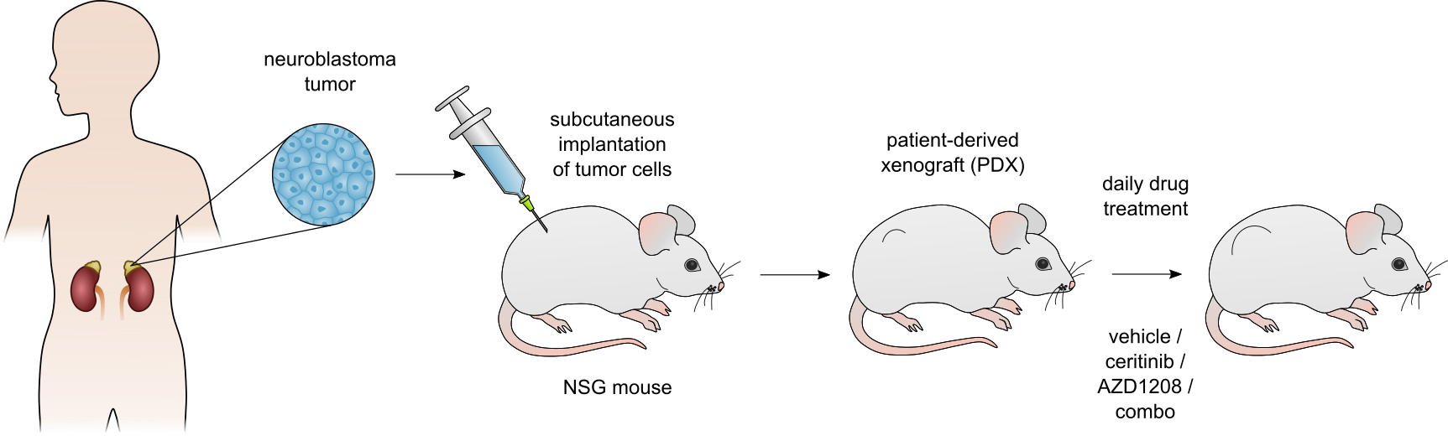
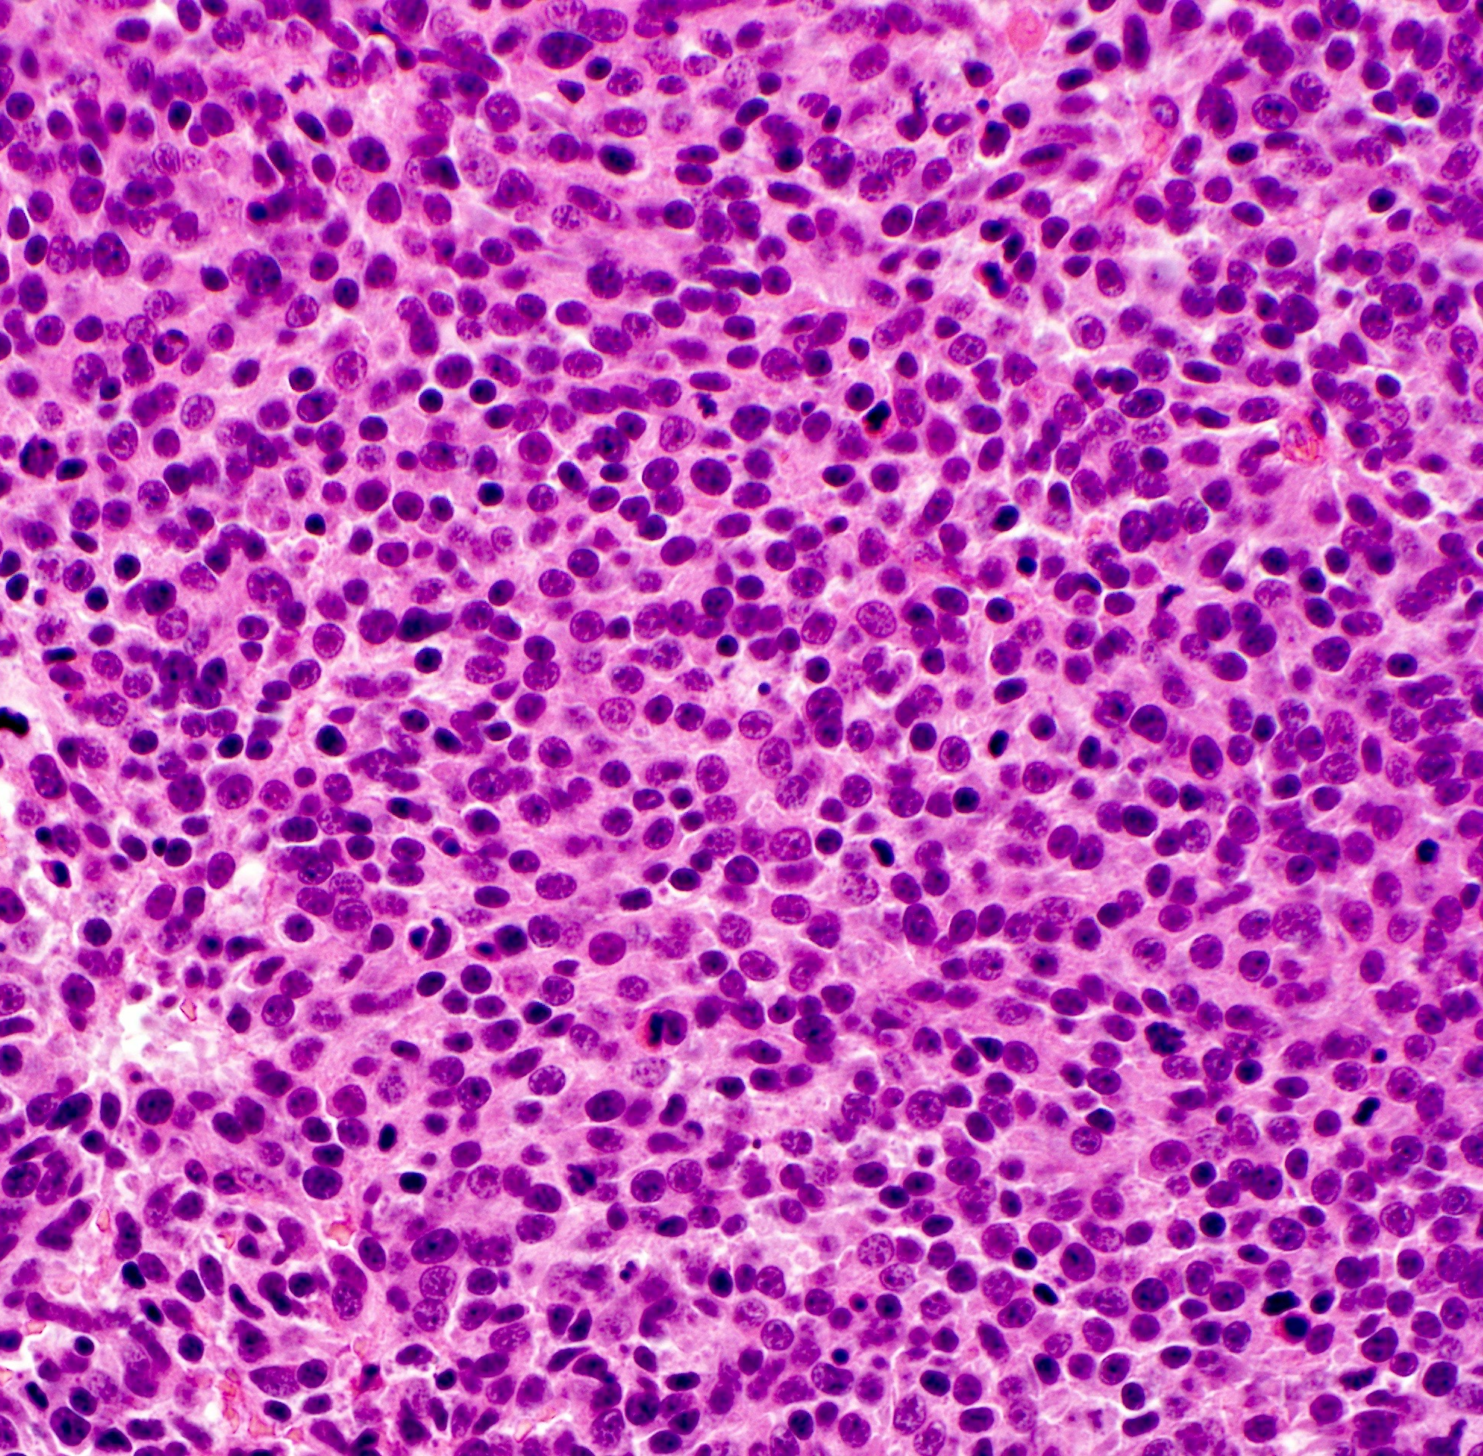
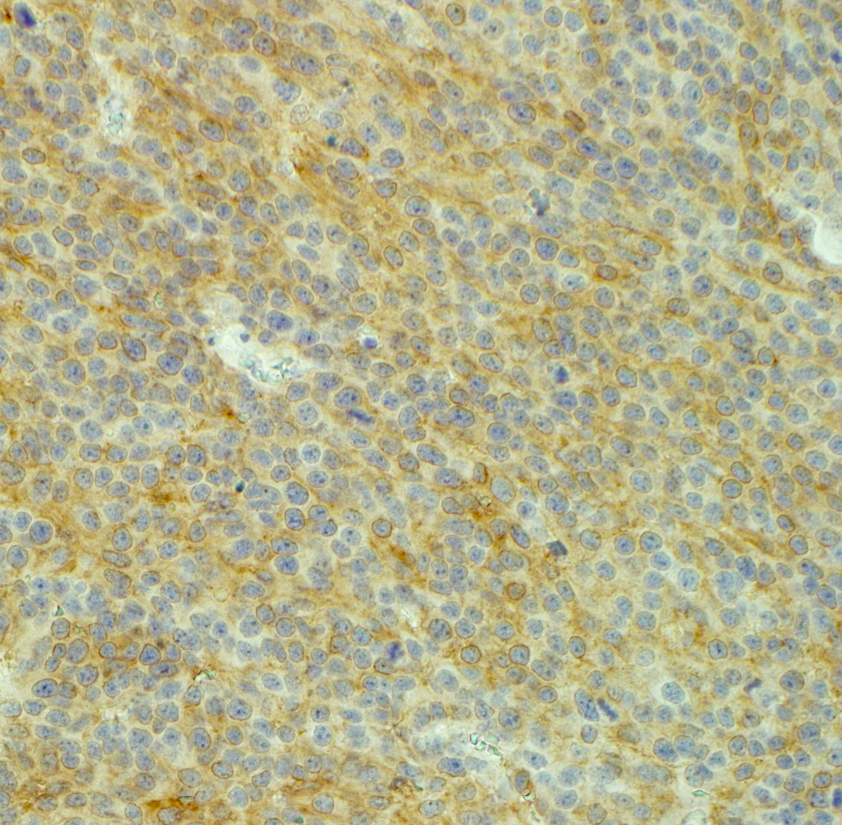
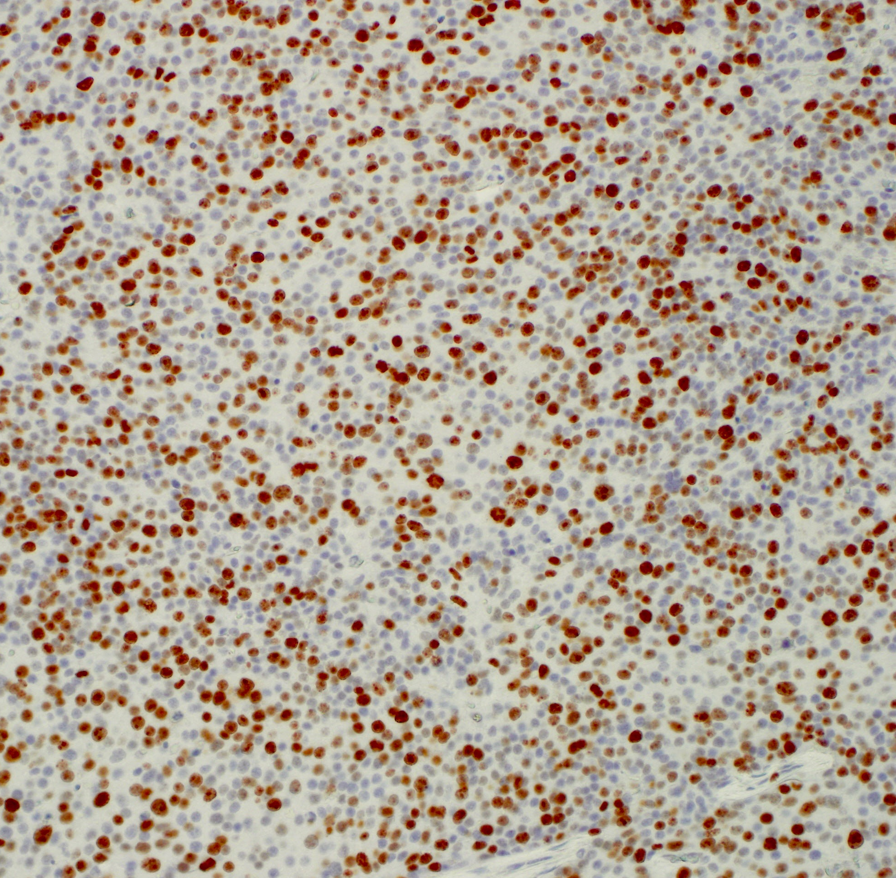
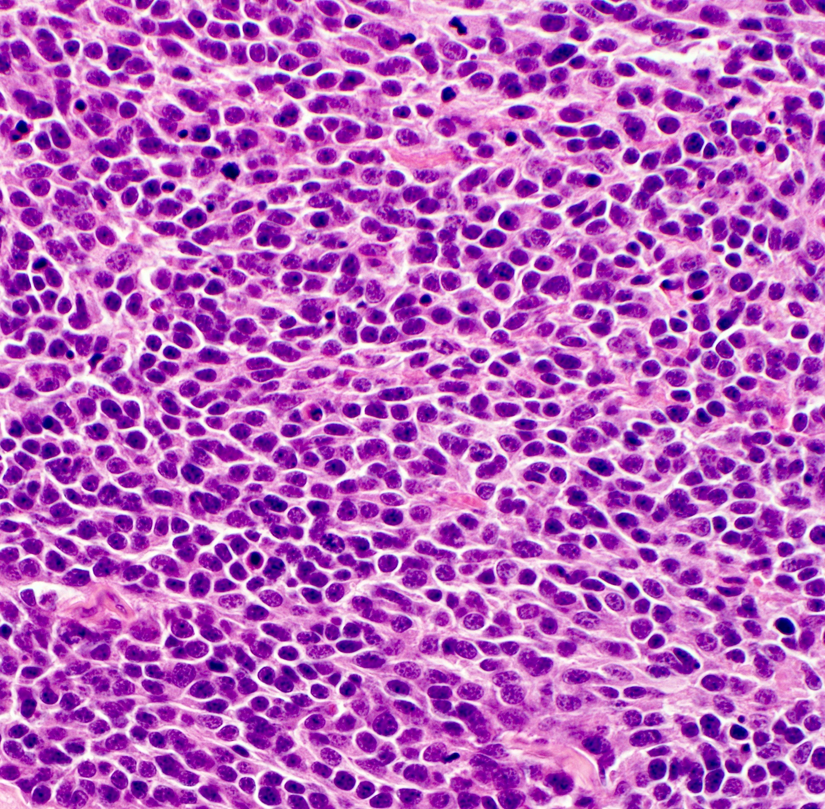
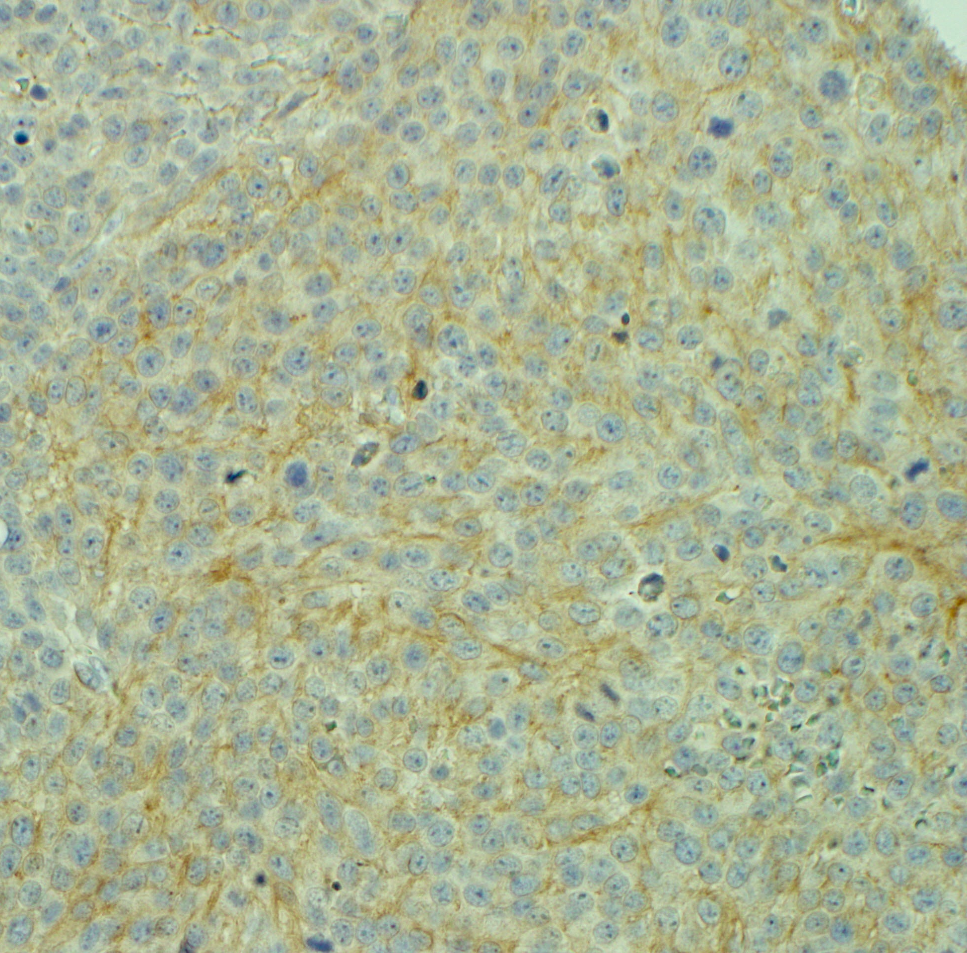
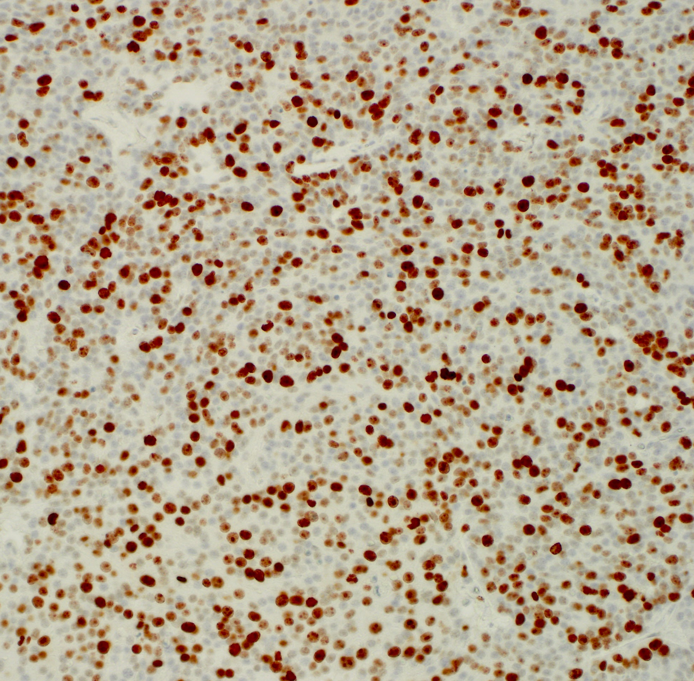
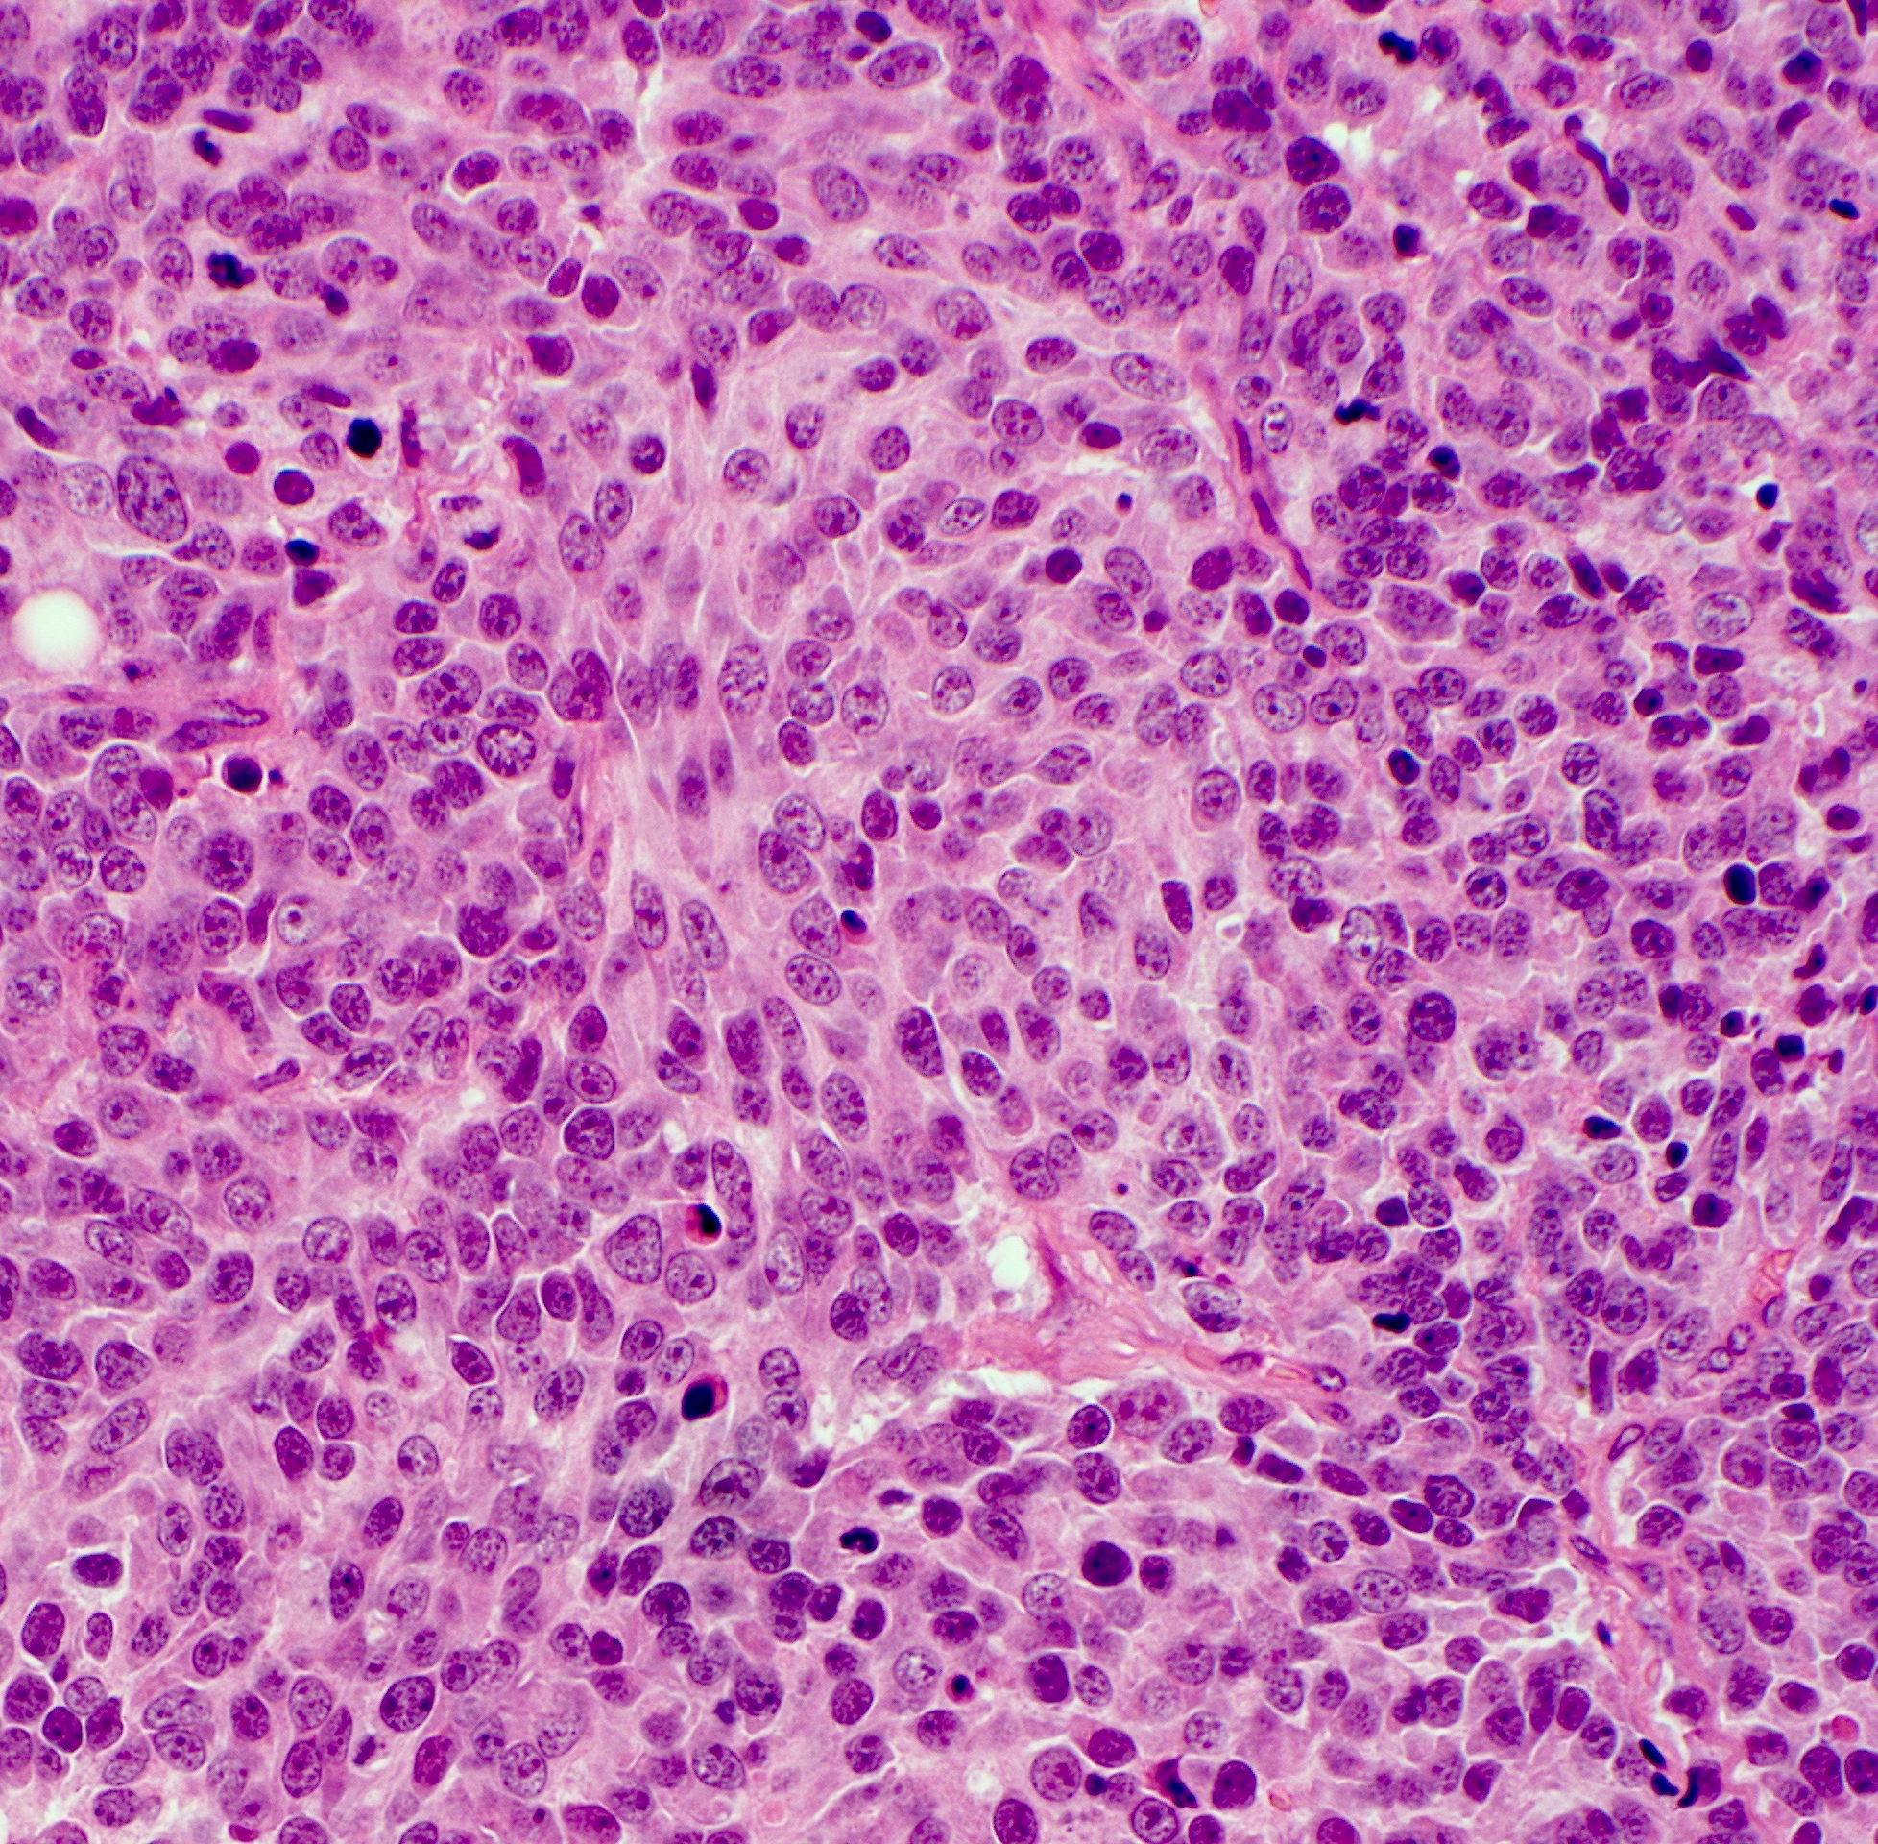
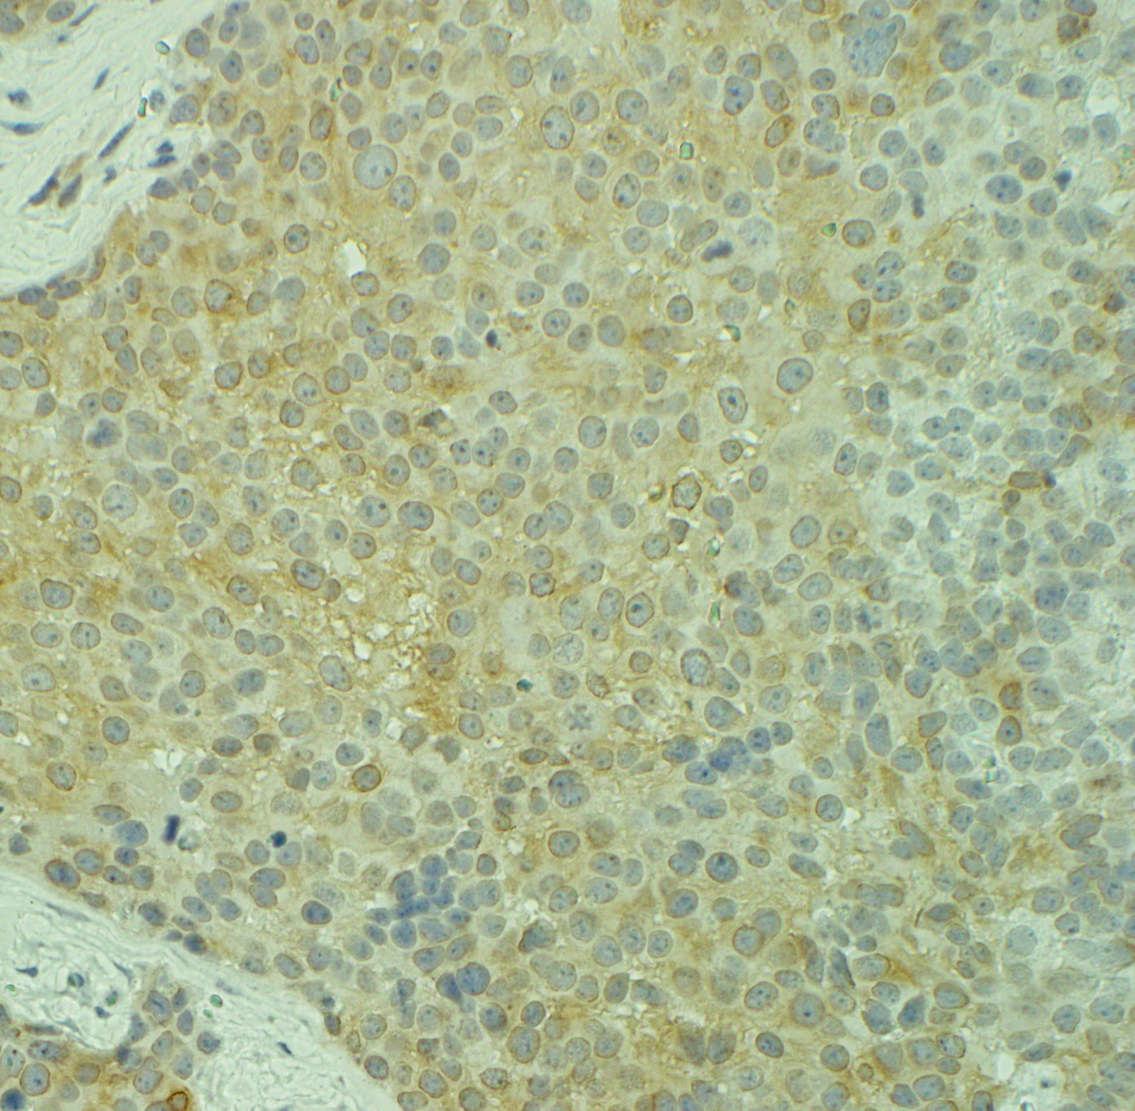
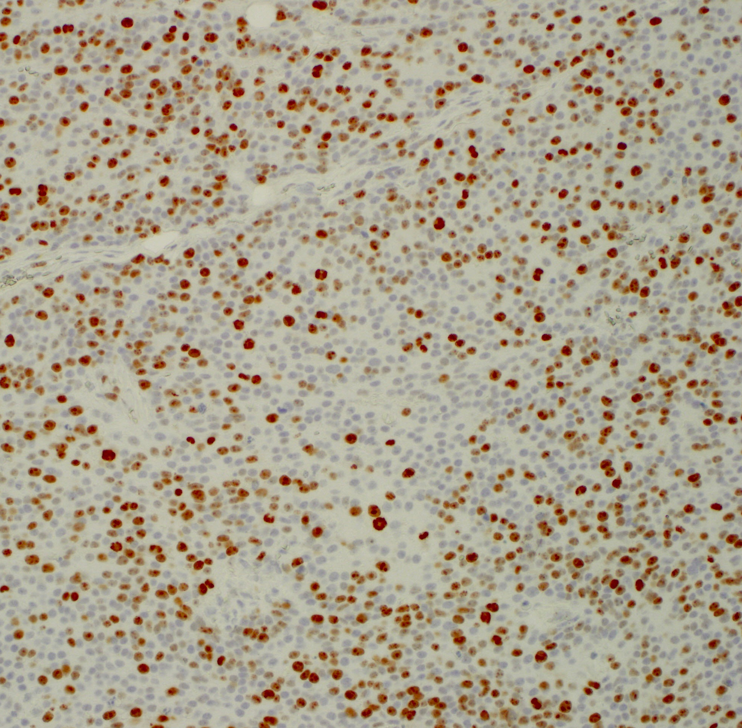
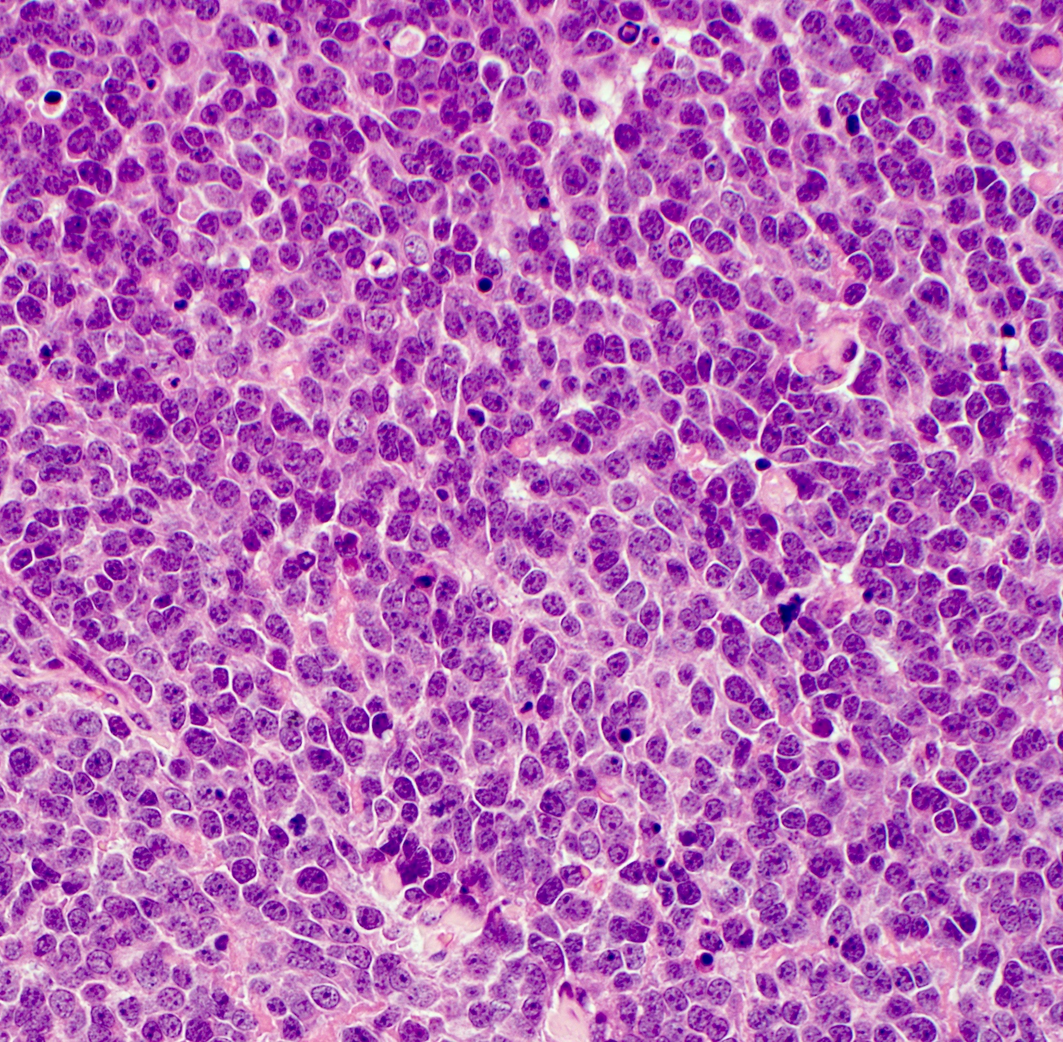
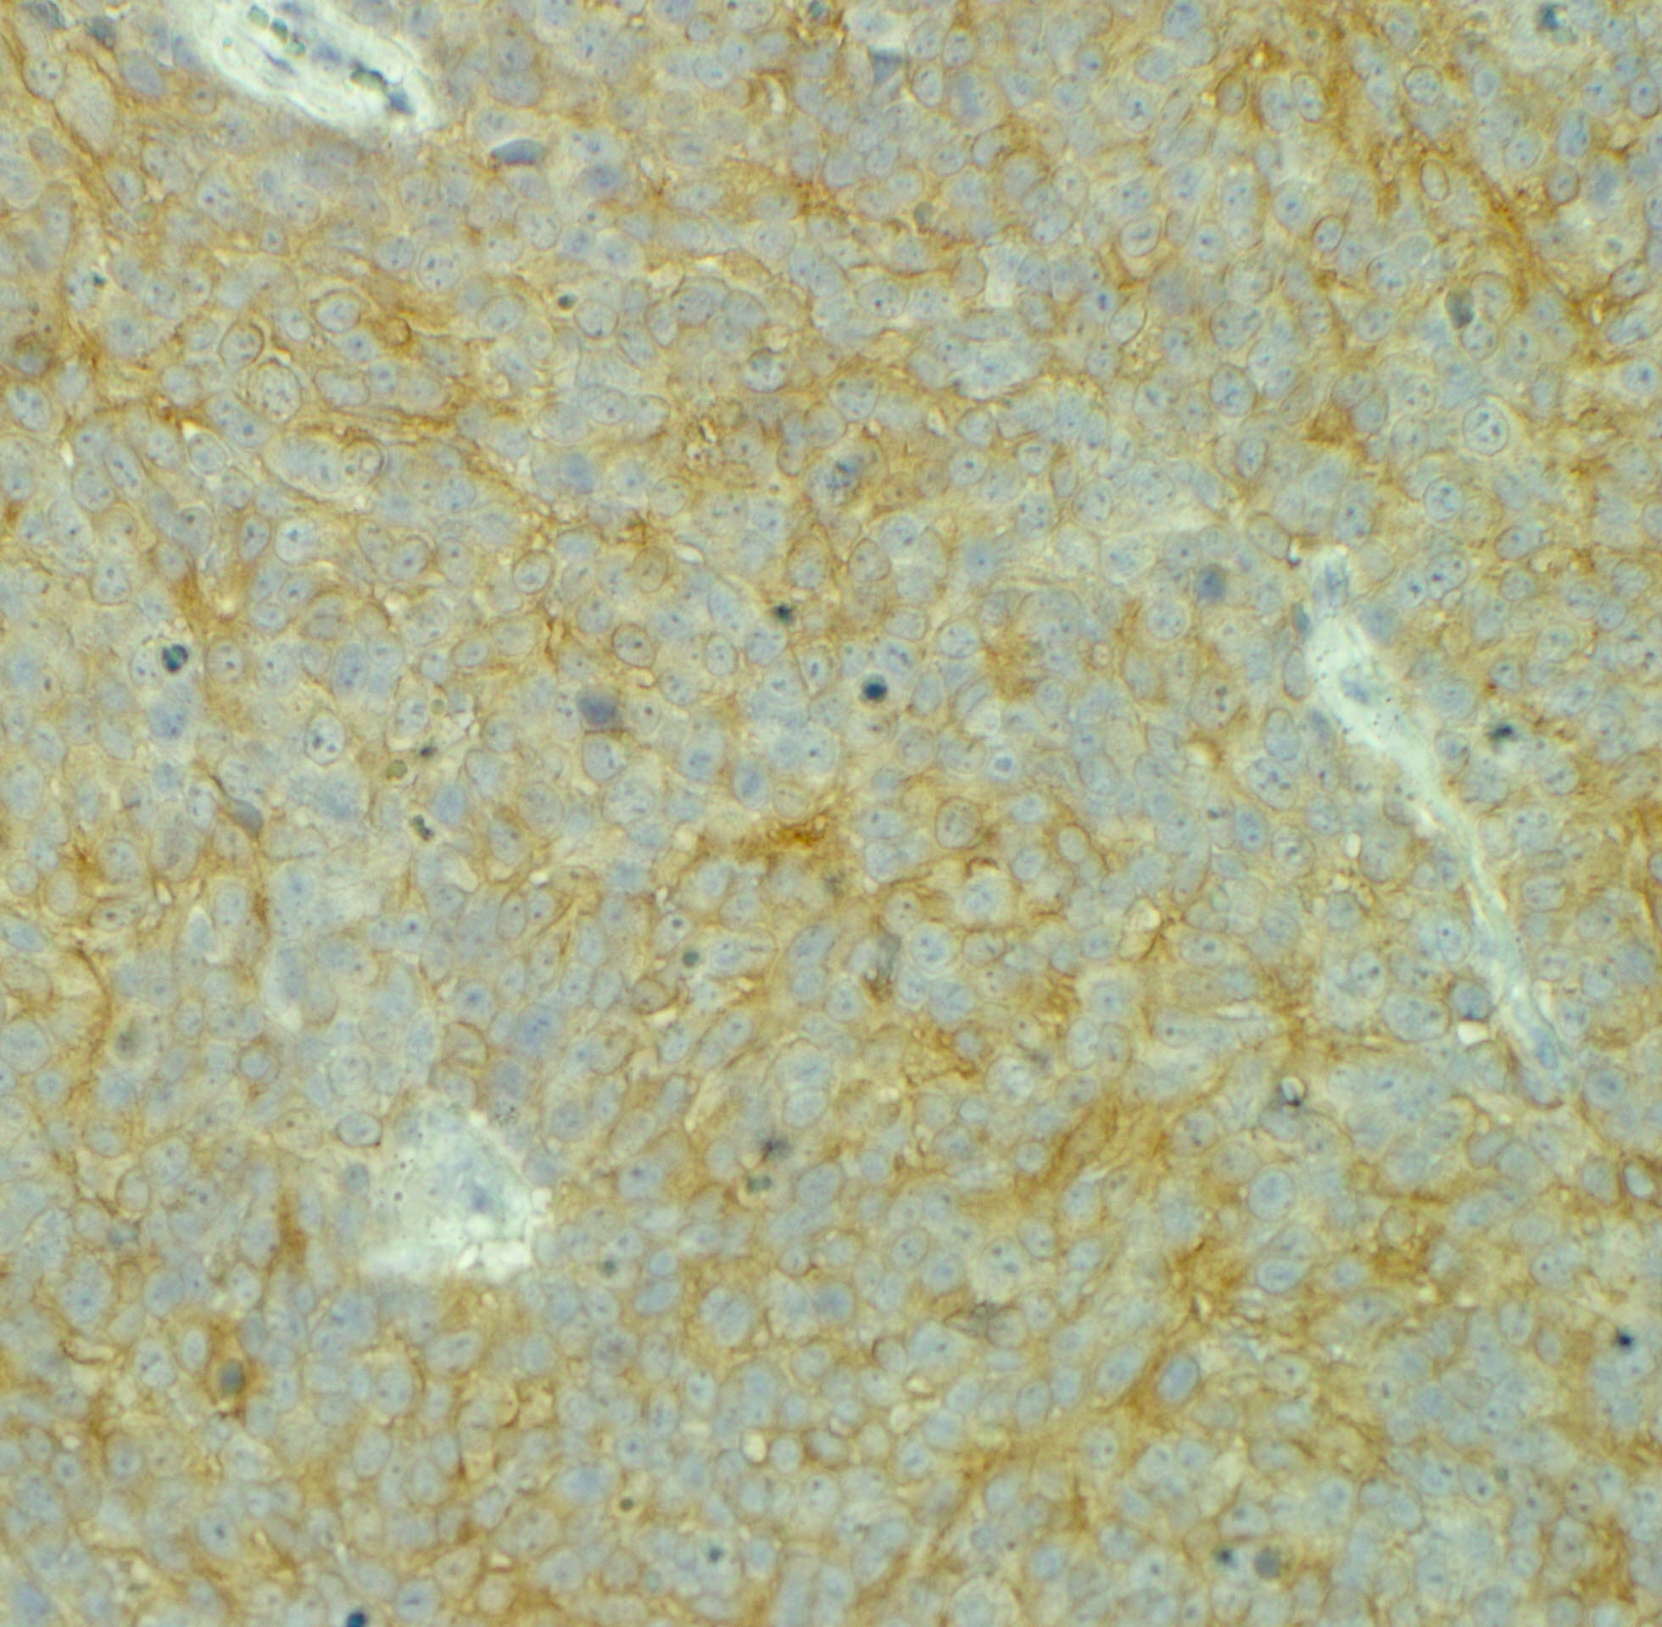
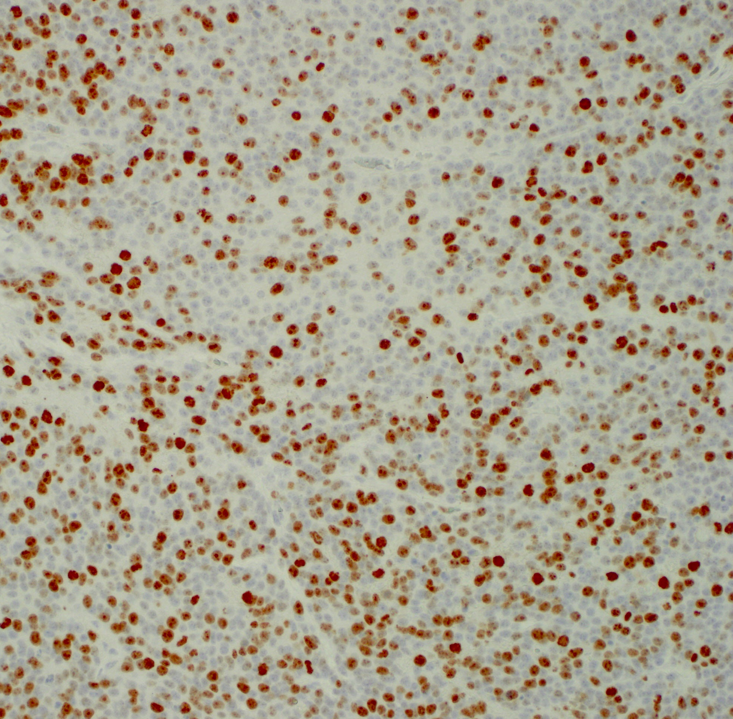
a
Supplementary Fig. 8
b
H&E
ALK
Ki-67
c
vehicle
ceritinib
AZD1208
Treatment
d
combo
e
Cell line and its respective ALK and MYCN status
Supplementary Fig. 8 Immunohistochemical analysis of residual COG-N-426x PDX tumor tissue
a Schematic illustration of patient-derived xenograft (PDX) generation. b Representative images of COG-N-426x residual tumor tissue taken at the experimental endpoint from each treatment group stained for H&E, ALK and Ki-67. Scale bars, 50 μm. c Average number of Ki-67⁺ cells per tumor tissue section per treatment group in COG-N-426x mice. Data represent means (n ≥ 2) +/- s.e.m. Data were compared by unpaired Student’s t-test. d PIM1 mRNA levels in ALK-positive and ALK-negative NB cell lines after 6-hour treatment with DMSO or 320 nM NVP-TAE684. Data were obtained from ArrayExpress (Accession: E-MTAB-3205). Error bars represent means +/- s.e.m. of technical triplicates. *p < 0.05; **p < 0.005 (unpaired Student’s t-test). e Pearson correlation of endogenous PIM1 expression levels fold-increase PIM1 expression values from (d). Source data are provided as a Source Data file for 8c-e.

Slide 10
Cell line | ALK |  | MYCN | TP53 | IC₅₀ (brigatinib) | IC₅₀ (ceritinib)
CHLA-15 | c.3824G>A | p.1275R>Q | non-amplified | functional | - | -
CHLA-20 | c.3824G>A | p.1275R>Q | non-amplified | functional | 291 | 279
CHLA-90 | c.3733T>G | p.1245F>V | non-amplified | non-functional | 348.9 | 259.7
COG-N-426 | c.3734T>G | p.1245F>C | non-amplified | functional | 336.5 | 372.1
COG-N-426x | c.3734T>G | p.1245F>C | non-amplified | functional | - | -
COG-N-453x | c.3522C>A | p.1174F>L | amplified | functional | - | -
Kelly | c.3522C>A | p.1275R>Q | amplified | non-functional | 140.4 | 94.34
LAN-5 | c.3824G>A | p.1275R>Q | amplified | functional | - | -
LAN-6 | c.3271G>A | p.1091D>N | non-amplified | functional | - | -
NB-1643 | c.3824G>A | p.1275R>Q | amplified | functional | 86.03 | 51.18
SH-SY5Y | c.3522C>A | p.1174F>L | non-amplified | functional | 294.6 | 277.5
Supplementary Table 1. Genotype of NB cell lines and patient-derived cells with respect to ALK, MYCN and TP53. In addition, the ED50 values (nM) for brigatinib and ceritinib are shown for the indicated cell lines.

Slide 11
Candidate gene | Brigatinib Log₁₀ ED₅₀ (nM) |  |  |  | Ceritinib Log₁₀ ED₅₀ (nM)
 | gRNA 1 | p-value | gRNA 2 | p-value | gRNA 1 | p-value | gRNA 2 | p-value
Scrambled | 2.420 | - | - | - | 2.327 | - | - | -
BDNF | 2.360 | ns | 2.752 | <0.0001 | 2.385 | ns | 2.604 | <0.0001
COPZ2 | 2.610 | <0.0001 | 2.520 | <0.01 | 2.528 | <0.0001 | 2.491 | <0.0001
CLYBL | 2.470 | ns | 2.401 | ns | 2.298 | ns | 2.279 | ns
EGR4 | 2.650 | <0.0001 | 2.565 | <0.0001 | 2.480 | <0.0001 | 2.403 | ns
EML2 | 2.670 | <0.0001 | 2.557 | <0.0001 | 2.538 | <0.0001 | 2.458 | <0.0001
ETV1 | 2.559 | <0.0001 | 2.578 | <0.0001 | 2.497 | <0.0001 | 2.490 | <0.0001
FAIM2 | 2.677 | <0.0001 | 2.513 | <0.01 | 2.527 | <0.0001 | 2.379 | ns
FOXP1 | 2.491 | ns | 2.544 | <0.0001 | 2.424 | <0.01 | 2.447 | <0.0001
KRAS | 2.697 | <0.0001 | 2.540 | <0.0001 | 2.929 | <0.0001 | 2.647 | <0.0001
MET | 2.901 | <0.0001 | 2.843 | <0.0001 | 3.001 | <0.0001 | 2.995 | <0.0001
MFSD2A | 2.630 | <0.0001 | 2.766 | <0.0001 | 2.510 | <0.0001 | 2.635 | <0.0001
MYC | 2.777 | <0.0001 | 2.641 | <0.0001 | 2.615 | <0.0001 | 2.449 | <0.001
NIN | 2.529 | <0.001 | 2.602 | <0.0001 | 2.382 | ns | 2.432 | <0.01
NKX2-4 | 2.536 | <0.0001 | 2.477 | ns | 2.409 | <0.05 | 2.343 | ns
NPY | 2.451 | ns | 2.761 | <0.0001 | 2.432 | <0.01 | 2.652 | <0.0001
PIK3CD | 2.632 | <0.0001 | 2.592 | <0.0001 | 2.489 | <0.0001 | 2.461 | <0.0001
PIM1 | 2.772 | <0.0001 | 2.717 | <0.0001 | 2.674 | <0.0001 | 2.582 | <0.0001
PRRX2 | 2.557 | <0.0001 | 2.609 | <0.0001 | 2.481 | <0.0001 | 2.489 | <0.0001
RRAS | 2.461 | ns | 2.505 | <0.05 | 2.378 | ns | 2.403 | ns
SAGE1 | 2.545 | <0.0001 | 2.534 | <0.001 | 2.357 | ns | 2.371 | ns
SEMA4A | 2.610 | <0.0001 | 2.633 | <0.0001 | 2.469 | <0.0001 | 2.465 | <0.0001
SLC7A3 | 2.478 | ns | 2.576 | <0.0001 | 2.373 | ns | 2.400 | ns
SSBP3 | 2.579 | <0.0001 | 2.462 | ns | 2.414 | <0.05 | 2.394 | ns
SURF2 | 2.565 | <0.0001 | 2.671 | <0.0001 | 2.445 | <0.001 | 2.494 | <0.0001
UTF1 | 2.629 | <0.0001 | 2.494 | ns | 2.505 | <0.0001 | 2.428 | <0.01
Supplementary Table 2. Validation of candidate genes from the CRISPRa screen performed in SH-SY5Y cells. Separate cell populations were transduced with gRNA targeting each gene (gRNA 1 and gRNA 2), and treated with brigatinib or ceritinib for 96 hours. Dose-response curves were generated and ED50 values calculated for each gRNA-treated cell population relative to NT gRNA. Log10-transformed ED50 values and one-way ANOVA p-values are shown for each gRNA.

Slide 12
Gene | Overall survival |  | Event-free survival
 | Kocak (n = 476) | SEQC (n = 498) | Kocak (n = 476) | SEQC (n = 498)
BDNF | 1.1 x 10⁻⁷ (-) | 6.9 x 10⁻¹⁰ (-) | 3.2 x 10⁻⁷ (-) | 1.5 x 10⁻⁴ (-)
COPZ2 | 1.8 x 10⁻² (+) | 4.8 x 10⁻³ (+) | ns | ns
EGR4 | 8.3 x 10⁻⁴ (-) | 7.2 x 10⁻³ (-) | 3.6 x 10⁻² (-) | 6.6 x 10⁻³ (-)
EML2 | 1.2 x 10⁻² (+) | 2.2 x 10⁻⁹ (+) | 1.5 x 10⁻² (+) | 8.1 x 10⁻⁷ (+)
ETV1 | 1.4 x 10⁻¹¹ (-) | 2.8 x 10⁻¹³ (-) | 4.5 x 10⁻⁸ (-) | 6.1 x 10⁻⁷ (-)
FAIM2 | 1.3 x 10⁻¹⁰ (+) | 1.7 x 10⁻²⁶ (+) | 8.5 x 10⁻¹¹ (+) | 1.0 x 10⁻¹⁸ (+)
FOXP1 | 2.1 x 10⁻¹⁶ (+) | 4.3 x 10⁻²⁴ (+) | 1.9 x 10⁻¹¹ (+) | 4.1 x 10⁻¹⁶ (+)
KRAS | 8.8 x 10⁻⁸ (+) | 5.8 x 10⁻⁶ (+) | 2.1 x 10⁻⁷ (+) | 1.4 x 10⁻³ (+)
MET | 3.1 x 10⁻⁸ (-) | 3.9 x 10⁻⁹ (-) | 8.7 x 10⁻⁸ (-) | 5.8 x 10⁻⁹ (-)
MFSD2A | 3.1 x 10⁻³ (-) | 7.5 x 10⁻⁷ (-) | ns | 3.6 x 10⁻⁶ (-)
MYC | 5.5 x 10⁻⁸ (+) | 1.4 x 10⁻¹¹ (+) | 2.0 x 10⁻⁵ (+) | 6.1 x 10⁻⁸ (+)
NIN | ns | ns | ns | ns
NKX2-4 | nd | 4.6 x 10⁻⁷ (-) | nd | 5.0 x 10⁻⁸ (-)
NPY | ns | ns | ns | ns
PIK3CD | 3.9 x 10⁻²⁵ (+) | 6.5 x 10⁻²⁹ (+) | 1.3 x 10⁻¹⁸ (+) | 1.9 x 10⁻¹⁹ (+)
PIM1 | 6.3 x 10⁻⁴ (-) | 6.2 x 10⁻⁴ (-) | 3.8 x 10⁻² (-) | 7.8 x 10⁻⁴ (-)
PRRX2 | 1.3 x 10⁻¹⁷ (-) | 3.8 x 10⁻¹³ (-) | 5.8 x 10⁻⁵ (-) | 6.2 x 10⁻⁷ (-)
RRAS | 5.8 x 10⁻⁸ (+) | 1.3 x 10⁻⁹ (+) | 5.2 x 10⁻⁷ (+) | 7.9 x 10⁻⁶ (+)
SAGE1 | n | 2.2 x 10⁻⁶ (-) | n | 5.4 x 10⁻⁶ (-)
SEMA4A | ns | 1.4 x 10⁻⁸ (+) | ns | 4.4 x 10⁻⁵ (+)
SLC7A3 | ns | ns | ns | ns
SSBP3 | 4.9 x 10⁻² (+) | 6.7 x 10⁻¹² (+) | ns | 1.1 x 10⁻⁷ (+)
SURF2 | 4.6 x 10⁻² (-) | 5.2 x 10⁻⁵ (-) | ns | 3.8 x 10⁻⁶ (-)
UTF1 | ns | ns | ns | 2.6 x 10⁻² (-)
Supplementary Table 3. Significance of high expression of validated genes from the CRISPRa screen in SH-SY5Y cells on overall and event-free survival in Kocak and SEQC NB patient cohorts Numbers indicate Bonferroni-corrected p-values. - = poor survival; + = greater survival; ns = not significant; nd = not in database.

Slide 13
Parameter | HR (95% CI) | p
PIM1 expression | 1.014 (1.005 – 1.023) | 0.00223
MYCN amplification | 7.667 (5.181 – 11.345) | < 2e-16
Supplementary Table 4. Tabulated summary of the hazard ratio (HR, 95% confidence interval (CI) and p-value for PIM1 expression and MYCN amplification in the SEQC cohort described in Supplementary Figure 5.

Slide 14
Gene | Forward oligo (5’ → 3’) | Reverse oligo (5’ → 3’)
ARHGEF9_1 | CACCGCGCAAGCGCCCGCAGTCGCT | AAACAGCGACTGCGGGCGCTTGCGC
ARHGEF9_2 | CACCGGGCGGGTATGTCAGTGGCTC | AAACGAGCCACTGACATACCCGCCC
BCL10_1 | CACCGAGGTACTGACAAGCCCAGAC | AAACGTCTGGGCTTGTCAGTACCTC
BCL10_2 | CACCGGCAGGGTCTGGGAAAAGGGG | AAACCCCCTTTTCCCAGACCCTGCC
CRK_1 | CACCGACGCGCTCCCTGCCCGAGGG | AAACCCCTCGGGCAGGGAGCGCGTC
CRK_2 | CACCGGGCTGCCGGGAAGGGGCCCG | AAACCGGGCCCCTTCCCGGCAGCCC
EREG_1 | CACCGGGTGCTGCGAACTTTATACT | AAACAGTATAAAGTTCGCAGCACCC
EREG_2 | CACCGGAGCCCCTCCCGGGCCCTAA | AAACTTAGGGCCCGGGAGGGGCTCC
FOS_1 | CACCGAAACGTCACGGGCTCAACCA | AAACTGGTTGAGCCCGTGACGTTTC
FOS_2 | CACCGGGCGCCAGAGGGGTGGCGCG | AAACCGCGCCACCCCTCTGGCGCCC
NR4A2_1 | CACCGCAGCGCGGCGATTGGGCGGC | AAACGCCGCCCAATCGCCGCGCTGC
NR4A2_2 | CACCGGGCCAGGAGTCCAGGGAGCG | AAACCGCTCCCTGGACTCCTGGCCC
PLEKHG6_1 | CACCGCAGTAATGAGGGCTGAGTAA | AAACTTACTCAGCCCTCATTACTGC
PLEKHG6_2 | CACCGGGGCGGGGCGCCGCCGGGGG | AAACCCCCCGGCGGCGCCCCGCCCC
PRKACA_1 | CACCGTGCGGGGGCGTCACAGACAG | AAACCTGTCTGTGACGCCCCCGCAC
PRKACA_2 | CACCGGGCCTAGGCCAATGAGCGGC | AAACGCCGCTCATTGGCCTAGGCCC
PSD2_1 | CACCGGGGACGGACGGCAGGAGGGA | AAACTCCCTCCTGCCGTCCGTCCCC
PSD2_2 | CACCGGGAGCGGAGCCGTGAGCTGG | AAACCCAGCTCACGGCTCCGCTCCC
PTGES_1 | CACCGCTGCAGGGAAAGCACAAAGT | AAACACTTTGTGCTTTCCCTGCAGC
PTGES_2 | CACCGGGGCGGTGCTGGCTGCAGGA | AAACTCCTGCAGCCAGCACCGCCCC
RORC_1 | CACCGCCCCCAGTGCTTCTGGACTG | AAACCAGTCCAGAAGCACTGGGGGC
RORC_2 | CACCGGTTTAAGCTCTGCACCACAC | AAACGTGTGGTGCAGAGCTTAAACC
SAMD4A_1 | CACCGCTCCCCCCTTCTTGCAGCTT | AAACAAGCTGCAAGAAGGGGGGAGC
SAMD4A_2 | CACCGGATGGTGATTTCCGGCGTCC | AAACGGACGCCGGAAATCACCATCC
SPDEF_1 | CACCGTATAATGGGAAATCAGGCCC | AAACGGGCCTGATTTCCCATTATAC
SPDEF_2 | CACCGTTTGTTCAGGTAAATAAGGA | AAACTCCTTATTTACCTGAACAAAC
UBIAD1_1 | CACCGGCCGGCGGCGCGGGCTGGAC | AAACGTCCAGCCCGCGCCGCCGGCC
UBIAD1_2 | CACCGCCGCCCTCCAGCCCACCCTC | AAACGAGGGTGGGCTGGAGGGCGGC
YAP1_1 | CACCGGGCGAGTTTCTGTCTCAGTC | AAACGACTGAGACAGAAACTCGCCC
YAP1_2 | CACCGCAAACGCCAAAACTAAAGTT | AAACAACTTTAGTTTTGGCGTTTGC
Non-targeting | CACCGGGTCCCTCAGGGTGCAACTT | AAACAAGTTGCACCCTGAGGGACCC
Supplementary Table 5. Oligonucleotide sequences used to generate guide sequences for confirmation of CRISPR SAM activity.

Slide 15
Gene | Forward oligo (5’ → 3’) | Reverse oligo (5’ → 3’)
BDNF_1 | CACCGGATTCATTTTTTTGTGTTGG | AAACCCAACACAAAAAAATGAATCC
BDNF_2 | CACCGTGTGCGGTGGGGAGAGGAGG | AAACCCTCCTCTCCCCACCGCACAC
CLYBL_1 | CACCGGAAGGAGGGCGTGGCTGGCG | AAACCGCCAGCCACGCCCTCCTTCC
CLYBL_2 | CACCGGTCCTAAGCCCTGGCCGGGA | AAACTCCCGGCCAGGGCTTAGGACC
COPZ2_1 | CACCGACGGGGCCCCGAGGAAAGGG | AAACCCCTTTCCTCGGGGCCCCGTC
COPZ2_2 | CACCGGATGGGGGAGAACGAGCAAG | AAACCTTGCTCGTTCTCCCCCATCC
EGR4_1 | CACCGCAGGTGGGAAGCGCATCTAC | AAACGTAGATGCGCTTCCCACCTGC
EGR4_2 | CACCGGCCTCACCGGGCCGACCGTC | AAACGACGGTCGGCCCGGTGAGGCC
EML2_1 | CACCGCTCCCGATCCCAGGTTCTTT | AAACAAAGAACCTGGGATCGGGAGC
EML2_2 | CACCGGGGGAGAGTGGTTGAGAACA | AAACTGTTCTCAACCACTCTCCCCC
ETV1_1 | CACCGGGGGATTTACGGCTCGTTAT | AAACATAACGAGCCGTAAATCCCCC
ETV1_2 | CACCGGGTTACCCTGGATACCCGTC | AAACGACGGGTATCCAGGGTAACCC
FAIM2_1 | CACCGGCGCTGCGGAGCAACCCCAG | AAACCTGGGGTTGCTCCGCAGCGCC
FAIM2_2 | CACCGTCCCGGGGGAGGGCTAAGGG | AAACCCCTTAGCCCTCCCCCGGGAC
FOXP1_1 | CACCGGCGCCCCGGCCCCCTCCGCG | AAACCGCGGAGGGGGCCGGGGCGCC
FOXP1_2 | CACCGGTGTGGGGCGCGGCGCGGCG | AAACCGCCGCGCCGCGCCCCACACC
KRAS_1 | CACCGCGTACGAGAGGGAGCGGCTG | AAACCAGCCGCTCCCTCTCGTACGC
KRAS_2 | CACCGGCGGTGTGGGAAGAGGGAAG | AAACCTTCCCTCTTCCCACACCGCC
MET_1 | CACCGTGGCAGGGCAGCGCGCGTGT | AAACACACGCGCGCTGCCCTGCCAC
MET_2 | CACCGTGGTCGCCTGGCGGTGCCTC | AAACGAGGCACCGCCAGGCGACCAC
MFSD2A_1 | CACCGCTCCTAGCAATCCGAGAAGC | AAACGCTTCTCGGATTGCTAGGAGC
MFSD2A_2 | CACCGGCTTGGAGAACGTGGCTCGG | AAACCCGAGCCACGTTCTCCAAGCC
MYC_1 | CACCGGAACCCGGGAGGGGCGCTTA | AAACTAAGCGCCCCTCCCGGGTTCC
MYC_2 | CACCGGGTGGGGAGGAGACTCAGCC | AAACGGCTGAGTCTCCTCCCCACCC
NIN_1 | CACCGGGCCCGCGCGGCTCAGGCAG | AAACCTGCCTGAGCCGCGCGGGCCC
NIN_2 | CACCGGGCGGGCGCTCGGAGCGGGA | AAACTCCCGCCCGAGCGCCCGCCC
NKX2-4_1 | CACCGCGTCACAGGCTCAGCTGCCG | AAACCGGCAGCTGAGCCTGTGACGC
NKX2-4_2 | CACCGGTCTGTCGTAAACCTGGCGC | AAACGCGCCAGGTTTACGACAGACC
NPY_1 | CACCGAGGGGCGGGAAGTGGCGGGT | AAACACCCGCCACTTCCCGCCCCTC
NPY_2 | CACCGCGGGAGGGTTGGGGTGTGGG | AAACCCCACACCCCAACCCTCCCGC
PIK3CD_1 | CACCGGATGATGCCCCTCTAGCGGT | AAACACCGCTAGAGGGGCATCATCC
PIK3CD_2 | CACCGGGAAAAACAACAGGTCCTCC | AAACGGAGGACCTGTTGTTTTTCCC
PIM1_1 | CACCGCGGGACTGGGCGACTCCCCT | AAACAGGGGAGTCGCCCAGTCCCGC
PIM1_2 | CACCGGGGGAGCAGGGCTGCCGGGC | AAACGCCCGGCAGCCCTGCTCCCCC
PRRX2_1 | CACCGGGATGGAAAACGACAAAACA | AAACTGTTTTGTCGTTTTCCATCCC
PRRX2_2 | CACCGTGGGTGGGGAGGGTGAAGGG | AAACCCCTTCACCCTCCCCACCCAC
RRAS_1 | CACCGGGACACTTAAGGAGGGGGAC | AAACGTCCCCCTCCTTAAGTGTCCC
RRAS_2 | CACCGCGGGAATTCCGAATGAGGCG | AAACCGCCTCATTCGGAATTCCCCC
SAGE1_1 | CACCGCTCAAGGCGGATGGAAGGAA | AAACTTCCTTCCATCCGCCTTGAGC
SAGE1_2 | CACCGTGGGAGTGATGCTCATGGGG | AAACCCCCATGAGCATCACTCCCAC
SEMA4A_1 | CACCGCAGTATAACCAGCCTAGCAG | AAACCTGCTAGGCTGGTTATACTGC
SEMA4A_2 | CACCGGTGACATGATGGAGAGGCAG | AAACCTGCCTCTCCATCATGTCACC
SLC7A3_1 | CACCGGGCTTTGCAAAAGGATTGCG | AAACCGCAATCCTTTTGCAAAGCCC
SLC7A3_2 | CACCGTGAGGATGGGACGCAGTCTC | AAACGAGACTGCGTCCCATCCTCAC
SSBP3_1 | CACCGGAGCCGCTGCCTGCTCCTGC | AAACGCAGGAGCAGGCAGCGGCTCC
SSBP3_2 | CACCGTGCCGCGGCCGGCGCTGTCA | AAACTGACAGCGCCGGCCGCGGCAC
SURF2_1 | CACCGGGGCTGGGACGGGTGAGCGC | AAACGCGCTCACCCGTCCCAGCCCC
SURF2_2 | CACCGGTTGCAGCTGGGGCTGCGGG | AAACCCCGCAGCCCCAGCTGCAACC
UTF1_1 | CACCGAGGACCCGGCGGGCGGGGCG | AAACCGCCCCGCCCGCCGGGTCCTC
UTF1_2 | CACCGAGGGGTCGGTCCTGGCGCTG | AAACCAGCGCCAGGACCGACCCCTC
Supplementary Table 6. Oligonucleotide sequences used to generate guide sequences for validation of screen candidate genes.

Slide 16
Gene | Forward oligo (5’ → 3’) | Reverse oligo (5’ → 3’)
GAPDH_1 | GGAGCGAGATCCCTCCAAAAT | GGCTGTTGTCATACTTCTCATGG
GAPDH_2 | TGCACCACCAACTGCTTAGC | GGCATGGACTGTGGTCATGAG
ALK | AATCGGGCGTCCAGACAAC | GAGCCTGGGGATGTTCCTTC
ARHGEF9 | AATGAGCACTGAGCGTCACTA | AGCAGGGTCCTATCTCGCTG
BCL10 | TCTGGACACCCTTGTTGAATCT | TGGAAAAGGTTCACAACTGCTAC
BDNF | CTACGAGACCAAGTGCAATCC | AATCGCCAGCCAATTCTCTTT
COPZ2 | ATTGTGGATGGCGGTGTGATT | TCCTTGGCAGACTGAAGAACC
CRK | GCGGAGTAGCTGGTACTGG | GCGCGAGTTCTCTGAGACG
CLYBL | GAAGGTCGGGCCTCAAGTAG | TTGCCGGGCGTAGAGAATATC
EGR4 | TCCTCGTCAAGTCCACTGAAG | CAGGAGTCGGCTAAGTCCC
EML2 | GTGGCGGGAACCACTAAGG | CCACACCGAGAGCATGTGA
EREG | GTGATTCCATCATGTATCCCAGG | GCCATTCATGTCAGAGCTACACT
ETV1 | TGGCAGTTTTTGGTAGCTCTTC | CGGAGTGAACGGCTAAGTTTATC
FAIM2 | AGTTCGTCGAGTCTTTGTCAGA | TGGGTCCAGAACAGCAAGC
FOS | GGGGCAAGGTGGAACAGTTAT | CCGCTTGGAGTGTATCAGTCA
FOXP1 | ATGATGCAAGAATCTGGGACTG | AGCTGGTTGTTTGTCATTCCTC
KRAS | GAGTACAGTGCAATGAGGGAC | CCTGAGCCTGTTTTGTGTCTAC
MET | AGCAATGGGGAGTGTAAAGAGG | CCCAGTCTTGTACTCAGCAAC
MFSD2A | GGGAGCAGAGAGAACCCTATG | AGGTGTAGGTGCAAAACAAGAC
MYC | GTCAAGAGGCGAACACACAAC | TTGGACGGACAGGATGTATGC
NIN | CGTGATGGTCACCTGAACCG | CGTCCACTCTCATCGAAAGACT
NKX2-4 | ACCCACGCTACTCGTCAATCT | CCTGCCGTTTCATCTTGTACC
NPY | CGCTGCGACACTACATCAAC | CTCTGGGCTGG ATCGTTTTCC
NR4A2 | ACCACTCTTCGGGAGAATACA | GGCATTTGGTACAAGCAAGGT
PIK3CD | TCAACTCACAGATCAGCCTCC | CGCGAAAGTCGTTCACTTCT
PIM1 | GAGAAGGACCGGATTTCCGAC | CAGTCCAGGAGCCTAATGACG
PIM2 | AGGTGGCCATCAAAGTGATTC | CTTTCCATAGCAGTGCGACTT
PIM3 | CACTGCCACAGCTGCGG | CGCACCCGAACCGAAGT
PLEKHG6 | CCGCCCTACAGAAGCTGAAG | GGATAATGGTCGAGAACTCAGGA
PRKACA | ACCCTGAATGAAAAGCGCATC | CGTAGGTGTGAGAACATCTCCC
PRRX2 | GCACCACGTTCAACAGCAG | TCCTTGGCCTTGAGACGGA
PSD2 | GGATGGCCTGTCAGACTCAGA | CAGCCTGCTAAACTCGTTGTT
PTGES | TCCTAACCCTTTTGTCGCCTG | CGCTTCCCAGAGGATCTGC
RORC | GTGGGGACAAGTCGTCTGG | AGTGCTGGCATCGGTTTCG
RRAS | GACCCCACTATTGAGGACTCC | CGGTCGTTAATGGCGAACAC
SAGE1 | TACCAGGGATCTGCATTCTACC | CTGTGGGACCAGTTGACAAGA
SAMD4A | TCGAGGCTTTGGGCAATCC | GAGCTGACGAATCCACTGGT
SEMA4A | AGCCAGCGAGTTTGACTTCTT | CGTGGCGGATGACGTTGAA
SLC7A3 | GCCATCCATTGTGATCTGCTT | GTGGTTCCCAATCAGGTTGTC
SPDEF | CAGTGCCCGGTCATTGACA | CAGCCGGTATTGGTGCTCT
SSBP3 | GGAACACCCATTATGCCCAGT | GACCCATCGGGAAGTTGGAC
SURF2 | GGGAGCTGCAAGTGATGACAG | CGGTACACGGTCGTCTCTCT
UBIAD1 | CTACTACCTGTCCCCTCTGAAAC | TGGATGGCGTAGGCGAACAT
UTF1 | CGCCGCTACAAGTTCCTTAAA | GGATCTGCTCGTCGAAGGG
YAP1 | TAGCCCTGCGTAGCCAGTTA | TCATGCTTAGTCCACTGTCTGT
Supplementary Table 7. RT-qPCR primer sequences.

Slide 17
Primer | Sequence (5’ → 3’)
 | Illumina P5 adapter sequencing forward staggered priming site
F1 | AATGATACGGCGACCACCGAGATCTACACTCTTTCCCTACACGACGCTCTTCCGATCTTAAGTAGAGGCTTTATATATCTTGTGGAAAGGACGAAACACC
F2 | AATGATACGGCGACCACCGAGATCTACACTCTTTCCCTACACGACGCTCTTCCGATCTATCATGCTTAGCTTTATATATCTTGTGGAAAGGACGAAACACC
F3 | AATGATACGGCGACCACCGAGATCTACACTCTTTCCCTACACGACGCTCTTCCGATCTGATGCACATCTGCTTTATATATCTTGTGGAAAGGACGAAACACC
F4 | AATGATACGGCGACCACCGAGATCTACACTCTTTCCCTACACGACGCTCTTCCGATCTCGATTGCTCGACGCTTTATATATCTTGTGGAAAGGACGAAACACC
F5 | AATGATACGGCGACCACCGAGATCTACACTCTTTCCCTACACGACGCTCTTCCGATCTTCGATAGCAATTCGCTTTATATATCTTGTGGAAAGGACGAAACACC
F6 | AATGATACGGCGACCACCGAGATCTACACTCTTTCCCTACACGACGCTCTTCCGATCTATCGATAGTTGCTTGCTTTATATATCTTGTGGAAAGGACGAAACACC
F7 | AATGATACGGCGACCACCGAGATCTACACTCTTTCCCTACACGACGCTCTTCCGATCTGATCGATCCAGTTAGGCTTTATATATCTTGTGGAAAGGACGAAACACC
F8 | AATGATACGGCGACCACCGAGATCTACACTCTTTCCCTACACGACGCTCTTCCGATCTCGATCGATTTGAGCCTGCTTTATATATCTTGTGGAAAGGACGAAACACC
F9 | AATGATACGGCGACCACCGAGATCTACACTCTTTCCCTACACGACGCTCTTCCGATCTACGATCGATACACGATCGCTTTATATATCTTGTGGAAAGGACGAAACACC
F10 | AATGATACGGCGACCACCGAGATCTACACTCTTTCCCTACACGACGCTCTTCCGATCTTACGATCGATGGTCCAGAGCTTTATATATCTTGTGGAAAGGACGAAACACC
 | Illumina P7 adapter index sequencing reverse priming site
R1 | CAAGCAGAAGACGGCATACGAGATGAAGAAGTGTGACTGGAGTTCAGACGTGTGCTCTTCCGATCTGCCAAGTTGATAACGGACTAGCCTT
R2 | CAAGCAGAAGACGGCATACGAGATCGTTACCAGTGACTGGAGTTCAGACGTGTGCTCTTCCGATCTGCCAAGTTGATAACGGACTAGCCTT
R3 | CAAGCAGAAGACGGCATACGAGATGTCTGATGGTGACTGGAGTTCAGACGTGTGCTCTTCCGATCTGCCAAGTTGATAACGGACTAGCCTT
R4 | CAAGCAGAAGACGGCATACGAGATTTACGCACGTGACTGGAGTTCAGACGTGTGCTCTTCCGATCTGCCAAGTTGATAACGGACTAGCCTT
R5 | CAAGCAGAAGACGGCATACGAGATTTGAATAGGTGACTGGAGTTCAGACGTGTGCTCTTCCGATCTGCCAAGTTGATAACGGACTAGCCTT
R6 | CAAGCAGAAGACGGCATACGAGATTCCTTGGTGTGACTGGAGTTCAGACGTGTGCTCTTCCGATCTGCCAAGTTGATAACGGACTAGCCTT
R7 | CAAGCAGAAGACGGCATACGAGATACAGGTATGTGACTGGAGTTCAGACGTGTGCTCTTCCGATCTGCCAAGTTGATAACGGACTAGCCTT
R8 | CAAGCAGAAGACGGCATACGAGATAGGTAAGGGTGACTGGAGTTCAGACGTGTGCTCTTCCGATCTGCCAAGTTGATAACGGACTAGCCTT
R9 | CAAGCAGAAGACGGCATACGAGATAACAATGGGTGACTGGAGTTCAGACGTGTGCTCTTCCGATCTGCCAAGTTGATAACGGACTAGCCTT
R10 | CAAGCAGAAGACGGCATACGAGATACTGTATCGTGACTGGAGTTCAGACGTGTGCTCTTCCGATCTGCCAAGTTGATAACGGACTAGCCTT
R11 | CAAGCAGAAGACGGCATACGAGATAGGTTATCGTGACTGGAGTTCAGACGTGTGCTCTTCCGATCTGCCAAGTTGATAACGGACTAGCCTT
R12 | CAAGCAGAAGACGGCATACGAGATAGGTTATCGTGACTGGAGTTCAGACGTGTGCTCTTCCGATCTGCCAAGTTGATAACGGACTAGCCTT
R13 | CAAGCAGAAGACGGCATACGAGATCAACTCTCGTGACTGGAGTTCAGACGTGTGCTCTTCCGATCTGCCAAGTTGATAACGGACTAGCCTT
Supplementary Table 8. Illumina-compatible primer sequences for preparation of the CRISPR SAM library.

