Slide 1
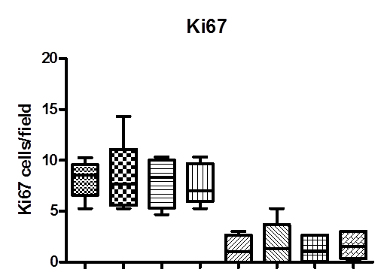
Supplementary figure 5
n.s.
n.s.
WT KO WT KO WT KO WT KO
CI-1040
Dialysis fluid
Sham

