Slide 1
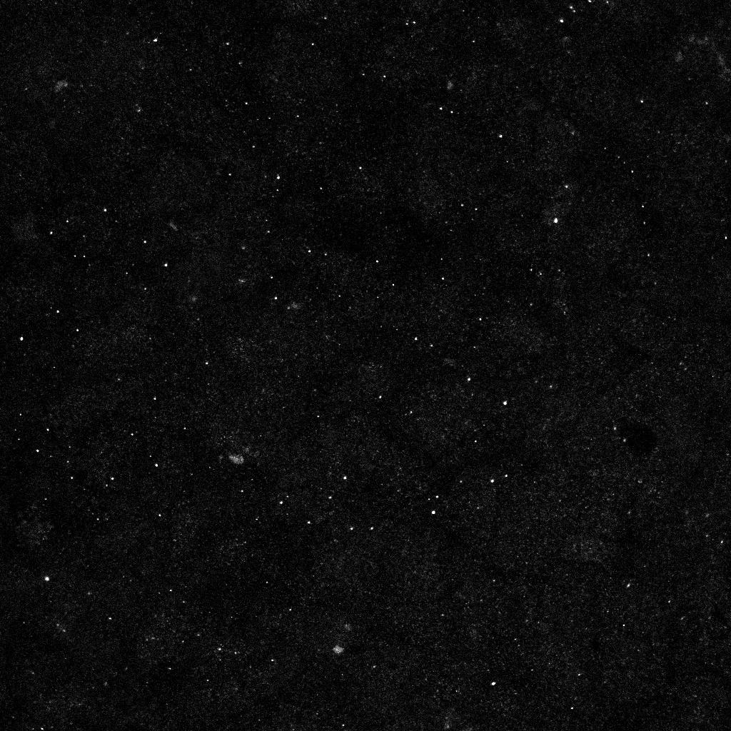
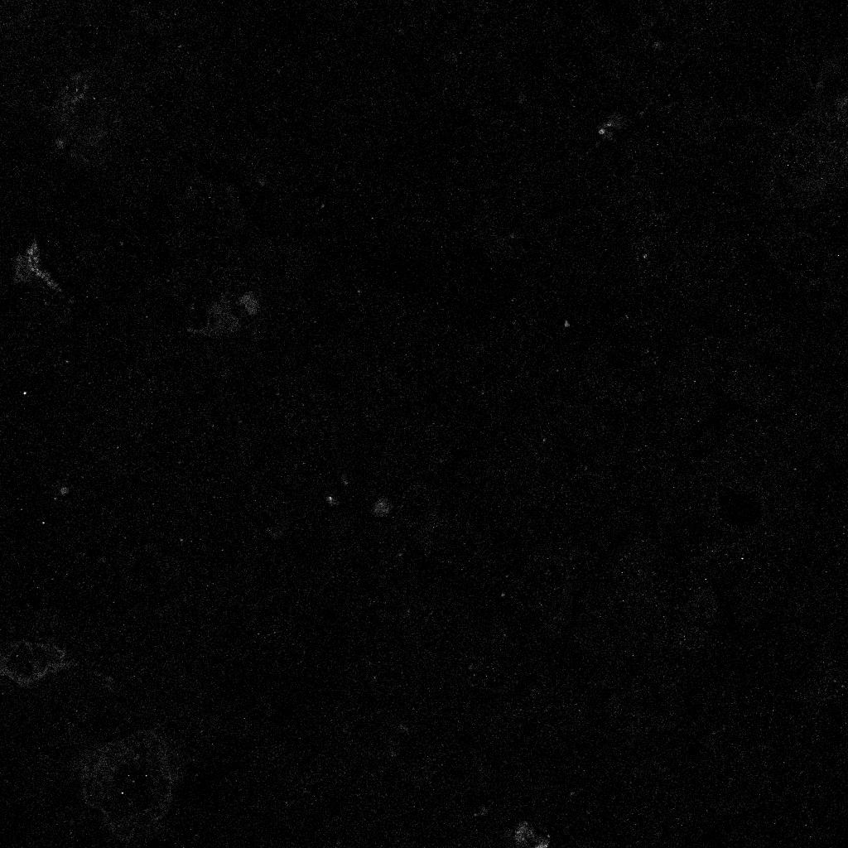
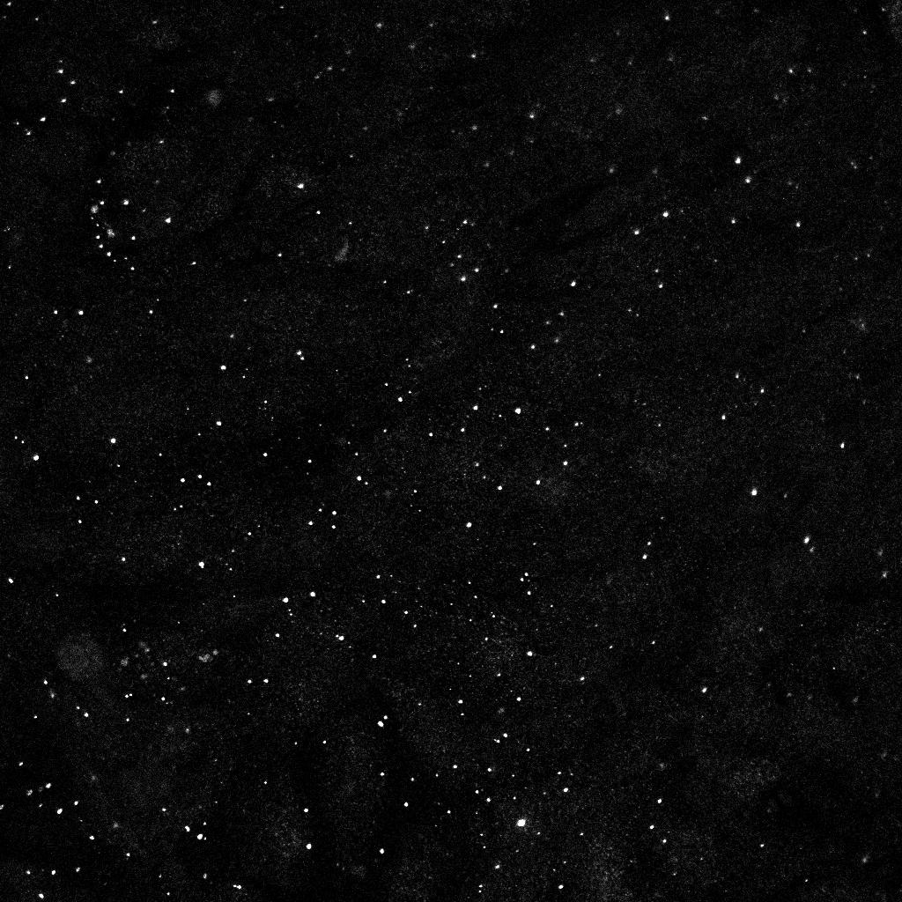
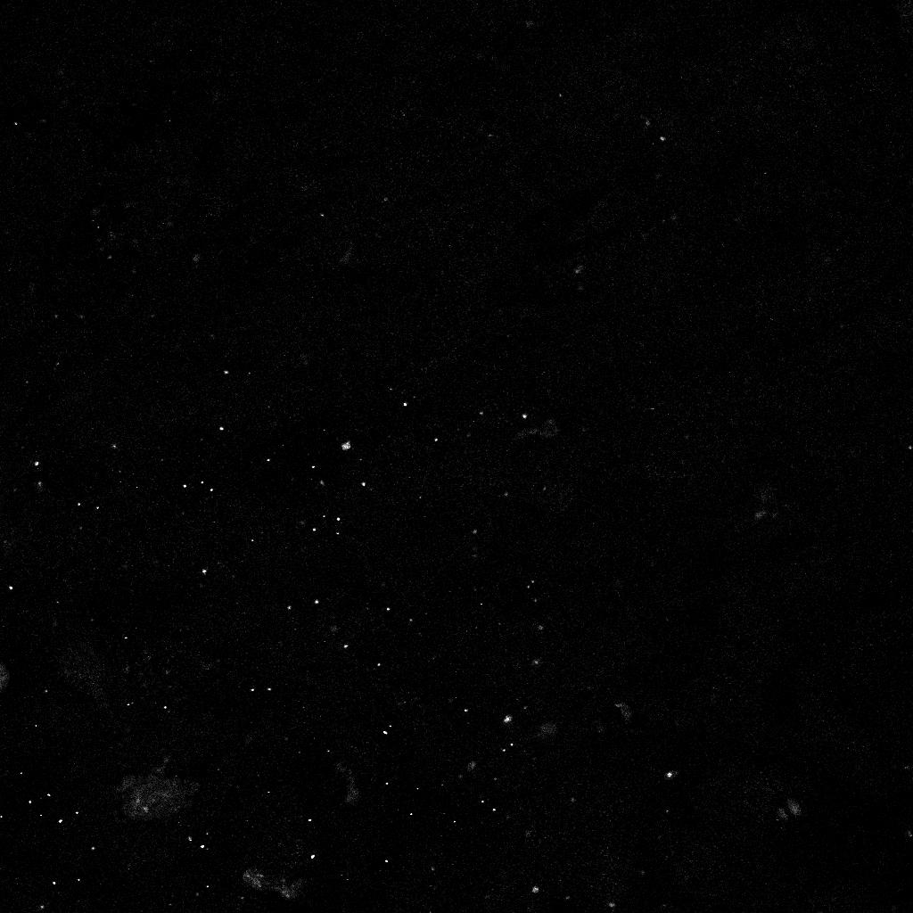
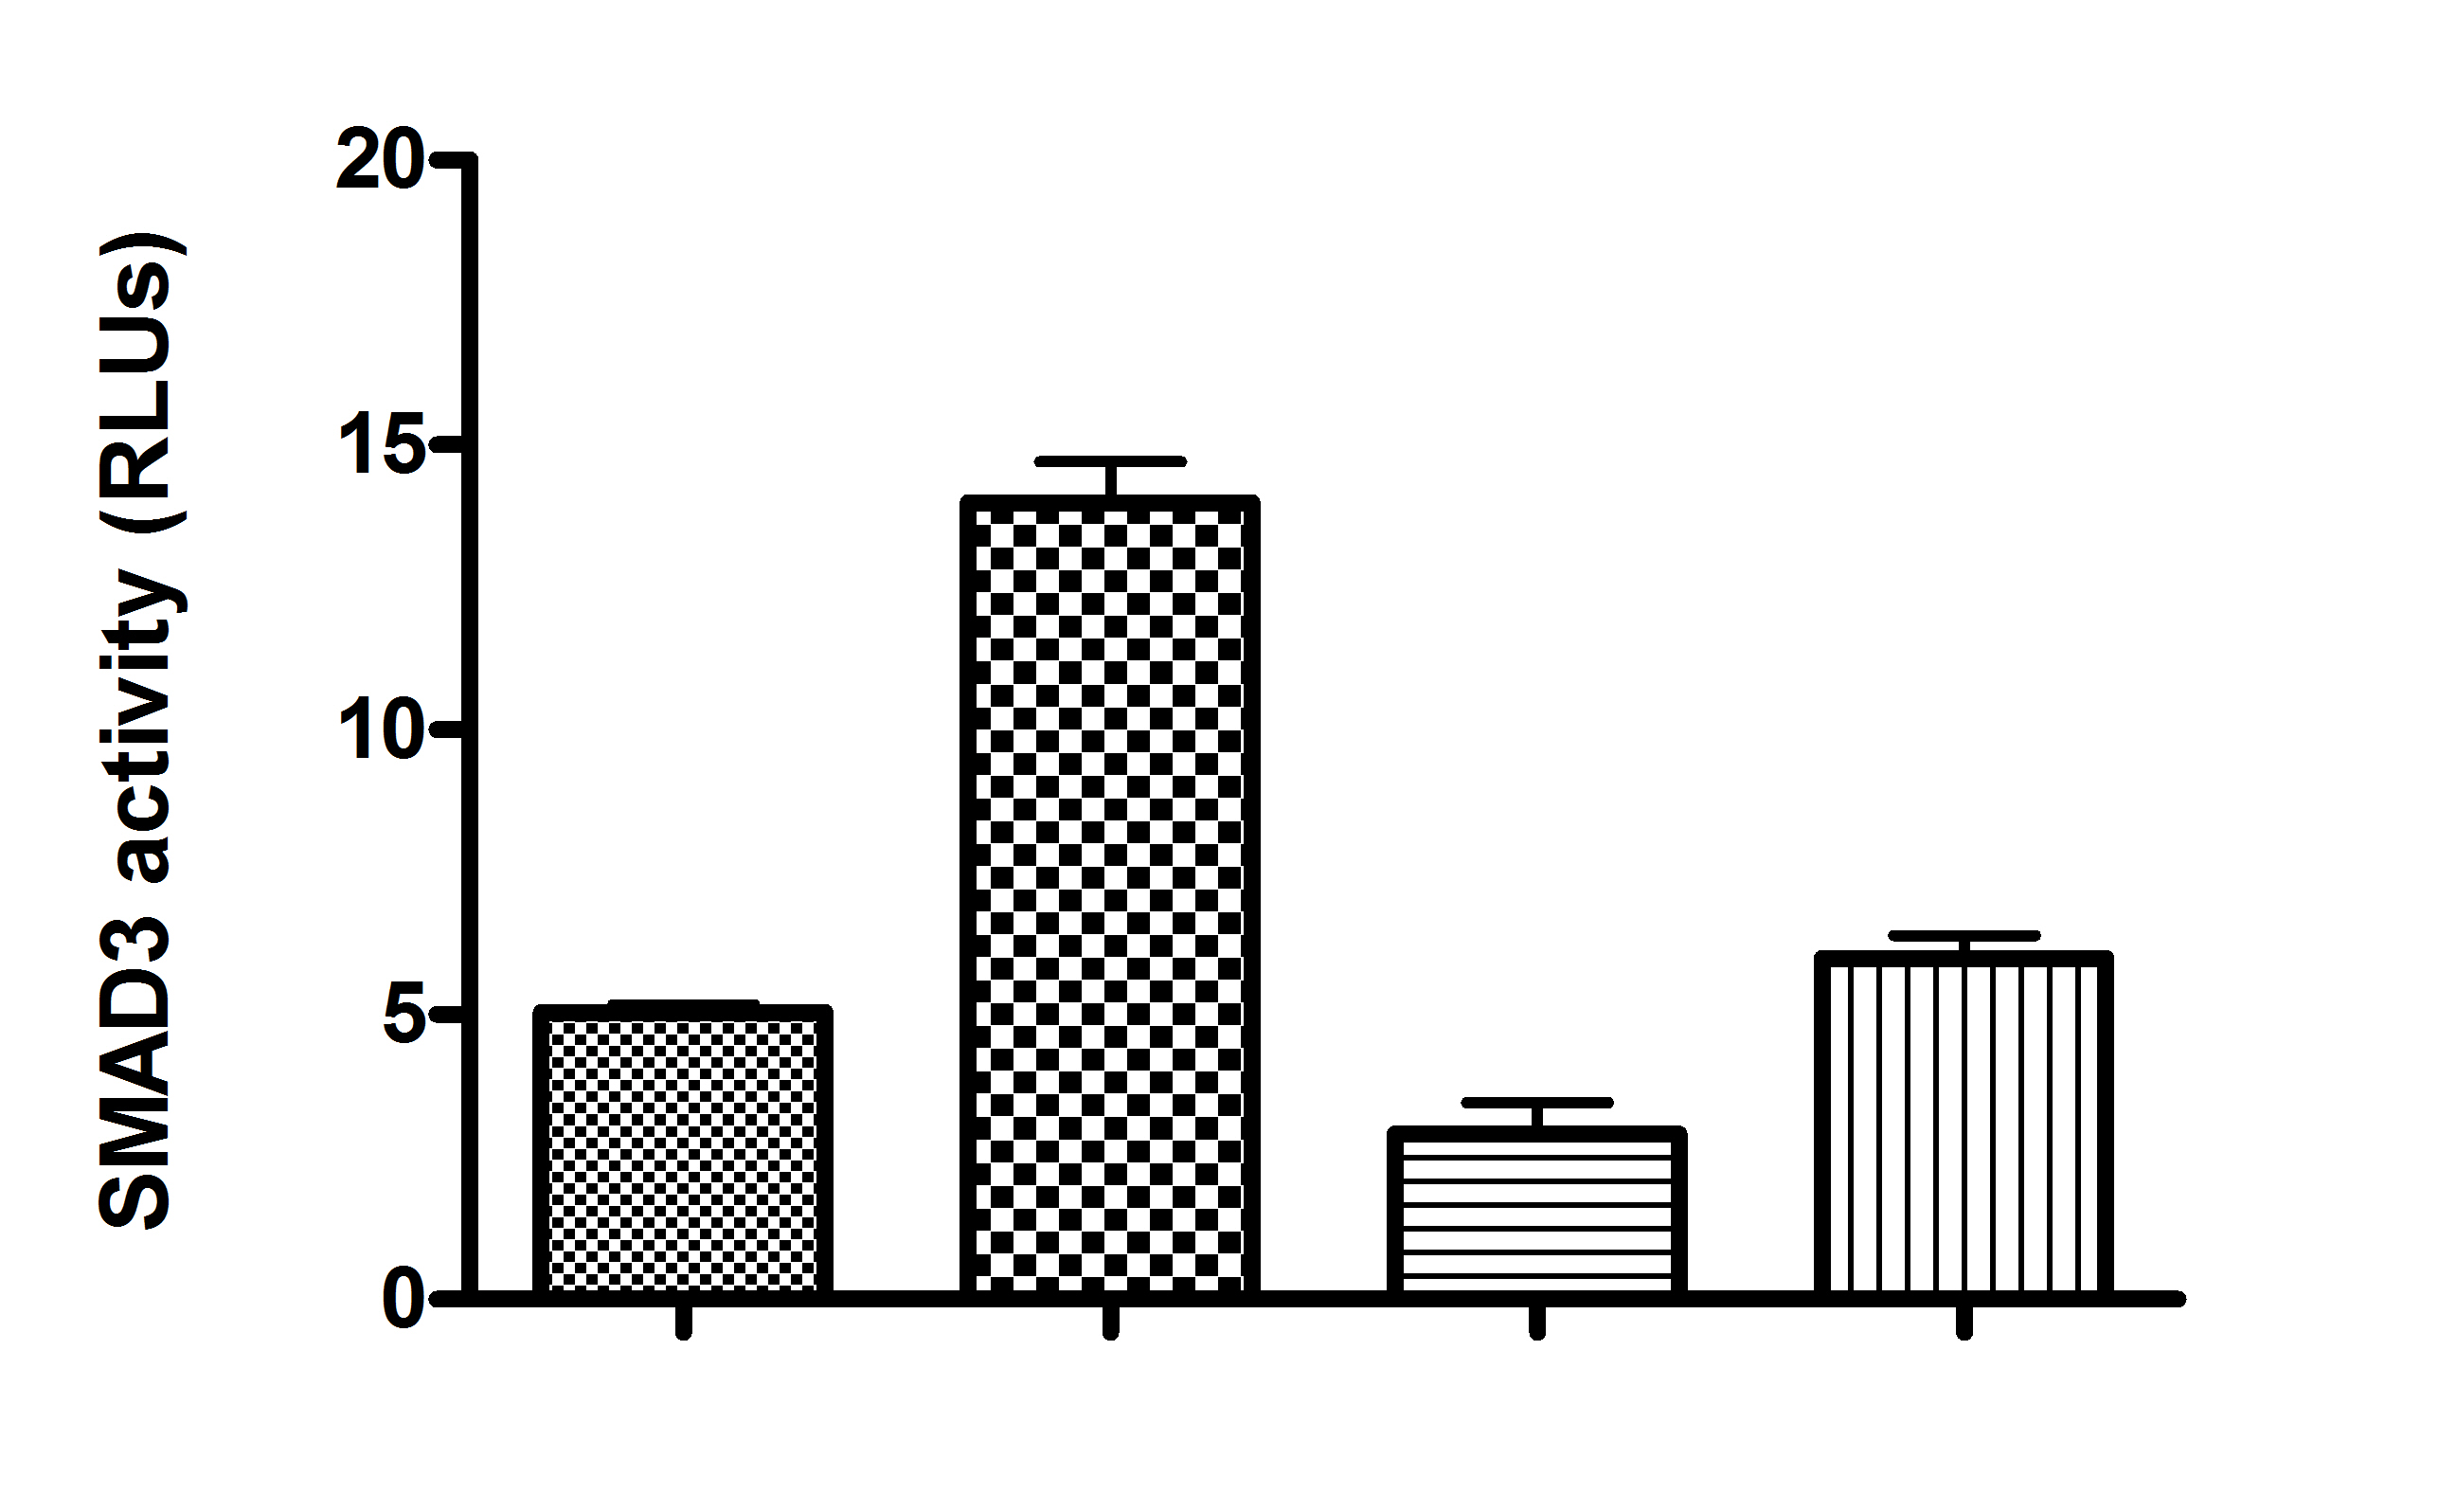
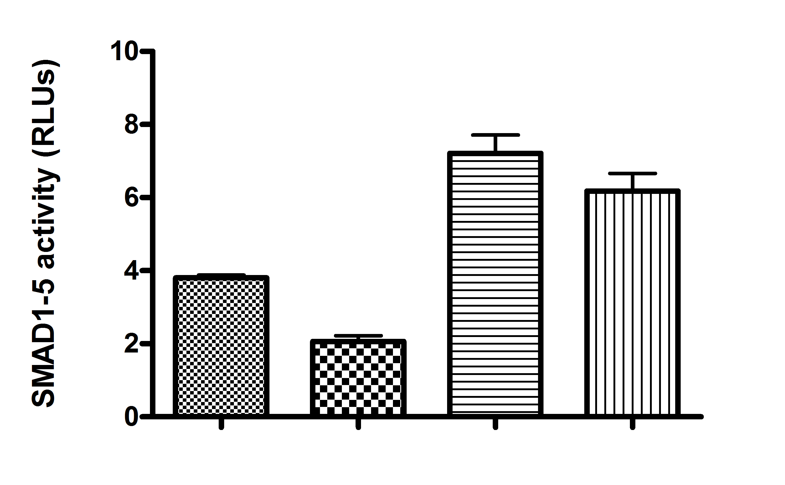

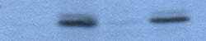

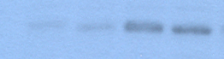
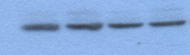


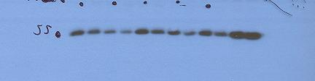

Supplementary Figure 2
A
Hoechst
Snail-1
phosphoMEK1
WT
CI-1040
cav1-/-
CI 1040
A
B
C
*
**
NT T NT T
NT T NT T
DMSO CI 1040
DMSO CI 1040
D
E
scr sicav1 L cav1
DMSO CI 1040
NT T NT T
NT T NT T
NT T NT T
.12 1 .53 1 .43 1 .05 1
.02 1 .07 .74
FN
pSMAD3
.15 .84 .46 1 .29 76 .2 .57
.21 .29 .94 1
PAI-1
pSMAD1-5-8
.0 19 .0 38 .0 1 .0 .45
Snail
tubulin
Cav1
tubulin

