Slide 1
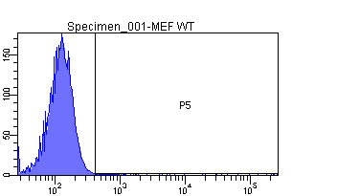
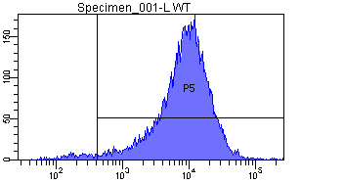
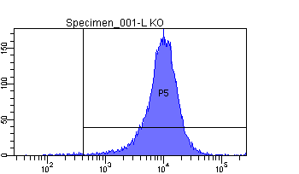
Supplementary Figure 7
cell number
MEF
ICAM1
MPMC
cav1 WT
cell number
ICAM1
MPMC
cav1-/-
cell number
ICAM1

