Slide 1
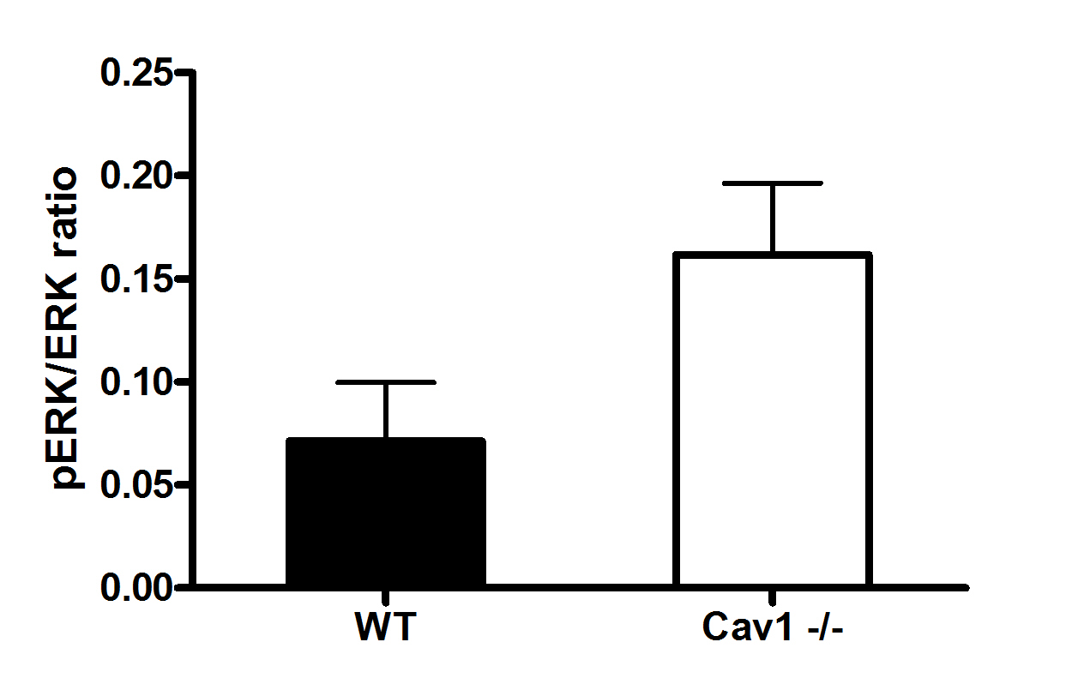
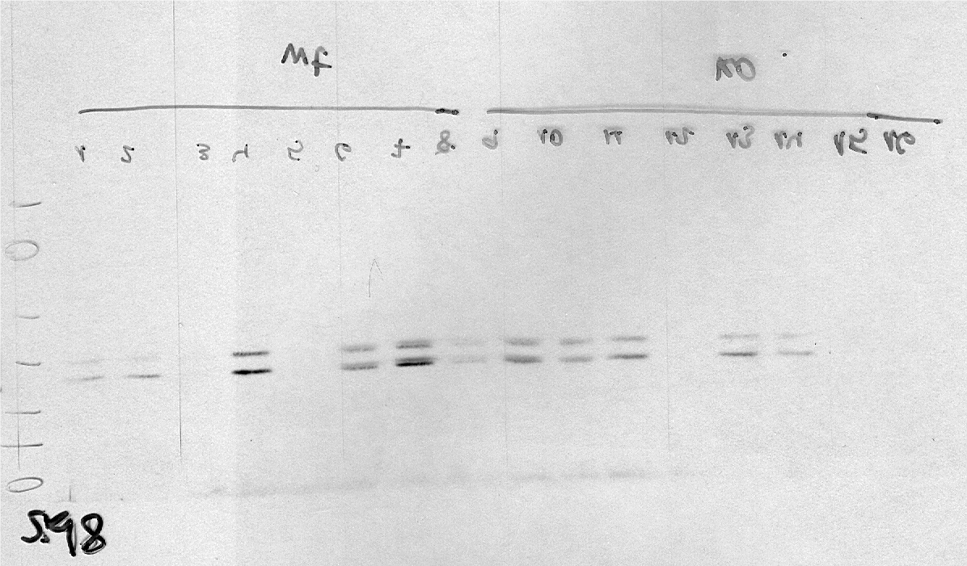
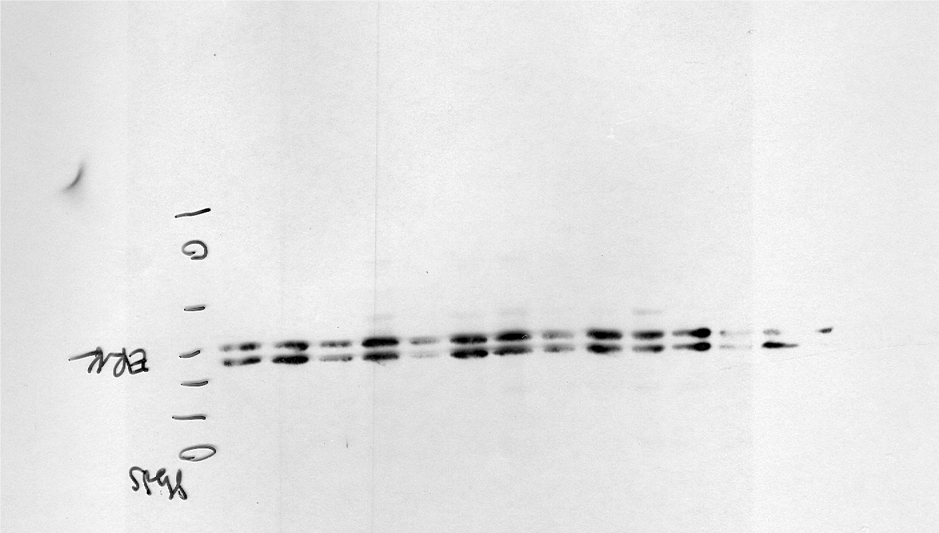
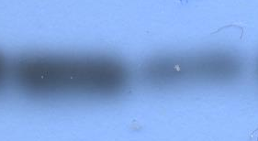
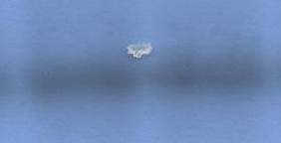
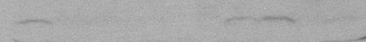
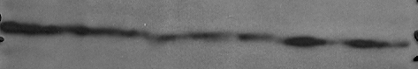
Supplementary Figure 4
A
*
WT
cav1-/-
pERK1/2
ERK1/2
B
NT D
1 .45
Cav1
tubulin
C
CI-1040
diluent
100 300 300
(mg/Kg)
KO WT KO KO WT WT KO KO WT WT
.35 .0 .0 0 .0 .0 .1 .31 .0 .27
pERK1/2
tubulin

