Slide 1
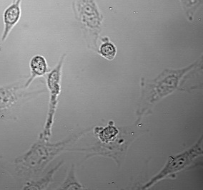
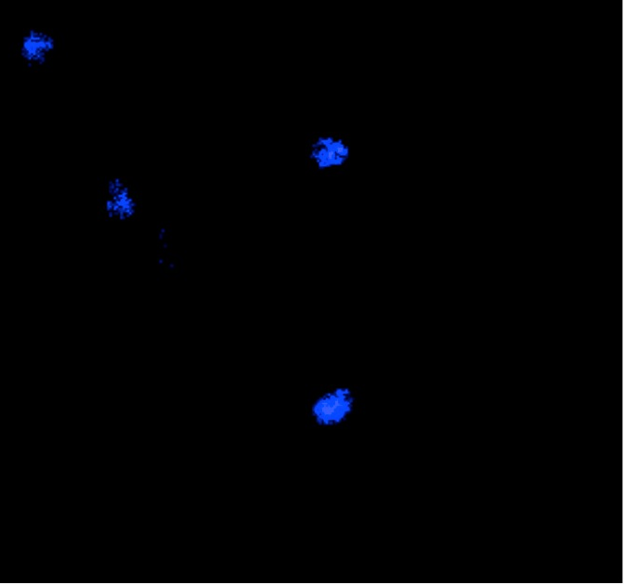

Supplementary Figure S1
T-FGM AhR+/+
Transmitted
DAPI
Alexa 488
20 μm
20 μm
20 μm
Supplementary Figure S1. Negative control for Cav-1 immunofluorescence. T-FGM AhR+/+ fibroblasts were grown, fixed and processed for immunofluorescence using the same conditions as in Fig. 1 except that the anti-Cav-1 antibody was not included. Secondary antibody used was Alexa 488. Cell nuclei were stained with DAPI. Transmitted light images were also taken from the same cultures. Bar corresponds to 50 μm.

