Slide 1
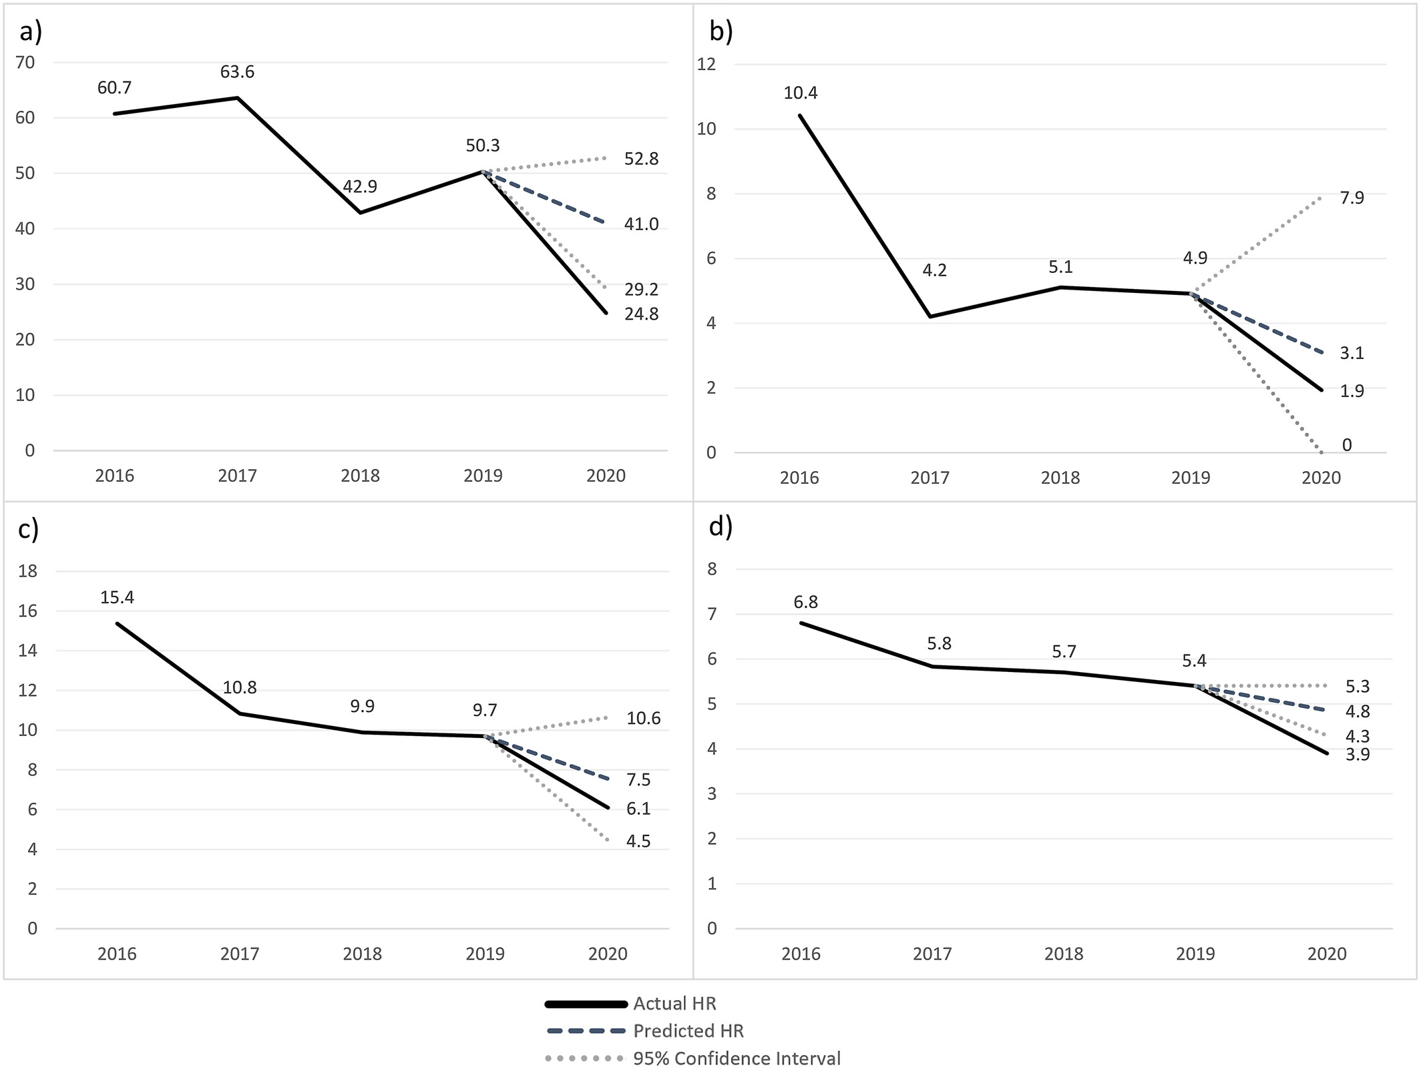
Trends in Paediatric Viral Meningitis and Encephalitis With Unconfirmed Aetiology: A Spanish Population‐Based Study, 2016–2020
Acta Paediatrica, Volume: 114, Issue: 9, Pages: 2298-2305, First published: 23 April 2025, DOI: (10.1111/apa.70107)
Notes:
Forecasting hospitalisation rates in Spain for paediatric meningitis and encephalitis‐encephalomyelitis of unknown origin by age group in 2020. (a) < 1 year (b) 1–4 years (c) 5–9 years (d) 10–14 years.
IF THIS IMAGE HAS BEEN PROVIDED BY OR IS OWNED BY A THIRD PARTY, AS INDICATED IN THE CAPTION LINE, THEN FURTHER PERMISSION MAY BE NEEDED BEFORE ANY FURTHER USE. PLEASE CONTACT WILEY'S PERMISSIONS DEPARTMENT ON PERMISSIONS@WILEY.COM OR USE THE RIGHTSLINK SERVICE BY CLICKING ON THE 'REQUEST PERMISSIONS' LINK ACCOMPANYING THIS ARTICLE. WILEY OR AUTHOR OWNED IMAGES MAY BE USED FOR NON-COMMERCIAL PURPOSES, SUBJECT TO PROPER CITATION OF THE ARTICLE, AUTHOR, AND PUBLISHER.

