Slide 1
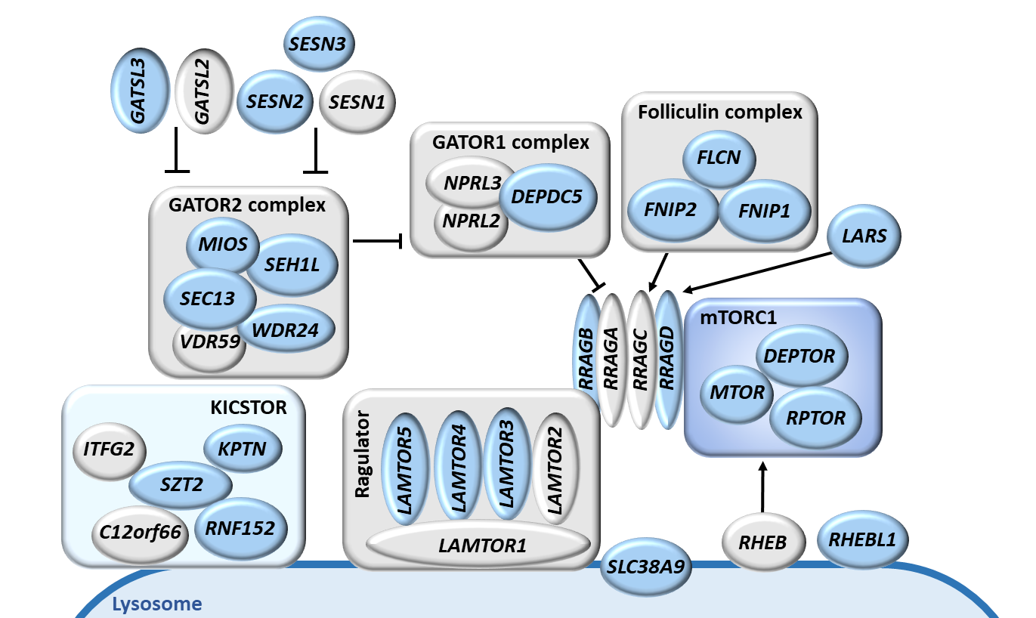
Figure S1. Components of the nutrient-mTORC1 pathway.
Cartoon with the regulatory network of genes within the mTORC1 pathway. Genes with SNPs included in the analysis are depicted in light blue.

Slide 2
Figure S2 (related to main Figure 1). Genetic associations.
A
B
C
D
Representation of −log10 p-values for associations of SNPs in each studied gene and metabolic characteristics in 790 volunteers. Each point represents one SNP within a gene. Associations of the SNPs with phenotypic characteristics were modeled through linear regression on the SNP adjusted by sex and age. The −log10 p-values following an additive model for the SNPs (effect in the homozygote minor allele is twice as much as that of the heterozygote) were represented.

Slide 3
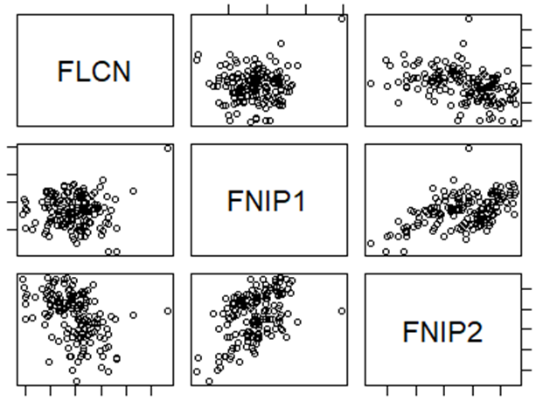
Figure S3 (related to main Figure 3). Transcriptomic consequences of rs2291007.
A
p=0.99
p=0.18
p=0.35
B
-4
-2
0
2
FLCN
-3
-5
Matrix of Pearson Correlation Coefficients
-7
 | FLCN | FNIP1 | FNIP2
FLCN | 1.000 | 0.064 | -0.429
FNIP1 | 0.064 | 1.000 | 0.491
FNIP2 | -0.429 | 0.491 | 1.000
2
0
FNIP1
2
Matrix of p.values of Correlation Test
-4
 | FLCN | FNIP1 | FNIP2
FLCN |  | 0.42 | 1.41e-08
FNIP1 |  |  | 3.64e-11
FNIP2
FNIP2
-4
-6
-8
-7
-6
-5
-4
-3
-2
-8
-7
-6
-5
-4
A. Correlation between FNIP2 and miR-181b expression in 89 healthy volunteers, according to their rs2291007 alleles. B. Correlation among FNIP2, FNIP1 and FLCN expression in 161 healthy volunteers. Associations between gene expression variables were analyzed through Pearson correlation coefficients.

Slide 4
Figure S4 (related to main Figure 4). A Fnip2^{C} Knock-in mouse to model FNIP2 rs2291007.
A
B
Sequence
miR-181b-5p binding prediction
Breeding: Fnip2^{T/C} x Fnip2^{T/C}
Fnip2^{T/T} | Fnip2^{T/C} | Fnip2^{C/C}
24.04% (25%) | 53.01% (50%) | 22.95% (25%)
TGTATAGG
✓
TGTATACG
✓
CGTATAGG
✗
CGTATACG
✗
C
Fnip2
D
p=0.5141
p=0.2957
Fnip2^{T/T}
ns
Fnip2^{C/C}
ns
Fnip2
T/T
C/C
T/T
C/C
Liver
WAT
A. Predictions for miR-181b-5p binding (Sfold) in Fnip2 3’UTR mouse sequences containing the T allele, the T allele plus the mutation introduced in the PAM, the C allele and the C allele plus the mutation introduced in the PAM. B. Progenies of Fnip2^{T/C} x Fnip2^{T/C} breeding scheme. C. RT-qPCR from liver and gonadal white adipose tissue (WAT) obtained from Fnip2^{T/T} (n=8) and Fnip2^{C/C} (n=9) mice after 16h fasting. Fnip2 mRNA levels are normalized by β-actin levels and relativized to the levels in Fnip2^{T/T}. Statistical significance was calculated by using unpaired two-tailed t-test. D. MEFs obtained from Fnip2^{T/T} (n=3) and Fnip2^{C/C} (n=3) mice were placed in complete RPMI medium or RPMI without amino acids for 2 hours and levels of miR-181b-5p were measured by RT-qPCR using TaqMan probes. miR-181b-5p levels are normalized by snoRNA 202 levels and made relative to the levels in Fnip2^{T/T} +AA.

Slide 5
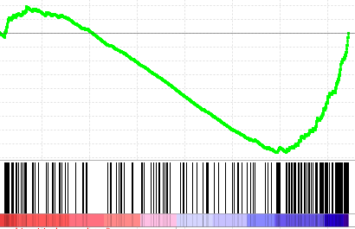
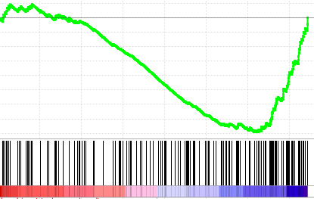
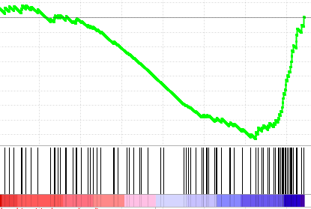
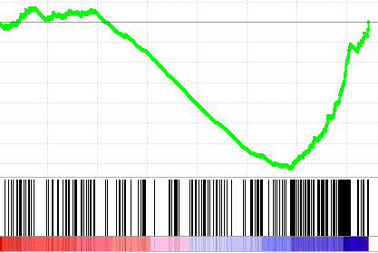
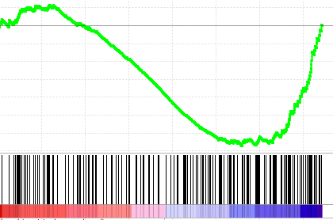
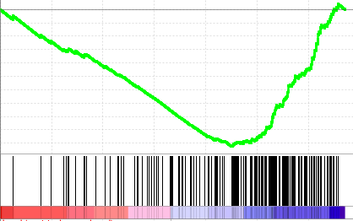
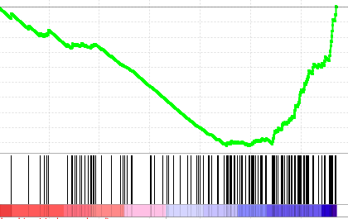
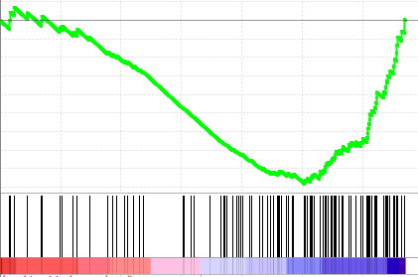
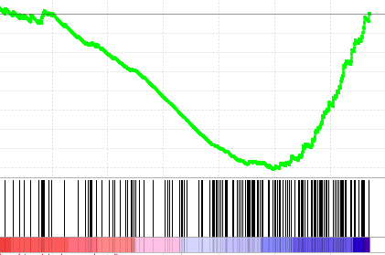
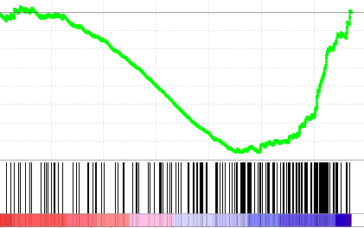
Figure S5 (related to main Figure 5). Impact of the engineered T-to-C substitution on mouse adiposity.
A
p=0.3650
C
p=0.0603
p=0.3004
R²=0.03048
R²=0.03964
B
Fnip2
T/T
C/C
p<0.0001
p<0.0001
p<0.0001
R²=0.5563
R²=0.5923
R²=0.6040
Fnip2 mRNA levels
Fnip2 mRNA levels
Fnip1 mRNA levels
D
Cohort #1
16h fasting
E
Oxidative phosphorylation
Xenobiotic
metabolism
Peroxisome
p=0.1036
p=0.3068
p=0.0458
NES = -2.01
FDR = 0
NES = -1.83
FDR = 0.005
NES = -1.74
FDR = 0.011
Fnip2^{C/C}
Fnip2^{T/T}
Fnip2^{C/C}
Fnip2^{T/T}
Fnip2^{C/C}
Fnip2^{T/T}
Adipogenesis
mTORC1
signaling
NES = -1.69
FDR = 0.016
NES = -1.57
FDR = 0.041
WAT
Fnip2
T/T
C/C
T/T
C/C
T/T
C/C
Fnip2^{C/C}
Fnip2^{T/T}
Fnip2^{C/C}
Fnip2^{T/T}
Cohort #2
ad libitum
F
Oxidative phosphorylation
Fatty acid
metabolism
Bile acid
metabolism
p=0.0146
p=0.0581
p=0.0864
NES = -2.47
FDR = 0
NES = -2.10
FDR = 0
NES = -1.97
FDR = 0
Fnip2^{C/C}
Fnip2^{T/T}
Fnip2^{C/C}
Fnip2^{T/T}
Fnip2^{C/C}
Fnip2^{T/T}
Adipogenesis
Xenobiotic
metabolism
Fnip2
T/T
C/C
T/T
C/C
T/T
C/C
NES = -1.92
FDR = 0
NES = -1.81
FDR = 0.002
Liver
Fnip2^{C/C}
Fnip2^{T/T}
Fnip2^{C/C}
Fnip2^{T/T}
A. Correlation between Fnip1 and Flcn mRNA levels in livers from Fnip2^{T/T} (n=14) and Fnip2^{C/C} (n=15) mice and their body weight. B. Correlation between Fnip2, Fnip1 and Flcn mRNA levels in livers from Fnip2^{T/T} (n=14) and Fnip2^{C/C} (n=15) mice. C. Fat content obtained by measuring body composition in 71-82w old Fnip2^{T/T} (n=9) and Fnip2^{C/C} (n=6) females. D. Weight of different fat depots in two cohorts of 16h-fasted 23-27w old Fnip2^{T/T} (n=8) and Fnip2^{C/C} (n=9) and ad libitum fed 17w old Fnip2^{T/T} (n=3) and Fnip2^{C/C} (n=5) females. E and F. Enrichment plots of top 5 enriched gene sets in Fnip2^{T/T} WAT (E) and livers (F). NES: Normalized Enrichment Score. FDR: False Discovery Rate.

Slide 6
Figure S6. Un-cropped Western blots
250
250
180
180
130
TFEB
130
95
95
P-T389-S6K
72
72
55
55
55
β-Actin
43
250
180
130
34
95
S6K
26
72
55

