Slide 1
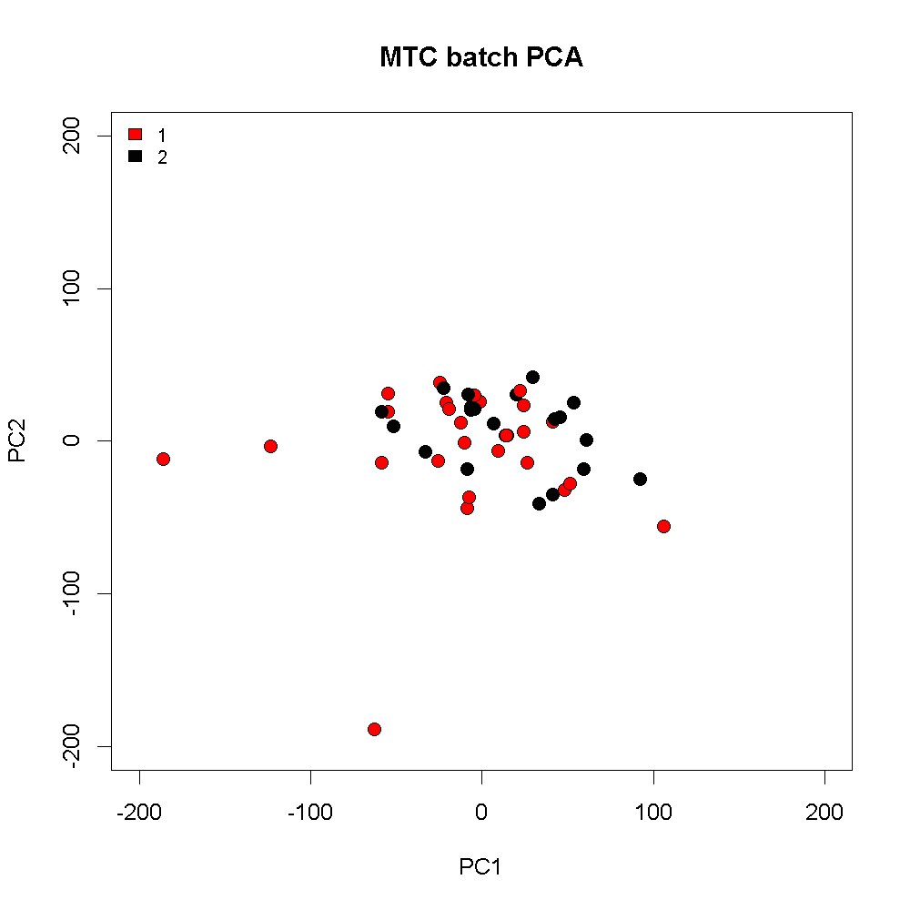
Supplementary Figure S2.
A principal component analysis using 14,346 probes did not reveal any apparent batch effect between the two arrays.

