Slide 1
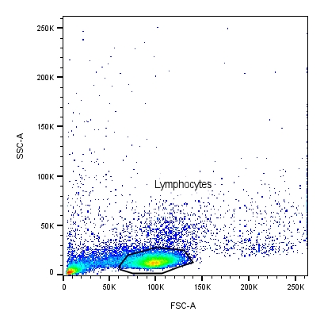
Supplemental Figure 1. Gating strategy to analyze CD8+ T cells (CD3+CD8+), NKT-like cells (CD3+CD56+) , and Tγδ cell populations (CD3+CD8±TCRγδ+) (A) and NK cells (CD3-CD56+) (B) by flow cytometry from PBMCs of the participants.
A
CD3 staining
CD8+ T cells
CD107a staining
CD56 staining
CD8- Tγδ cells
CD8+ Tγδ cells
CD107a staining
NKT-like cells
CD107a staining

Slide 2
B
CD3 staining
NK cells
CD107a staining

