Slide 1
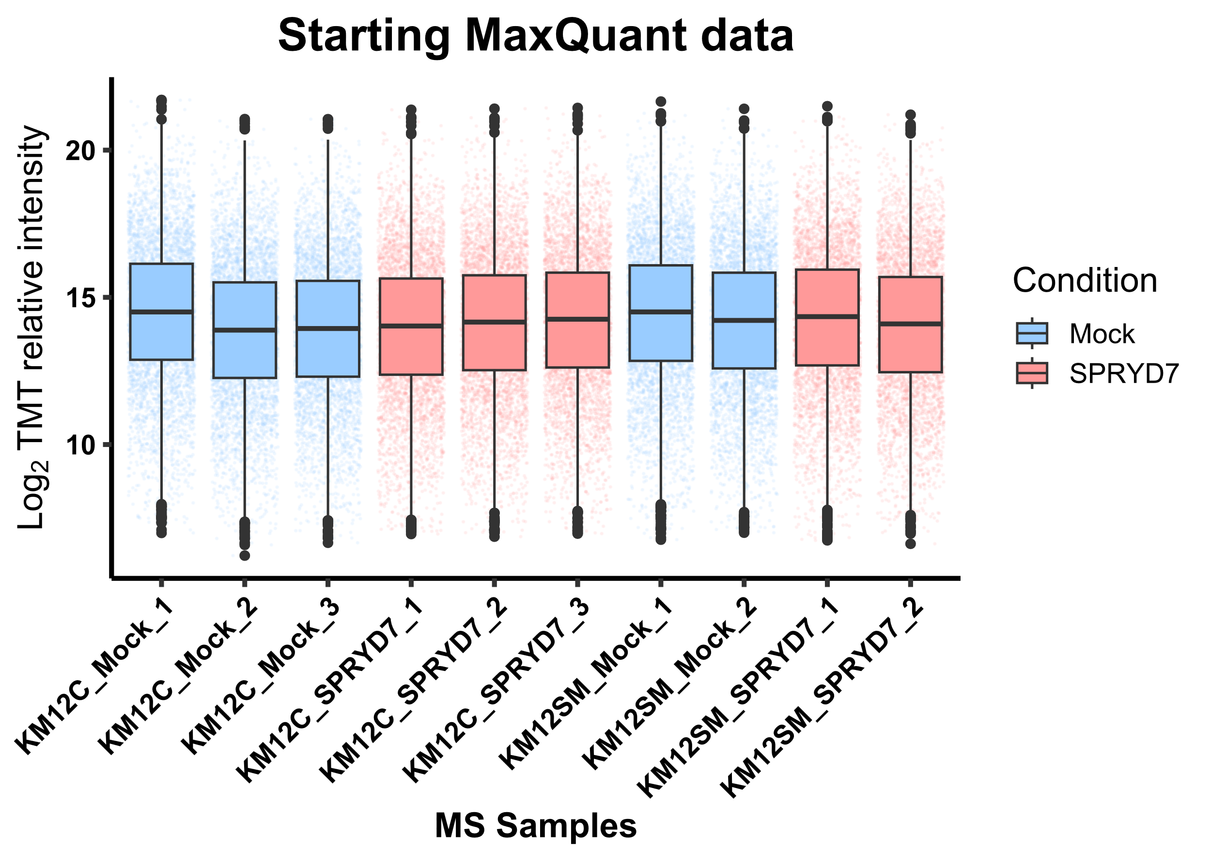
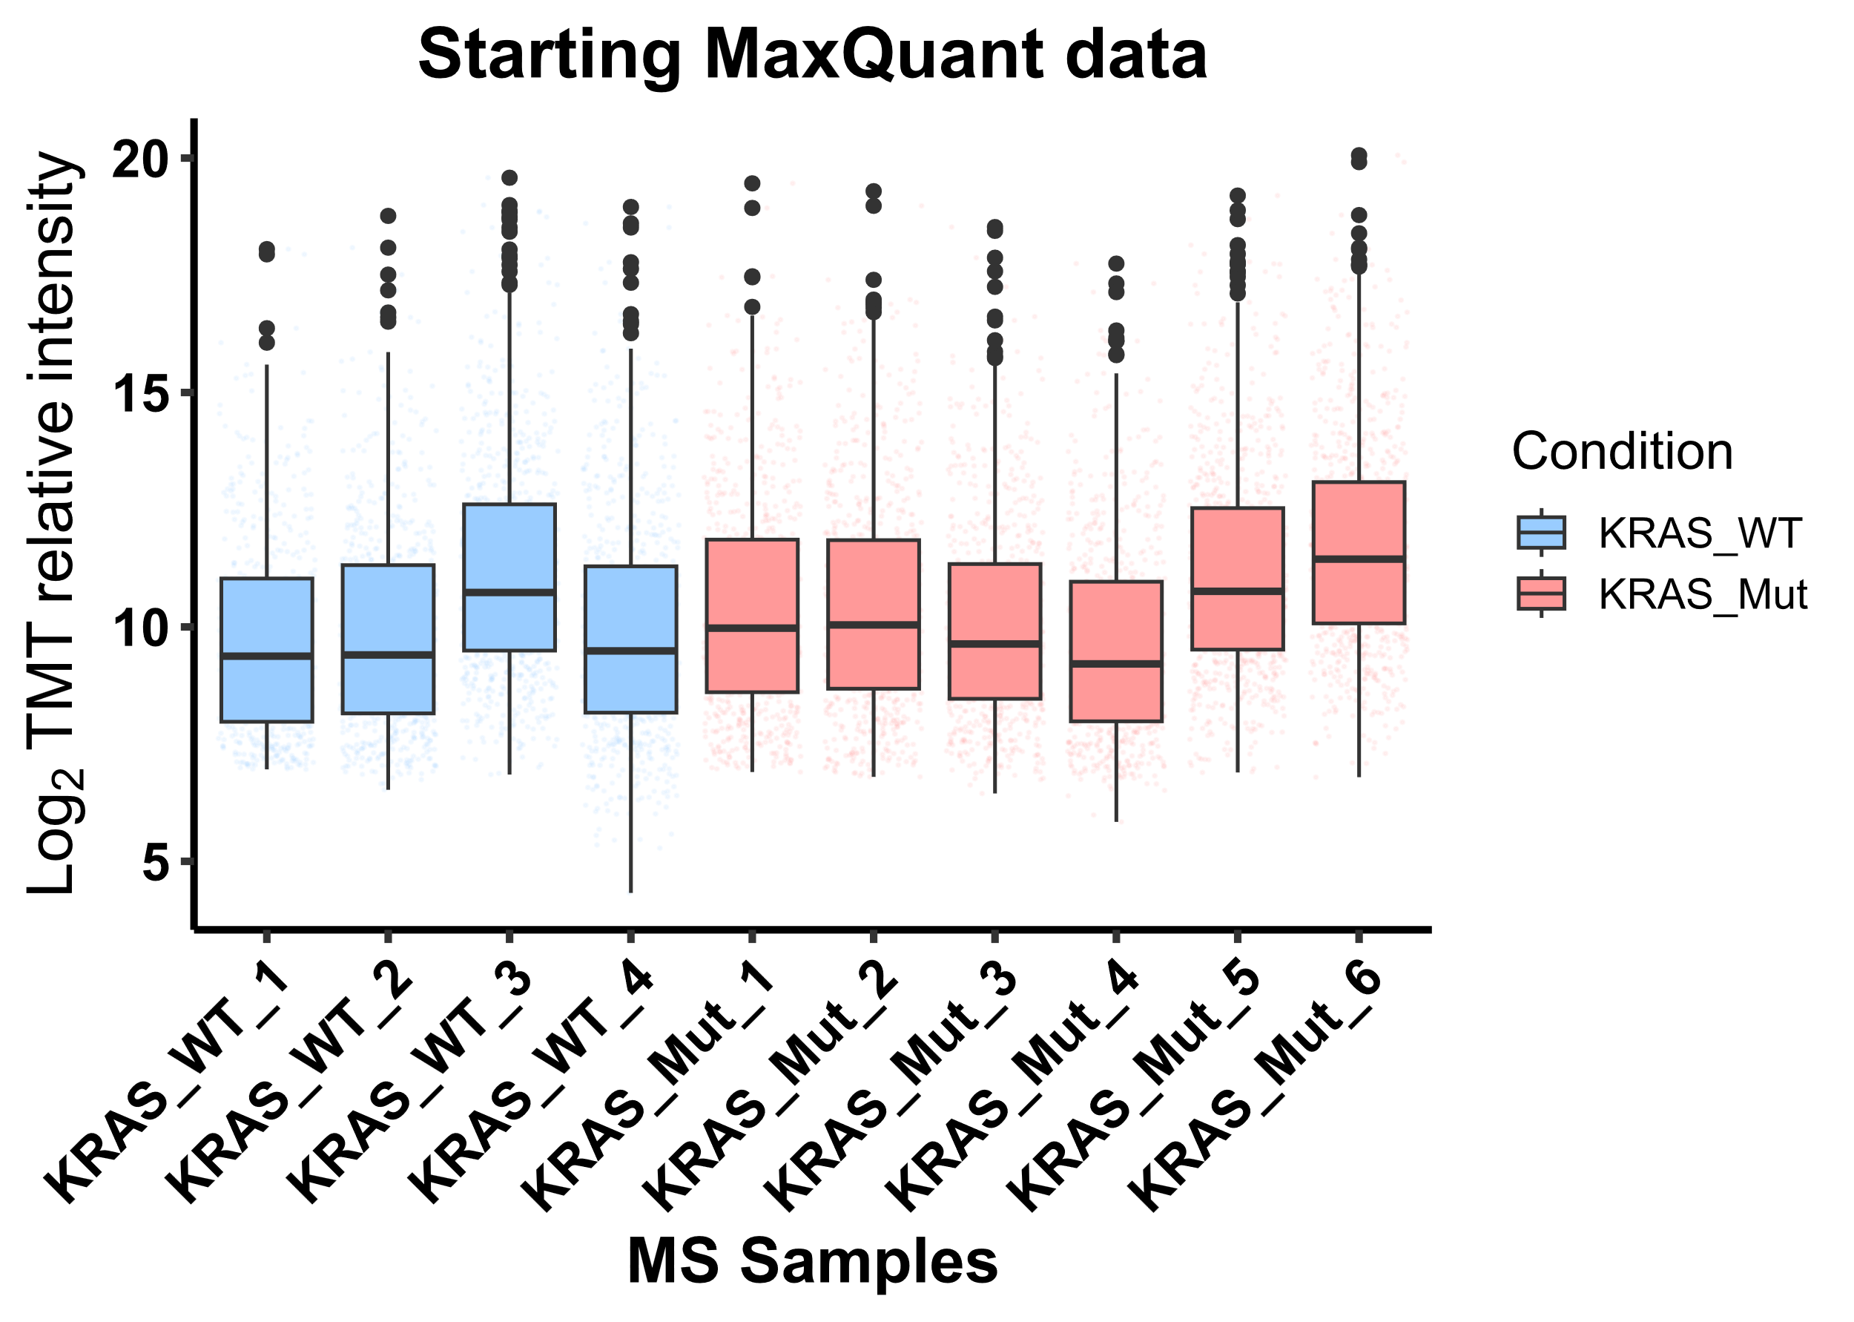
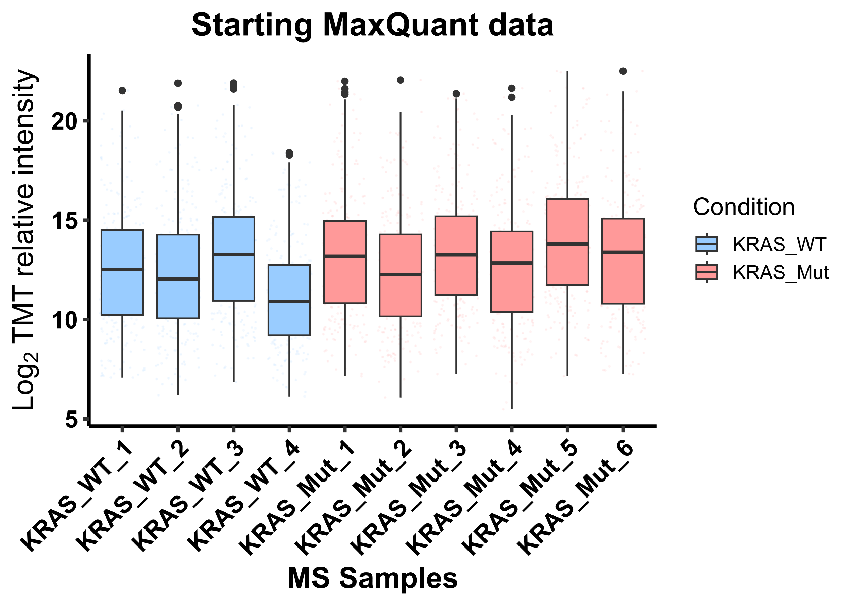
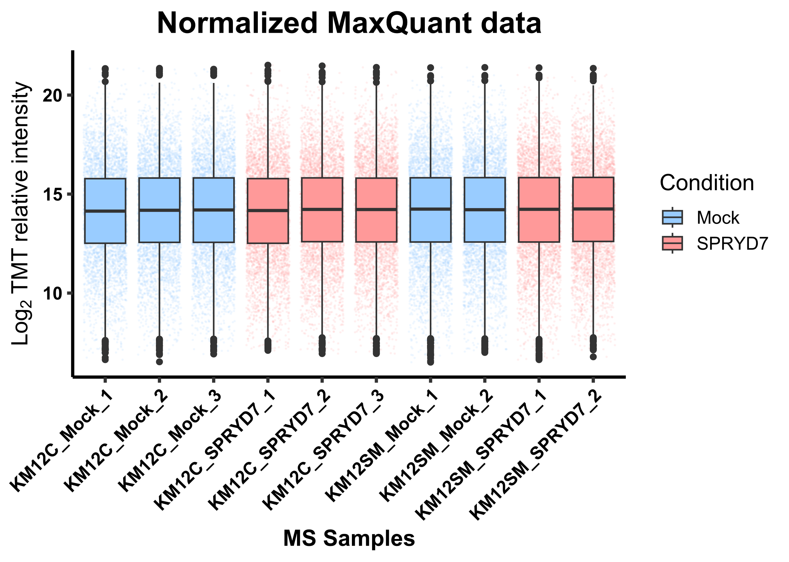
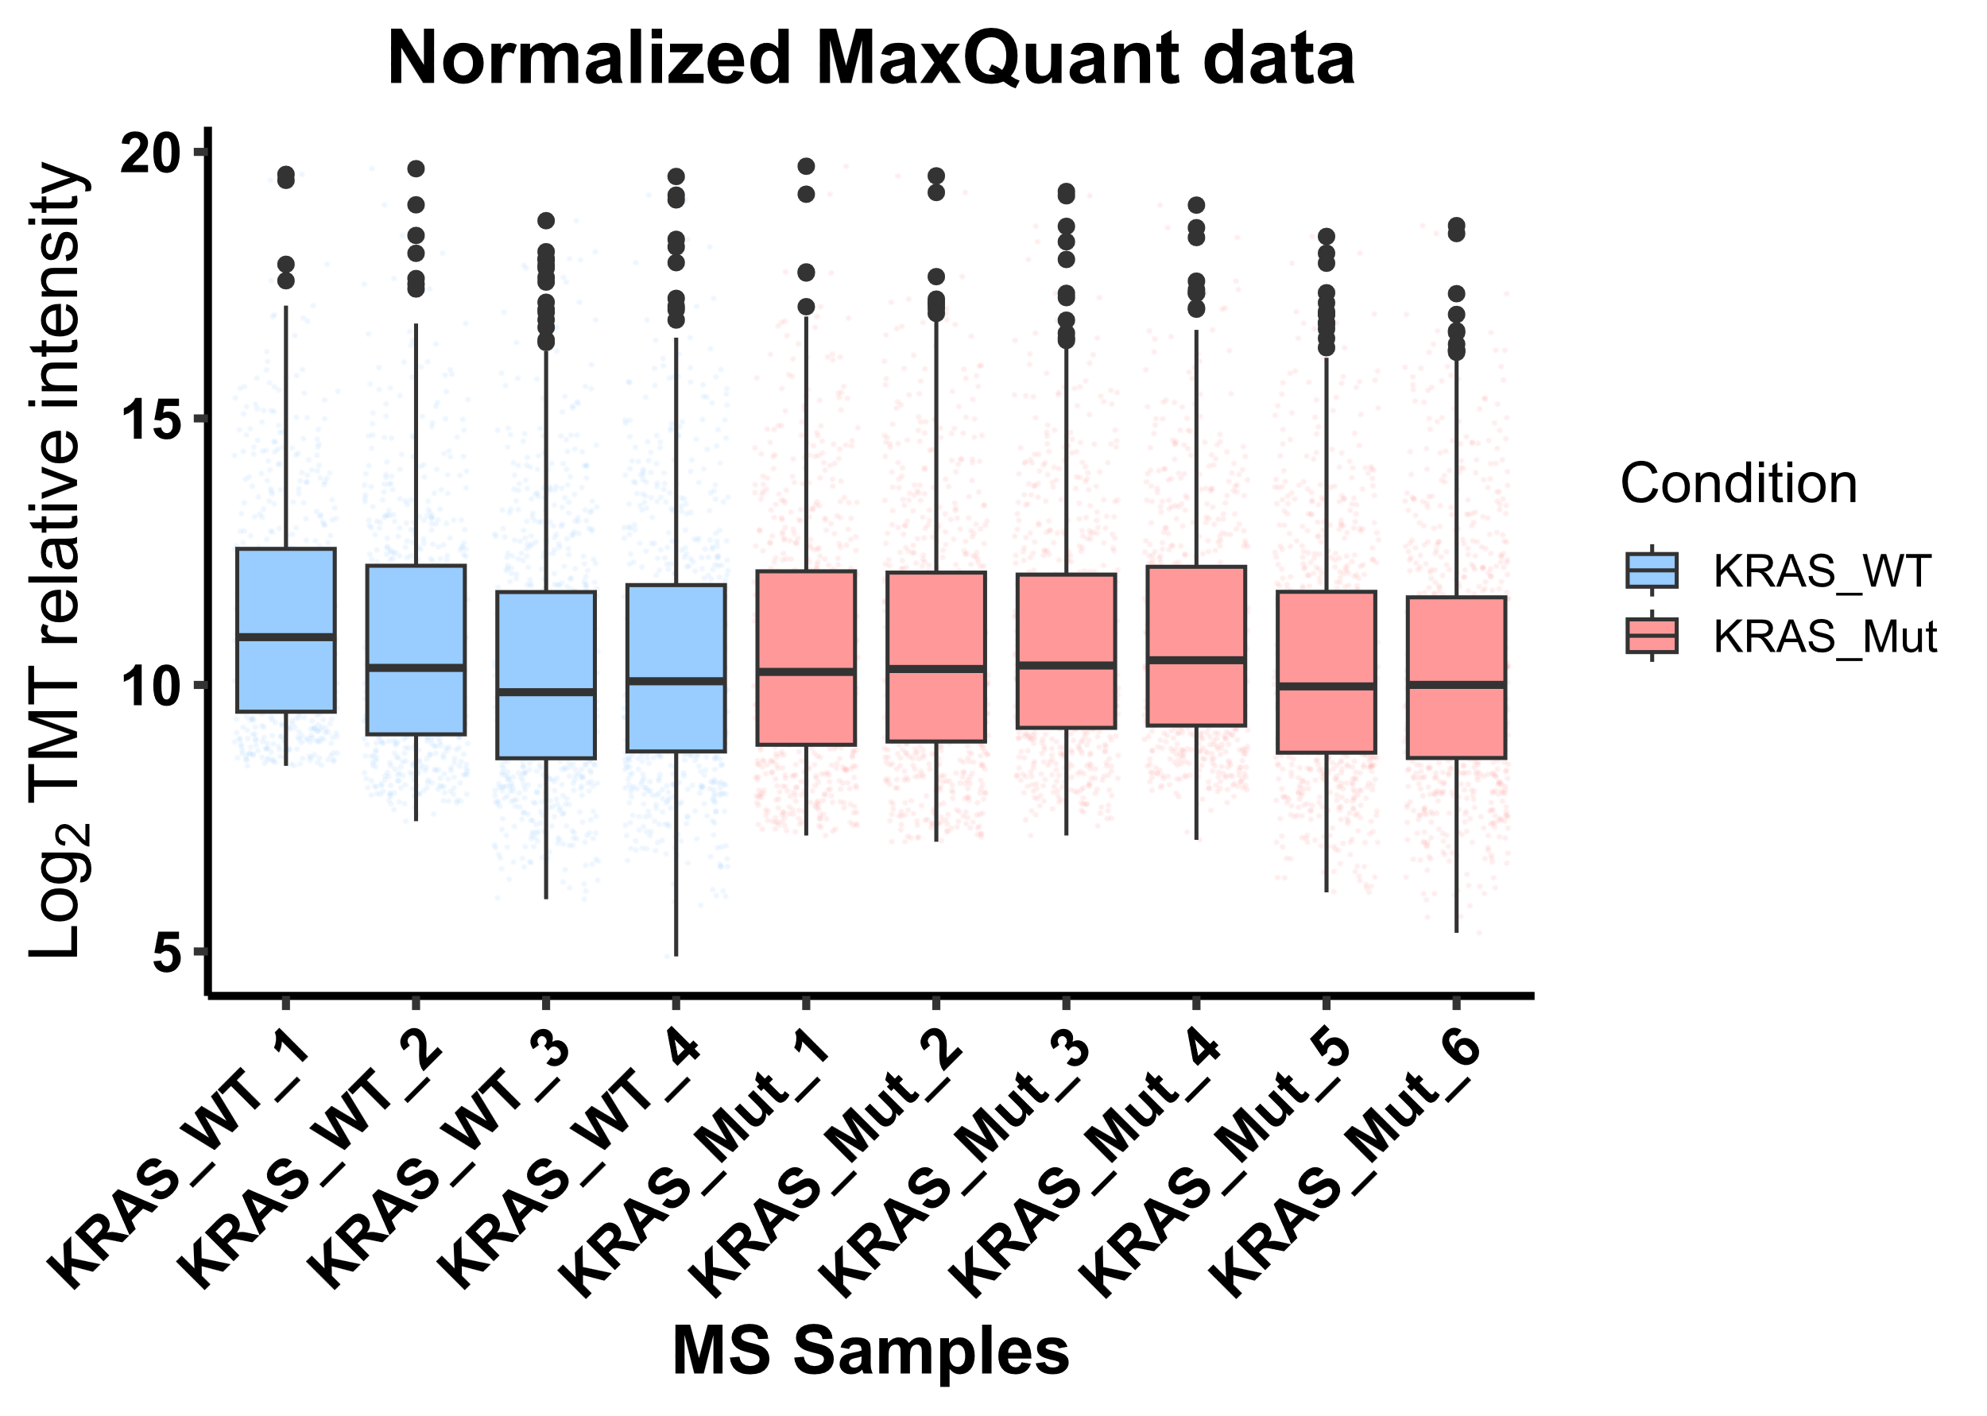
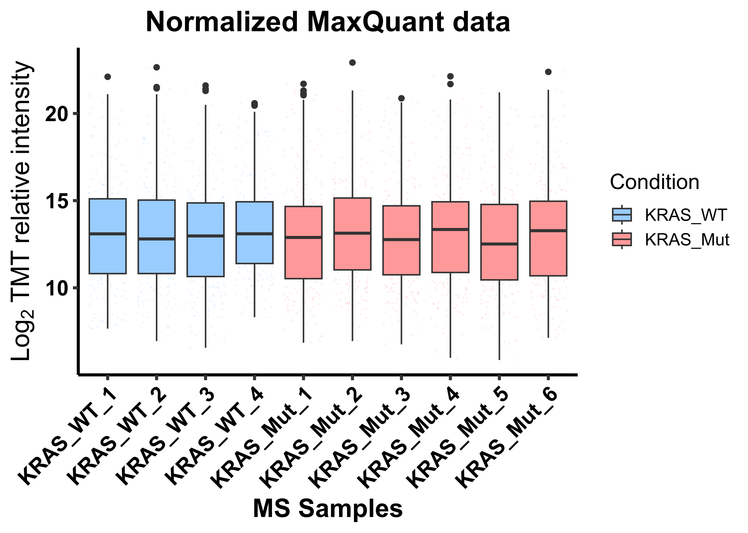
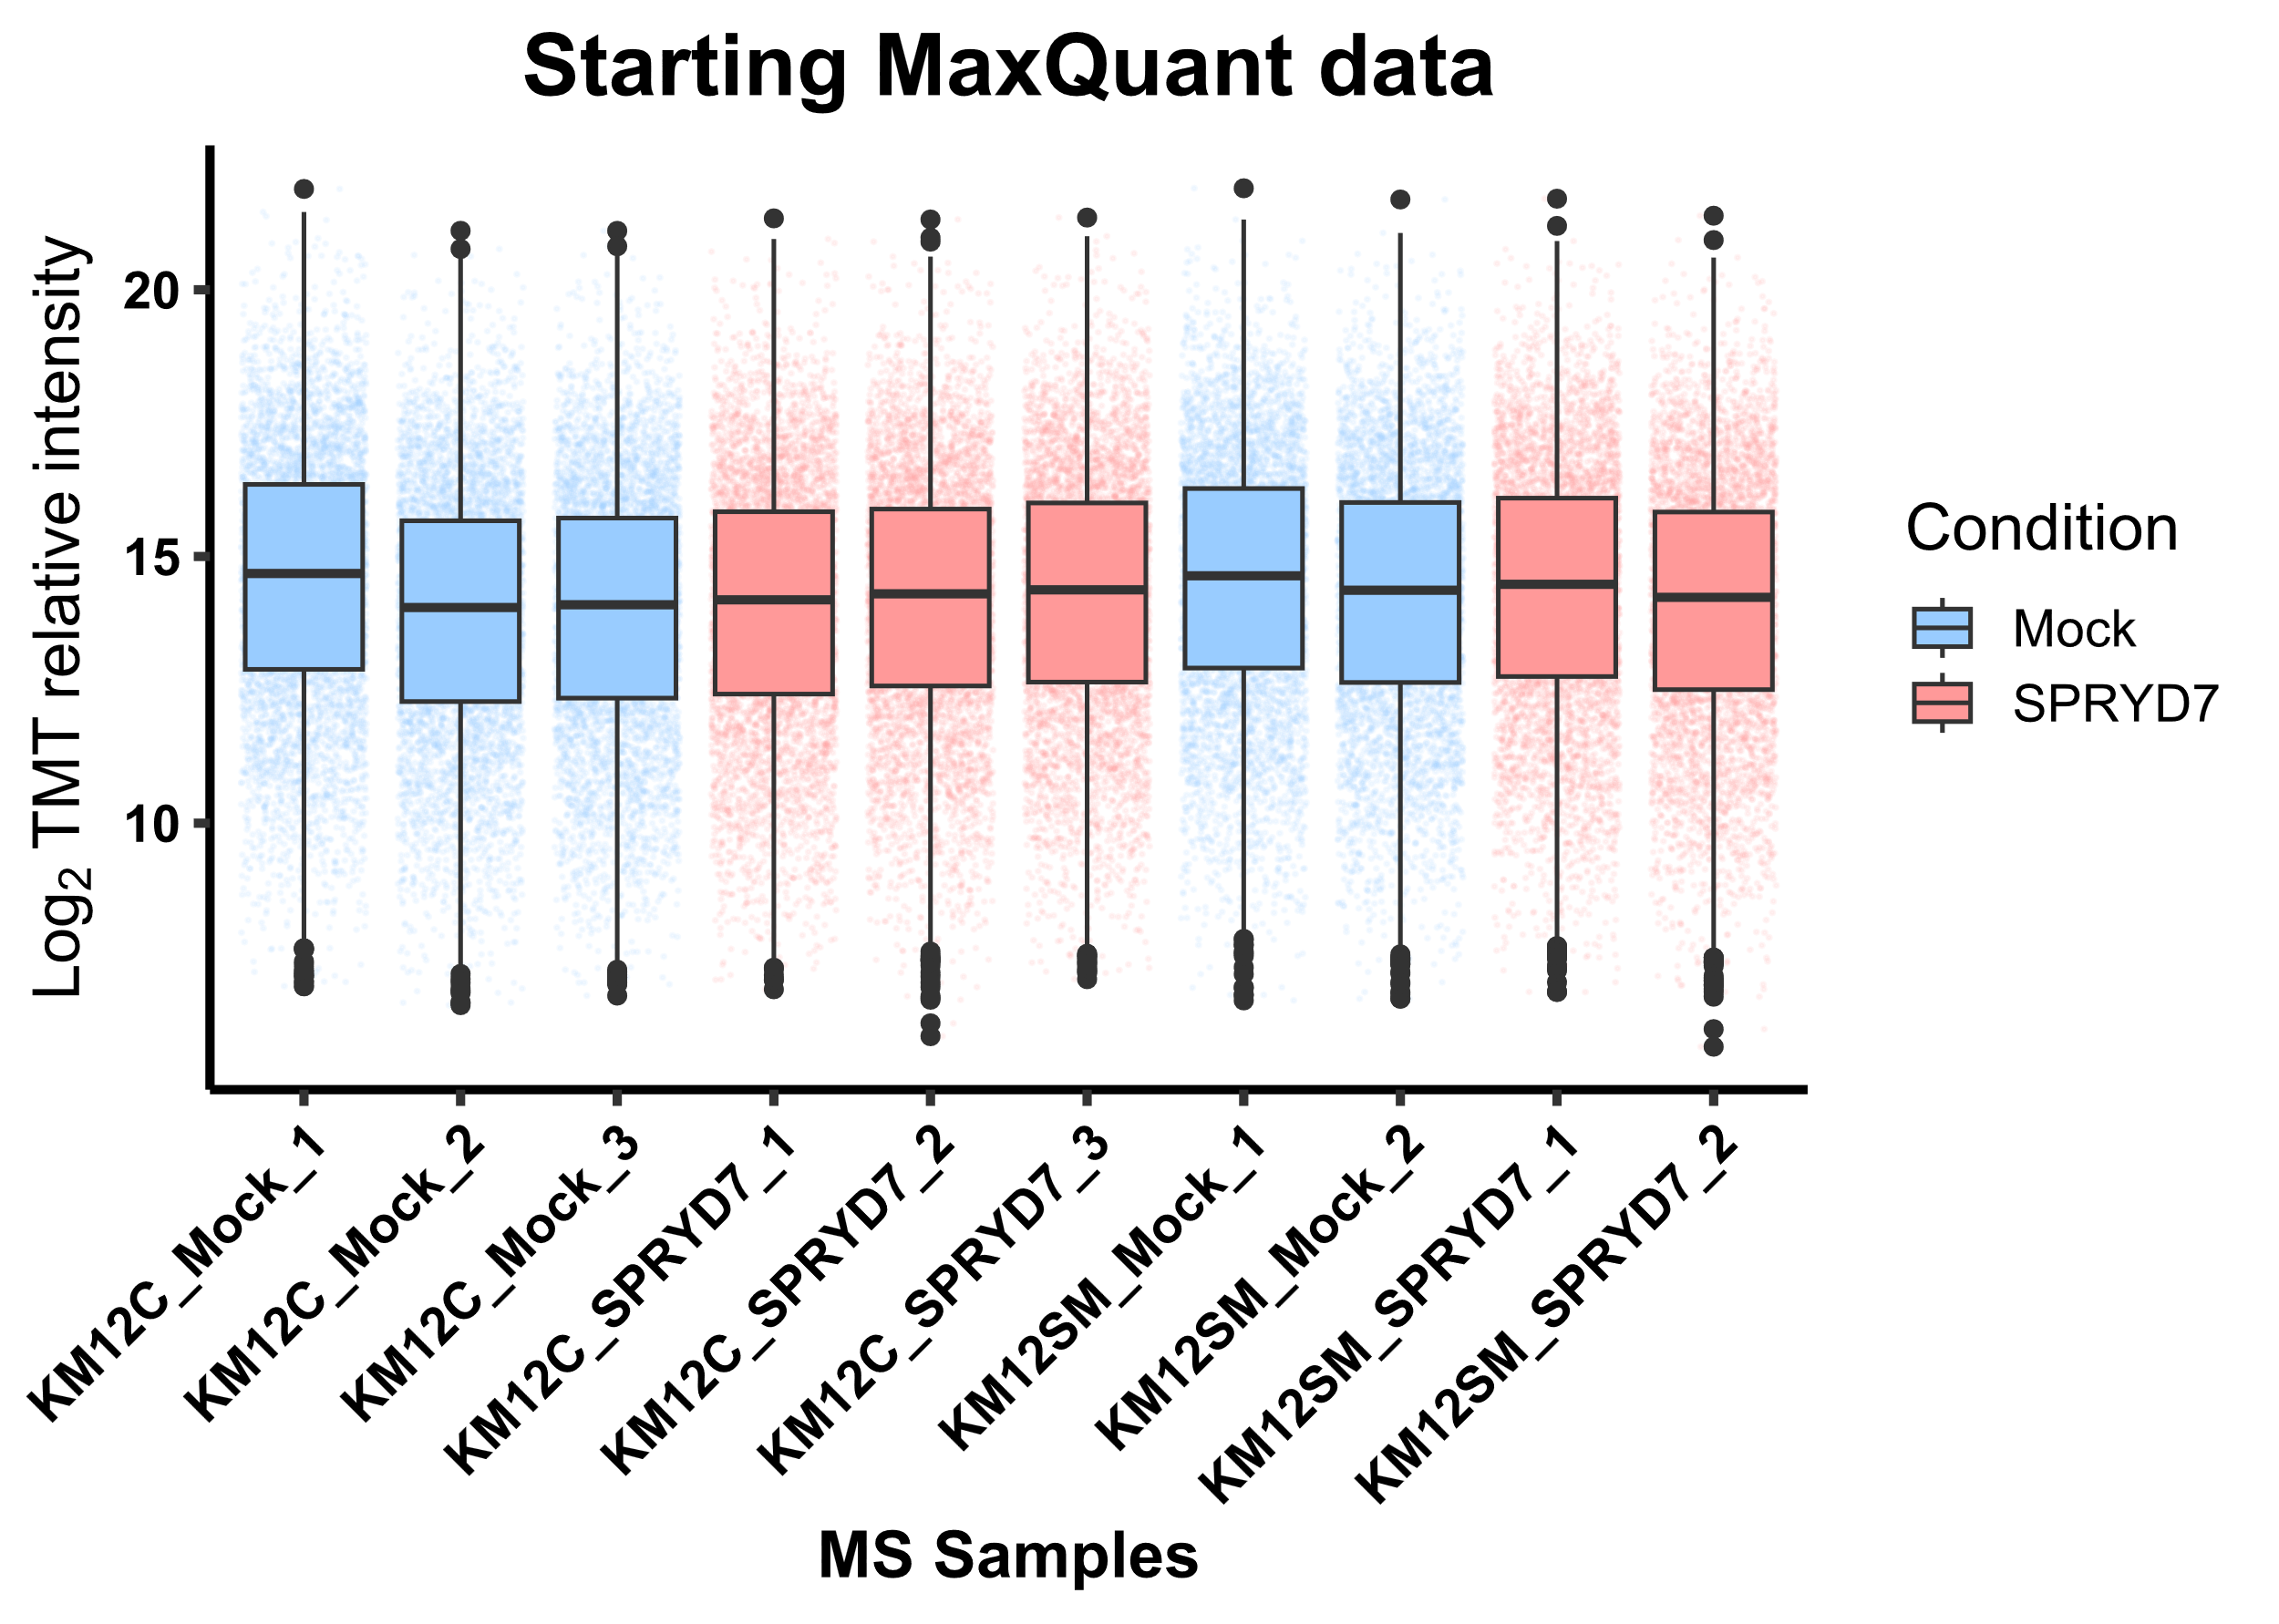
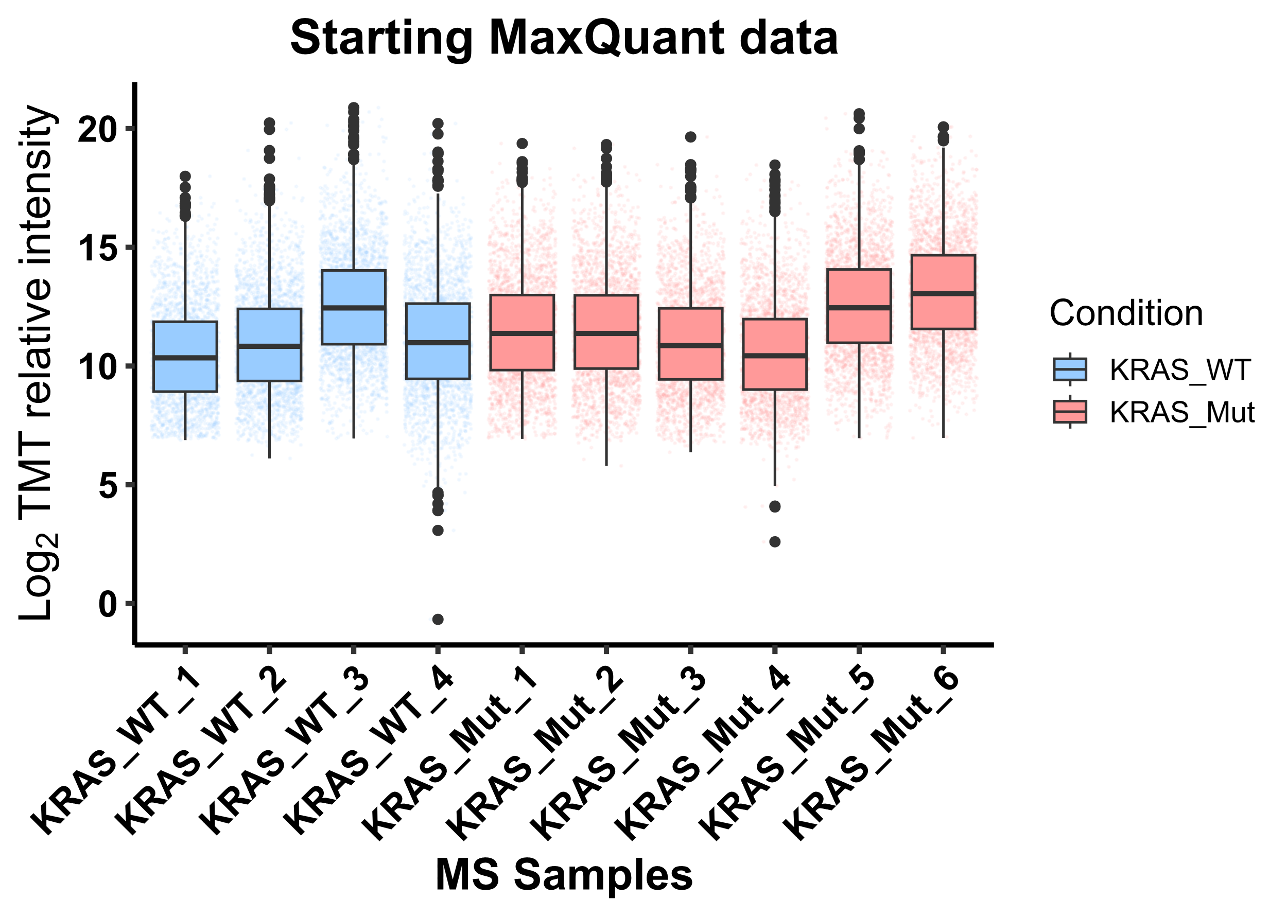
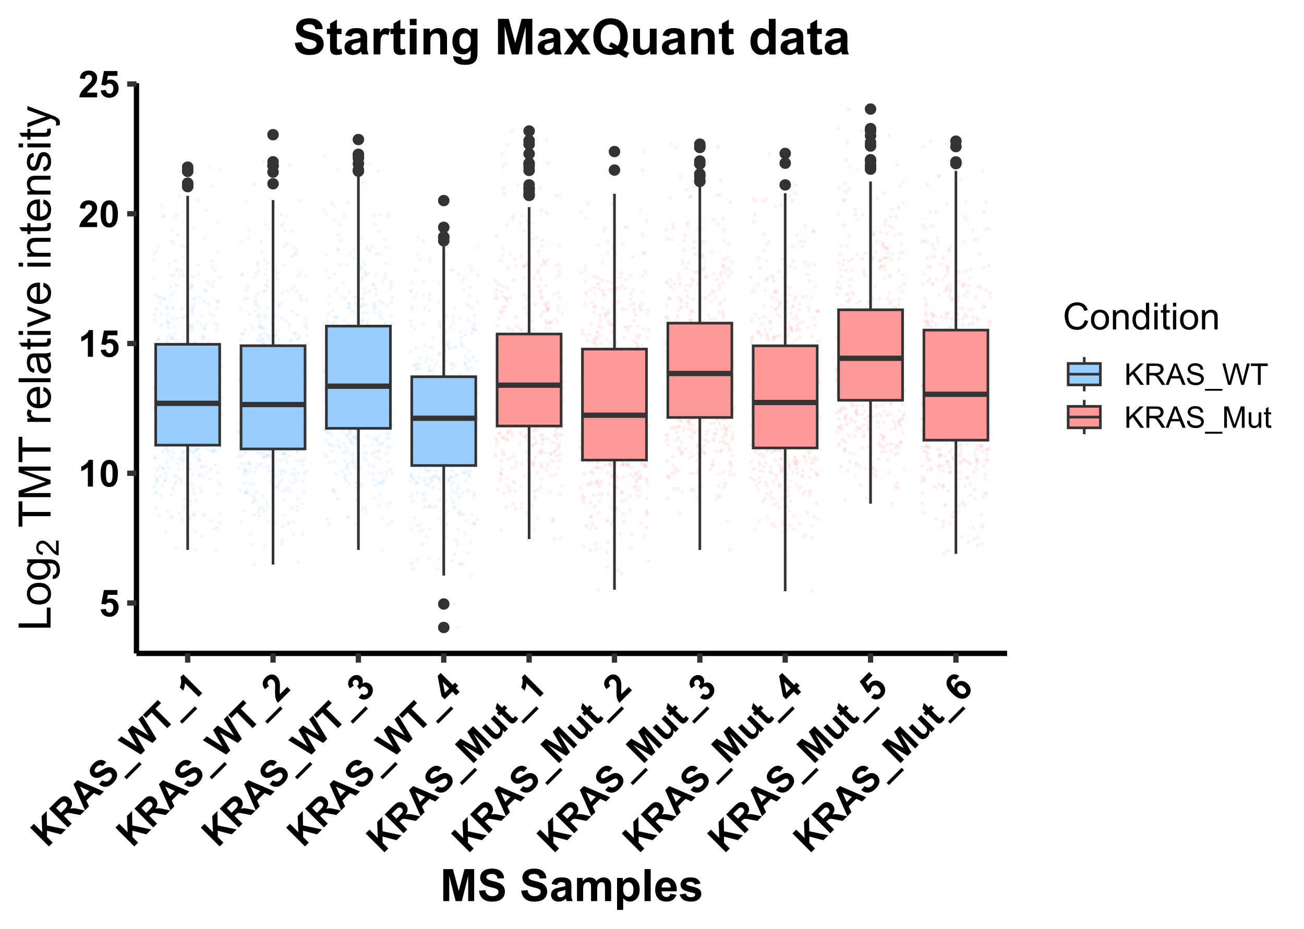
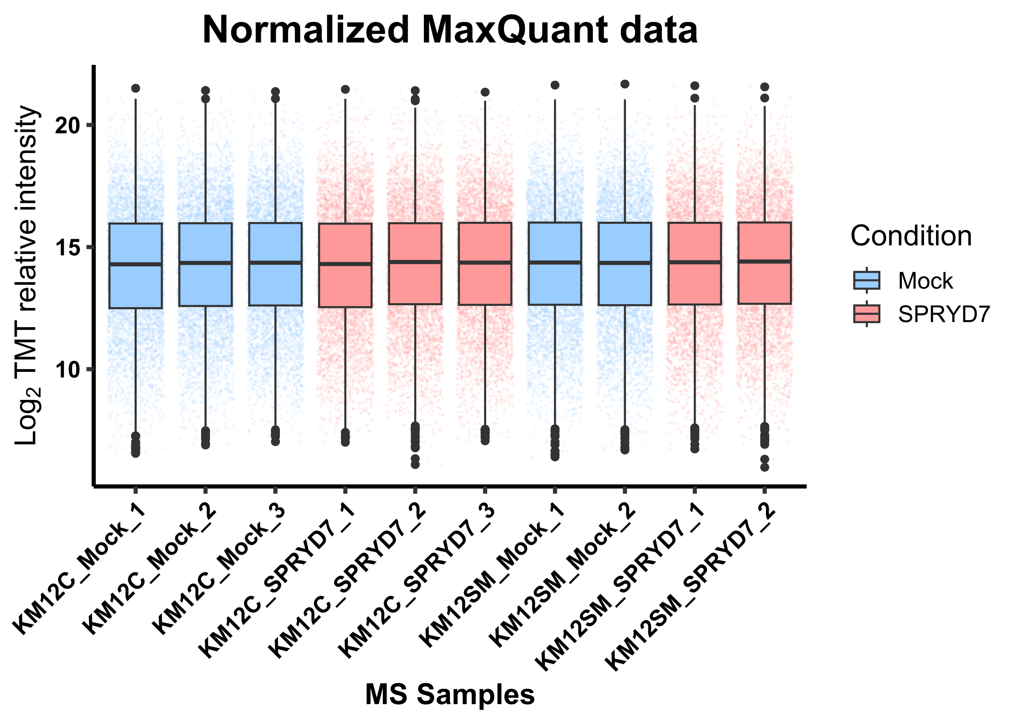
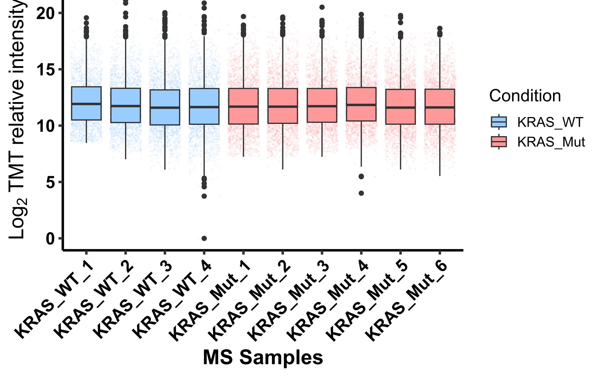
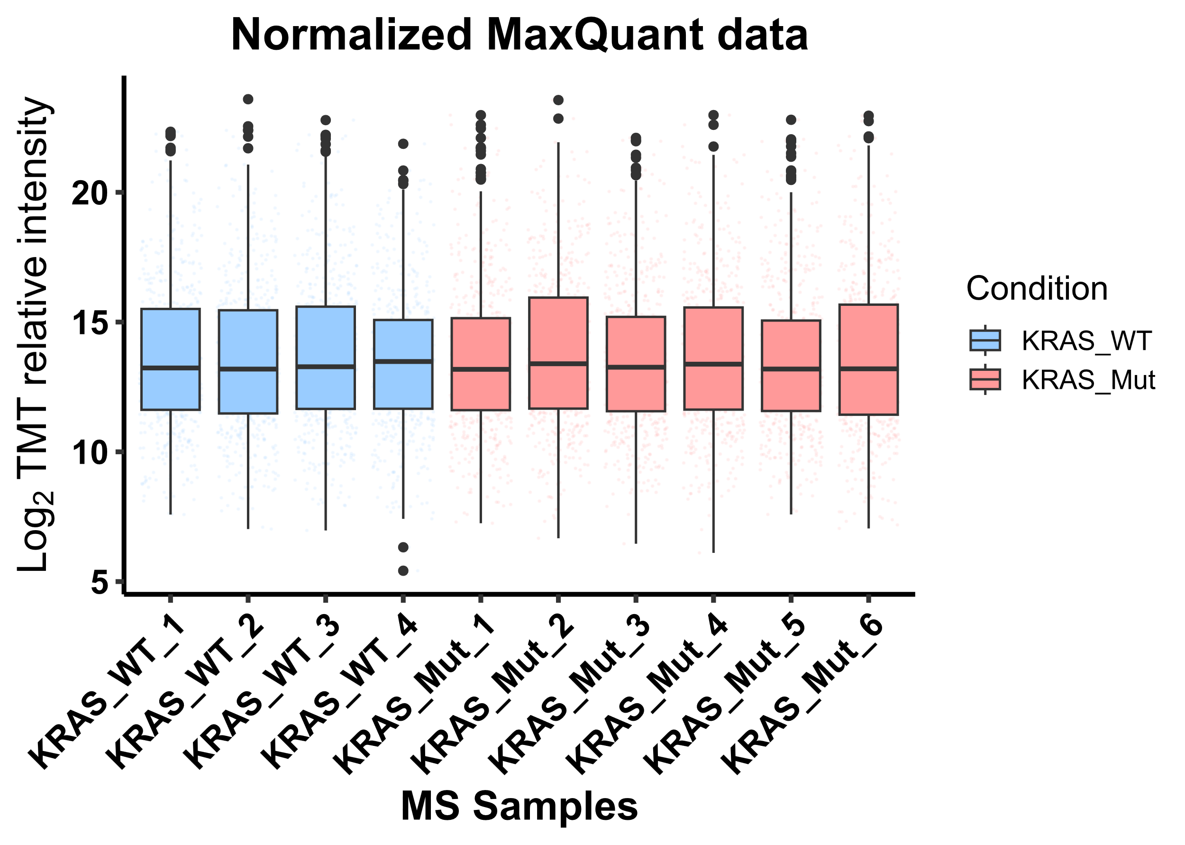
A
Cell samples
Tissue samples
Plasma exosomes
Starting MQ data
Starting MQ data
Starting MQ data
No FAIMS Pro Duo
SL normalized data
SL normalized data
SL normalized data
B
Cell samples
Tissue samples
Plasma exosomes
Starting MQ data
Starting MQ data
Starting MQ data
FAIMS Pro Duo
SL normalized data
SL normalized data
SL normalized data
Supplementary Figure S1

